Slide 1

11th
WORLD GLAUCOMA
CONGRESS
Where to in
2025?

Slide 2

CONGRESS ROTATION
The congress is biennial, and its location rotates between Europe, Asia and America. The period between two congresses held in the same country should not be less than 20 years under normal circumstances.

Slide 3
LOOKING BACK AT PREVIOUS EDITIONS
Editions | Dates | Locations | Rotation
WGC-2005 (1st edition) | July 6 - 9 | Vienna, Austria | Europe
WGC-2007 (2nd edition) | July 18 - 21 | Singapore, Rep. of Singapore | Asia
WGC-2009 (3rd edition) | July 8 - 11 | Boston, USA | North-America
WGC-2011 (4th edition) | June 29 - July 2 | Paris, France | Europe
WGC-2013 (5th edition) | July 17 - 20 | Vancouver, Canada | North-America
WGC-2015 (6th edition) | June 6 - 9 | Hong Kong, Hong Kong | Asia
WGC-2017 (7th edition) | June 28 - July 1 | Helsinki, Finland | Europe
WGC-2019 (8th edition) | March 27 - 30 | Melbourne, Australia | Australia
WGC-2021 (9th edition) | June 30 - July 3 | Beyond Borders (Japan) | Virtual (Asia)
WGC-2023 (10th edition) | June 28 - July 1 | Rome, Italy | Europe
WGC-2025 (11th edition) | ? | ? | America

Slide 4
DESTINATION CONSIDERED
Toronto, Canada → excluded from the short list as Vancouver hosted WGC-2013
San Diego, United States → no availability in 2025
Honolulu/Hawaii, United States
Fort Lauderdale, United States
The east coast of North America was excluded as there is a high likelihood that the AGS meeting takes place in this same area in 2025. Also Boston hosted WGC-2009.
South America has been put aside for now because of the current challenges: political and economic instability (inflation in some countries like Argentina is very high - between 35% and 75% in the past 5 years), the national restrictions regarding import, the safety for international travelers and the lower interest from the industry.

Slide 5
AVAILABLE
Toronto, Canada
Honolulu/Hawaii, United States
Fort Lauderdale, United States
SHORT-LISTED
Honolulu, Hawaii, United States
Fort Lauderdale, United States

Slide 6
CRITERIA FOR DESTINATIONS SELECTION
Destination: political and economic stability, good health and safety situation, excellent infrastructure and transportation with an international airport providing direct connections to flights across the world
Congress venue: availability, capacity and room requirements
Accommodation: options close by the venue, different budget
Local and national support: fundings or marketing support from convention bureau
Support from a local WGA Society

Slide 7
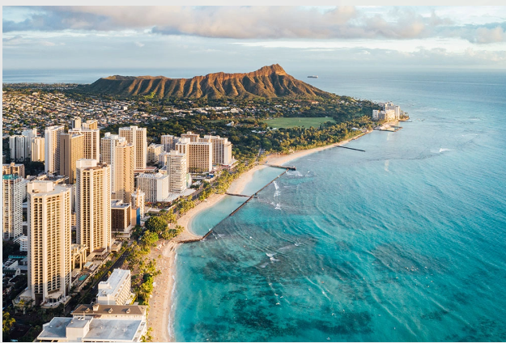
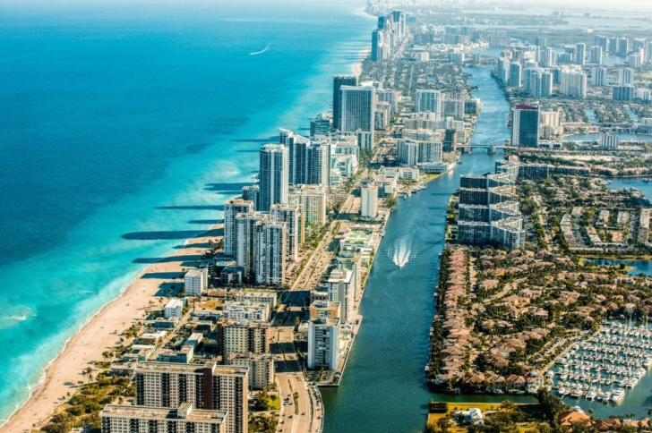
1. DESTINATION
Honolulu, Hawaii | Fort Lauderdale
O‘ahu island is famous for iconic Waikiki Beach, Pearl Harbor and the surfing mecca on the North Shore, but there’s much more to this storied destination. Honolulu is the capital city and business center of the state, with its airport a short 30-minute ride from the hotels and resorts of Waikiki. O‘ahu is where business and aloha meet. | While it faces the Atlantic Ocean, it’s also filled with 165 miles of inland waterways that weave through the city, similar to Venice, Italy. In fact, Fort Lauderdale is known as the Venice of America.

Slide 8
DESTINATION: SAFETY
(via travelsafe-abroad.com)
RISKS | Honolulu, Hawaii Safety index: 64 | Fort Lauderdale Safety index: 65
Overall Transport & Taxi Pick pockets Natural disaster Mugging Terrorism Scams Women travelers Tap water | LOW LOW MEDIUM MEDIUM LOW MEDIUM MEDIUM LOW MEDIUM | LOW LOW LOW MEDIUM LOW MEDIUM LOW LOW LOW

Slide 9
1. DESTINATION: ACCESS & TRANSPORTATION
Honolulu, Hawaii | Fort Lauderdale
Daniel K. Inouye International Airport: 13.5 km / 14 min drive from suggested congress venue Airport transportation: Shuttles, taxi’s and Ubers available at varied costs. The Bus which is the public transportation for Honolulu. http://www.thebus.org/ Cost is $3.00 USD each way. Non-Stop Transpacific Seats and Flights to Hawai‘i: Australia, Canada, Japan, Korea, US, New Zealand, Philippines, French Polynesia, Fiji | Lauderdale-Hollywood International Airport (FLL): 6.5 km / 8 min drive from suggested congress venue. Offers nonstop flights to and from over 80 U.S. cities and global connectivity to over 60 international destinations. Brightline, the area’s high-speed passenger railsystem, is a convenient way to travel between Greater Fort Lauderdale, West Palm Beach and Miami. Greater Fort Lauderdale’s central South Florida location makes it easy for attendees to arrive through two international airports and explore these neighboring areas. Miami international airport is 45 min drive away.

Slide 10
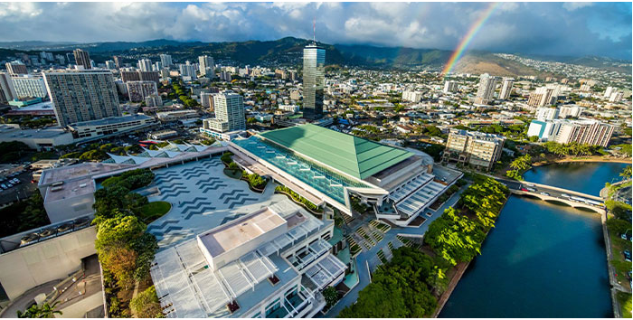
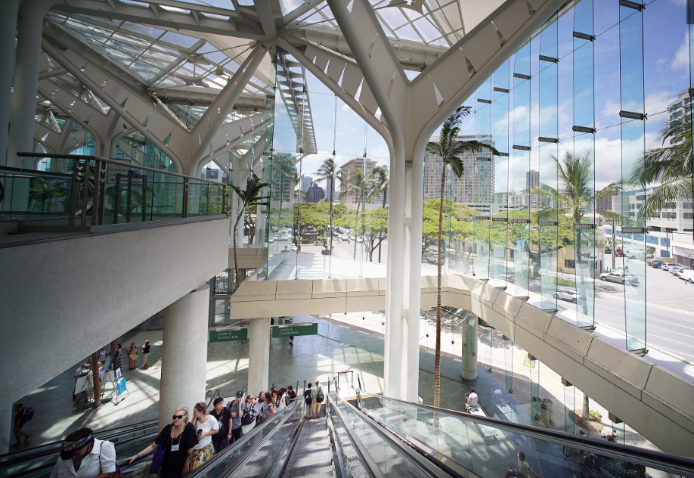
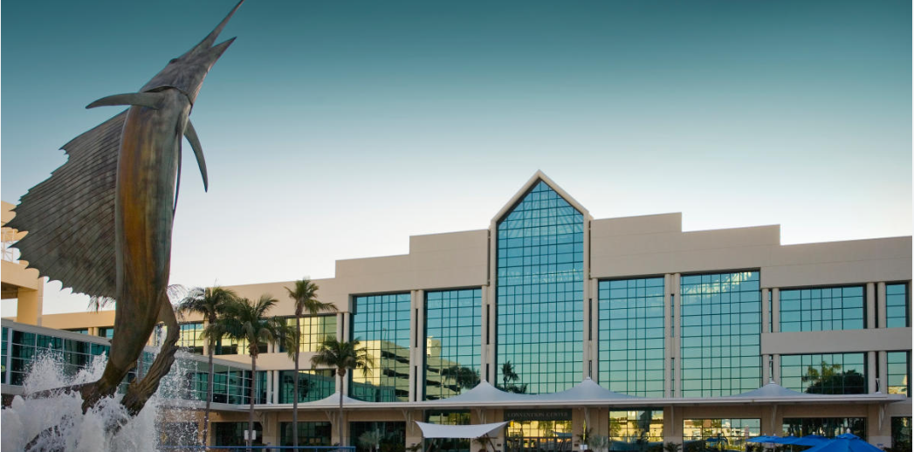
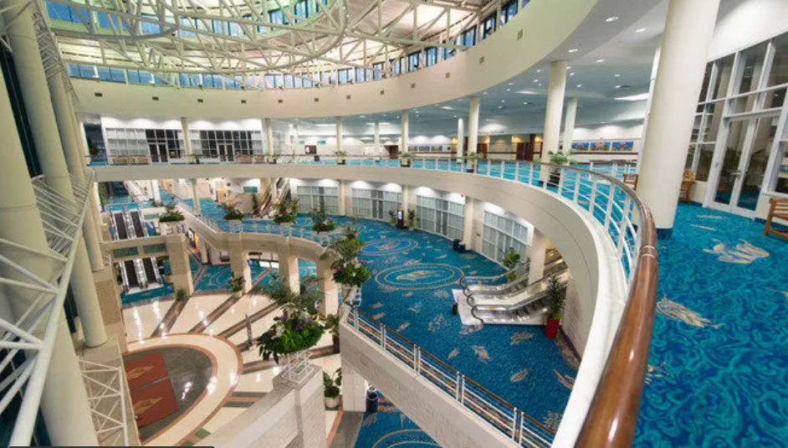
2. CONGRESS VENUE
Hawaii Convention Center (HCC) | Broward County Convention Center
Just steps from Waikīkī, the HCC is a stunning marriage of form and function, open to sky and sun between the shade of terraces and lanais, graced with courtyards, waterfalls and fishponds. Designed by world-renowned architects Wimberly Allison Tong & Goo and LMN, this luminous structure shines like a gem tucked into its tropical setting, blending state-of-the-art technology with authentic island ambiance as a monument to the cultural diversity and legendary spirit of aloha that inspires attendees to see the world in a new light. Click here to access the venue’s website | The Greater Fort Lauderdale/ Broward County Convention Center is undergoing a major transformation. Located on the scenic Intracoastal Waterway, the new convention center will offer both indoor and outdoor event space with stunning waterfront views–and even Water Taxi access (due Q3-Q4 2025). This venue is also just minutes from downtown, the beaches and the airport. Click here to access the venue’s website

Slide 11
2. CONGRESS VENUE: ROOM ALLOCATION
Hawaii Convention Center (HCC) | Broward County Convention Center
Stunning venue with a lot of daylight and open space. They can accommodate all capacity requested for session rooms and offices. Exhibition, poster area, registration would be on the first/ground floor. Session rooms would be on the third and foor floor. Offices would be on the second floor. A parking is on the second floor but it doesn’t deter attendees from moving up with escalators and elevators. Click here to watch a 3-min video tour of the venue Here is an interactive floorplan for more details | Venue is currently expanding with the construction of a hotel and a new ballroom. The full expansion project is due to finish August–Sept 2025. Click here to view live camera of the construction site. Click here to see the FUTURE convention center The space they are offering for WGC is not in the construction site. They are fully operational and are hosting events, currently a 10,000 delegates conference. All space suggested for WGC-2025 are bigger than requested, except the plenary room. Exhibition, poster area, registration would be on the first/ground floor. Session rooms would be on the second and third floor. Offices would be on the second floor. Click here for a virtual tour of the ACTUAL venue

Slide 12
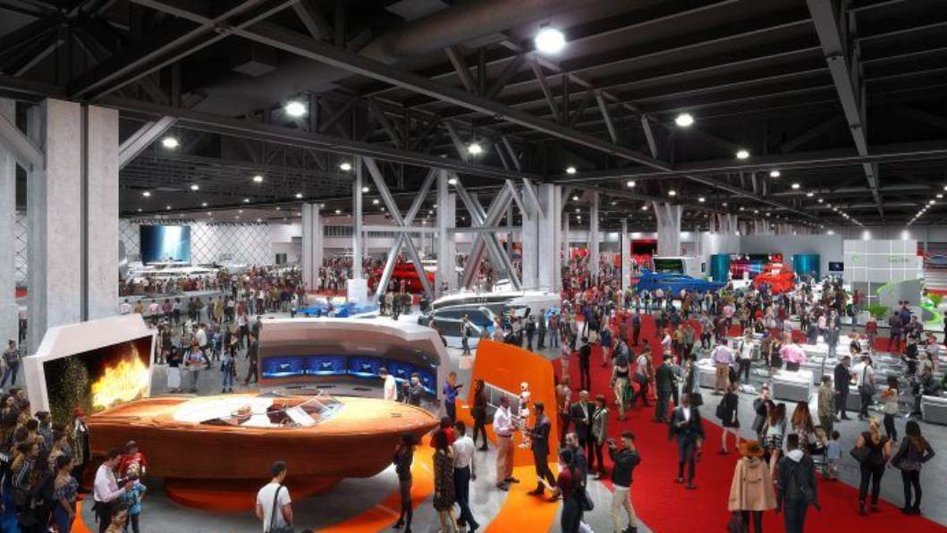
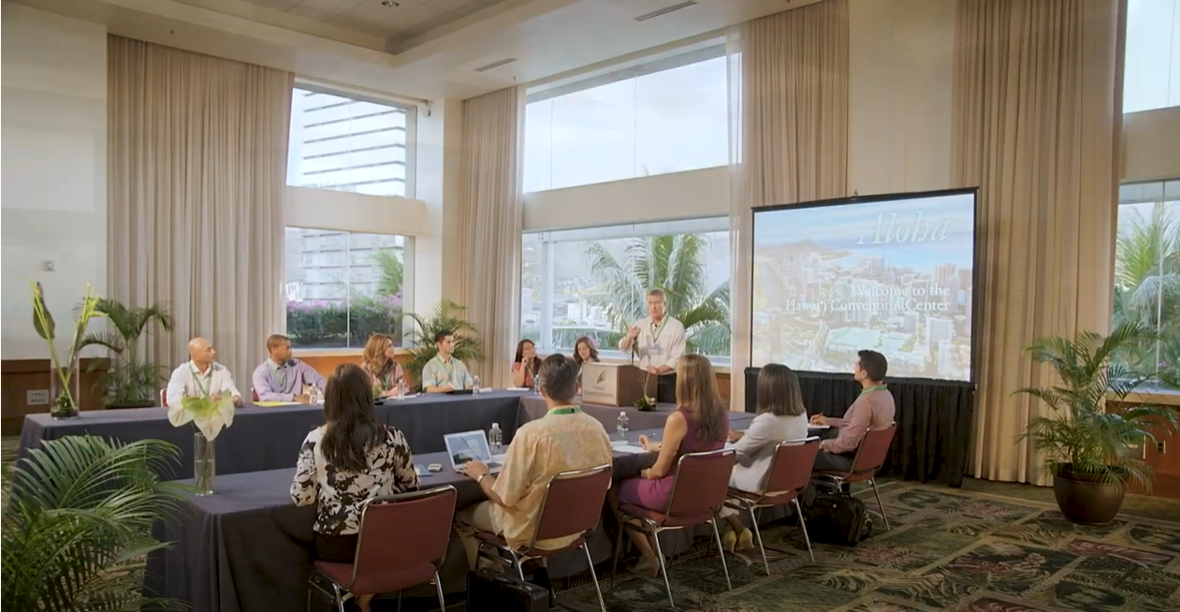
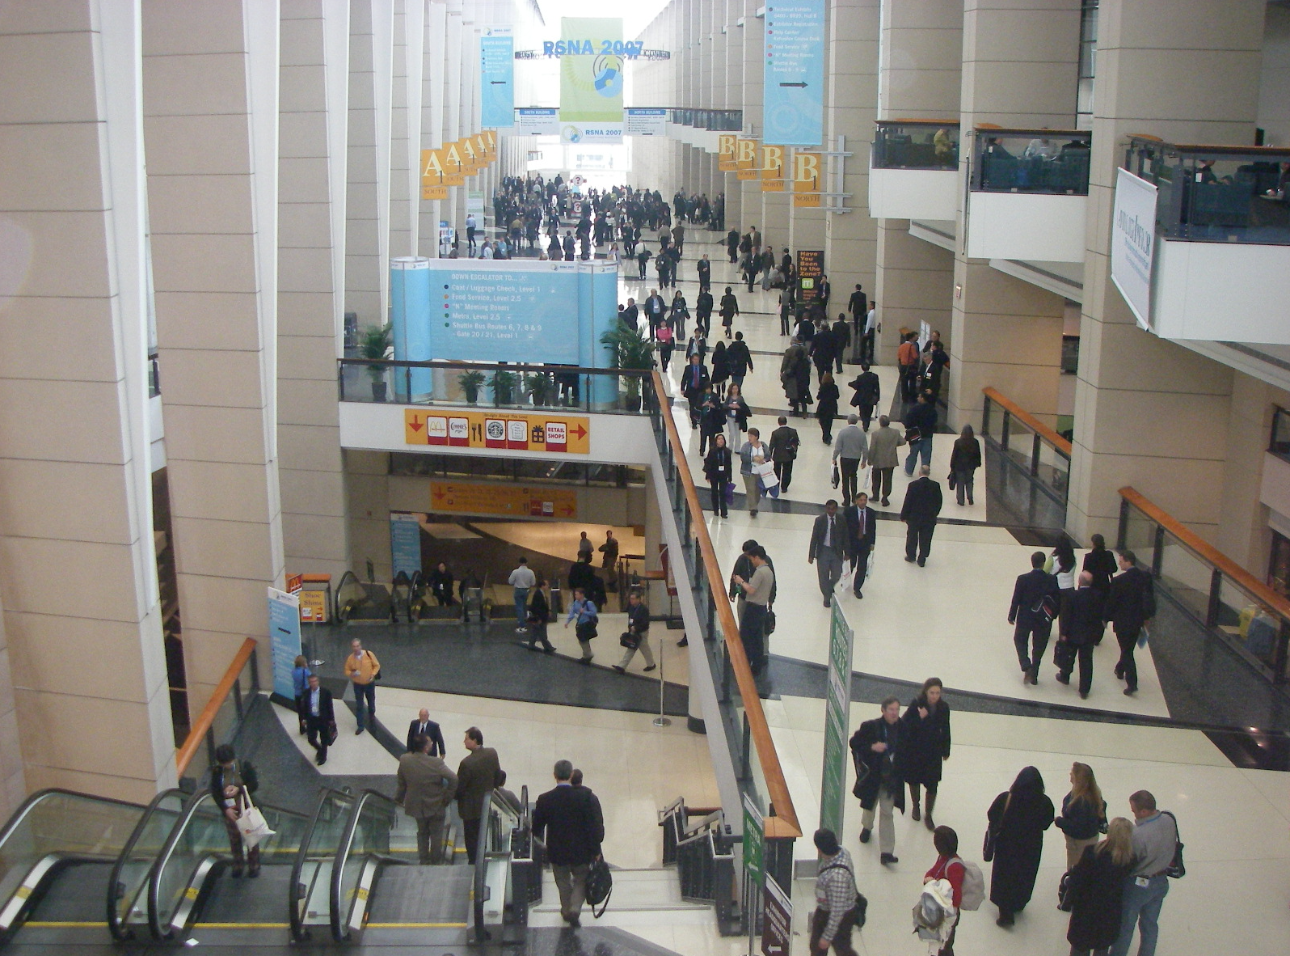
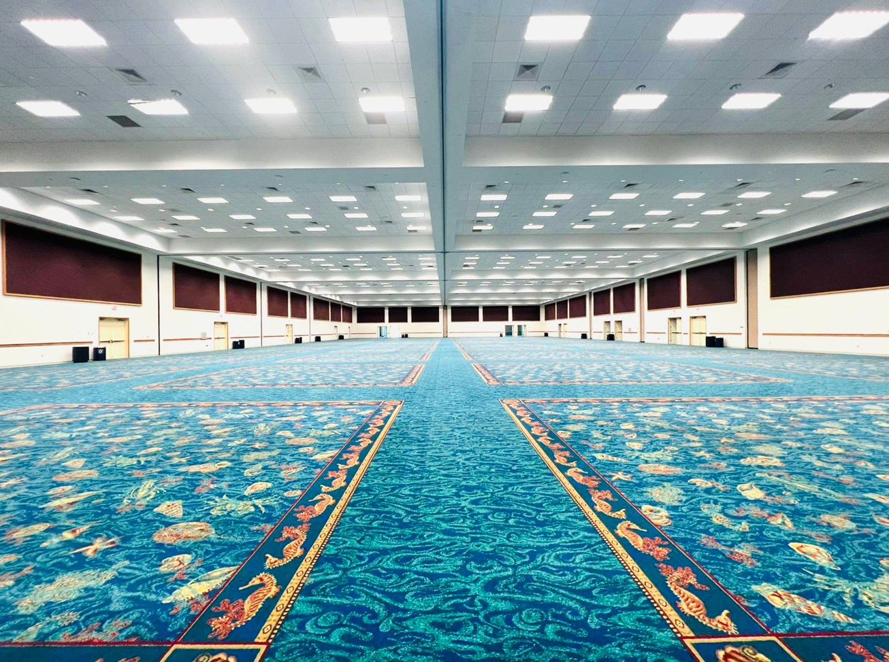
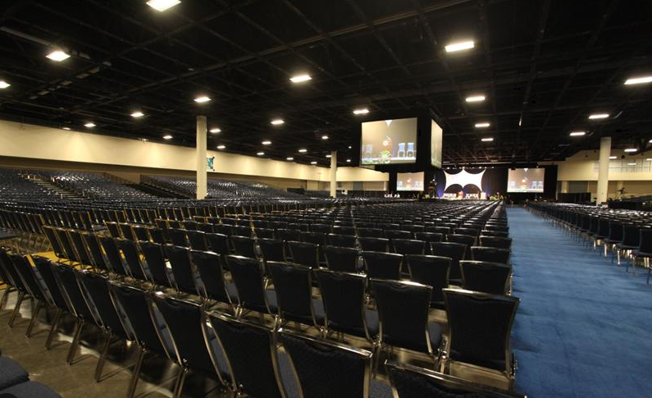
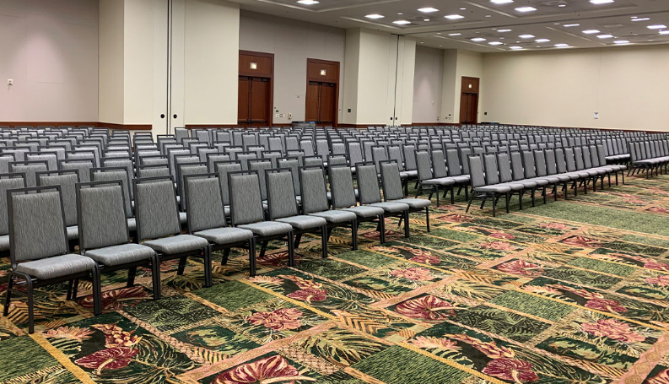
INCLUDED IN ROOM RENTAL
Hawaii Convention Center (HCC) | Broward County Convention Center
Room rental Lectern/Podium Easel Table, linen, chairs Refresh – one mid-day Electricity and Air conditioning | Room rental First set up of chairs is included (classroom, theater, etc.) except exhibition hall Electricity and Air conditioning

Slide 13
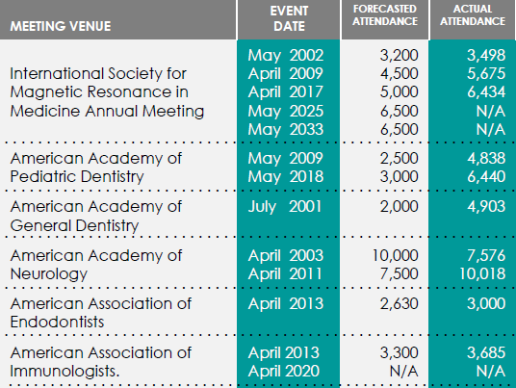
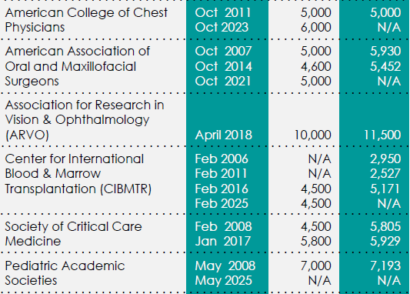
2. CONGRESS VENUE: REFERENCES
We asked them to provide references of medical events they hosted in the past 5 years
with regards to compliance of the destination. Here is the information they shared:
Hawaii Convention Center (HCC) | Broward County Convention Center
Not much happened from 2020 – 2021 because of the pandemic. Hawaii started having meetings again as of January 2022. | The Center was recently closed for expansion from 2020-2022, but please see below their medical/ pharmaceutical history. The Society of Thoracic Surgeons (2018): Est. Attendance 5,300 Pri-Med Conference (2024): Est. attendance 4,000

Slide 14
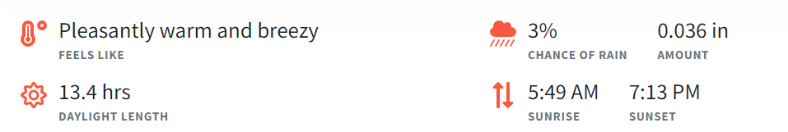
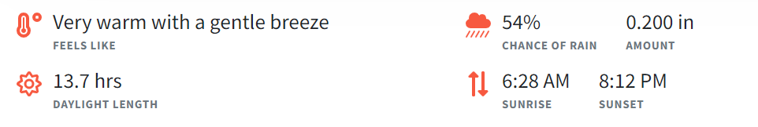
2. CONGRESS VENUE: DATES
Honolulu, Hawaii | Fort Lauderdale
Wednesday, June 25-Saturday, June 28, 2025 Average temperature is usually 23°C (74°F) to 27°C (80°F) Average relative humidity in June in Honolulu is 72% High season is July/August. Hawaii has a strong transient pull, but the spring and fall seem to be the “lower” season. June is on the shoulder of the lower season. | Wednesday, June 18-Saturday, June 21, 2025 Average temperature is usually 27°C (80°F) to 30°C (85°F) Average relative humidity in June in Fort Lauderdale is 74% High season runs from January to May, June is shoulder season.

Slide 15
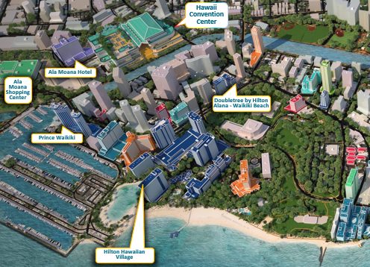
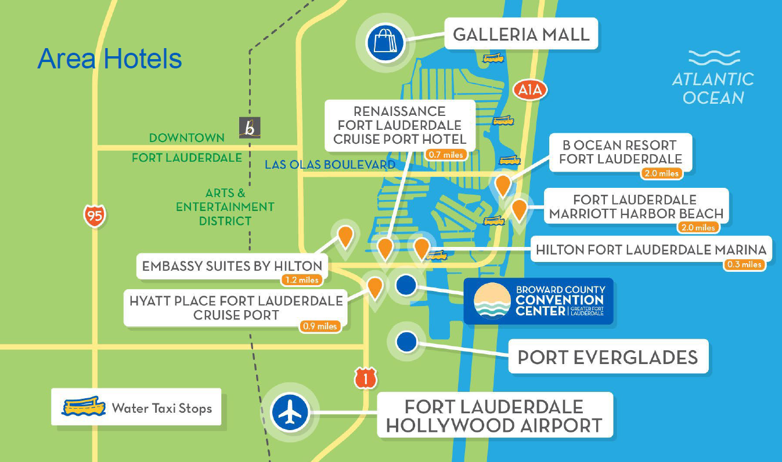
3. ACCOMMODATION
Honolulu, Hawaii | Fort Lauderdale
Honolulu has over 28,000 hotel rooms within 2.4 km /1.5 miles of the Convention Center. Within walking distance from HCC (from $200 USD to $400): Ala Moana Hotel : 5 min walk Prince Waikiki: 10 min walk Doubletree Waikiki: 5 min walk Hilton Hawaiian Village: 15 min walk Dorm rooms at the University of Hawai‘i, the East West Center and Chaminade University of Honolulu can also be secured to offer a more cost-effective housing option. Dorms are approximately 3.5 km / 2,2 miles from the venue and prices start at $72 USD per night. | The destination offers over 3,000 hotel rooms within 2.4 km / 1.5 miles of the Convention Center. Two closest hotels (from $250 USD to $450): Hilton Fort Lauderdale Marina: 4 min walk Renaissance: 6 min walk More options are available further away, see map below: Lower budget option: limited-service hotels in the area within 7 minutes from the Convention Center.

Slide 16
4. LOCAL AND NATIONAL SUPPORT
Honolulu, Hawaii | Fort Lauderdale
Rental fee will be waived if client spends a minimum of USD 75,000 on Food and Beverage at HCC. | Rental Rate will be waived if client commits to 500 Total Room Nights (TRN) on 3 peak nights across 2+ hotels in the area for June 2025.

Slide 17
COST COMPARISON
Destination | Financial support/benefits | Venue Rental | Catering | Dates
Honolulu, Hawaii | Rental fee will be waived if client spends a minimum of USD 75,000 on Food and Beverage at HCC. | USD 214,290 | Coffee Break: USD 8 per person Lunch Box: USD 30 per person Poster Reception: USD 14 per person | June 25-28, 2025
Fort Lauderdale | Rental Rate will be waived if client commits to 500 Total Room Nights (TRN) on 3 peak nights across 2+ hotels in the area for June 2025. | USD 160,630 | Coffee Break: USD 18 per person Lunch Box: USD 40 per person Poster Reception: USD 30 per person | June 18-21, 2025
*Prices indicated are excluding VAT and service charge where applicable. Prices are subject to change to reflect market price at time of event.

Slide 18
SUMMARY
Destination | Honolulu, Hawaii | Fort Lauderdale
Dates available | June 25-28, 2025 | June 18-21, 2025
Weather forecast Average temperature Average humidity Chances of rain | 23°C (74°F) to 27°C (80°F) 72% average humidity 3% chance of rain | 27°C (80°F) to 30°C (85°F) 74% average humidity 54% chance of rain
Accessibility of destination | - | +
Congress venue - Capacity and room requirements - Flexibility and responsiveness | + + | + -
Accommodation options | + | -
Local and national support/subvention | + | +

Slide 19
OTHER OPHTHALMOLOGY EVENTS IN 2025
Event | Date | Location
NANOS 51st Annual Meeting | March 15-20, 2025 | Tucson, USA
AGS | March TBD | USA TBD
40th APAO | April 3-6, 2025 | New Delhi, India
ASCRS | April 25-28, 2025 | Los Angeles, USA
ARVO Annual Meeting | May 4-8, 2025 | Austin, USA
AOS Annual Meeting | May 15-17, 2025 | Naples, USA
EGS | June TBD | TBD
SOE | June TBD | TBD
QLD Branch Annual Scientific Meeting | August 1-2, 2025 | TBD
ESCRS | September 12, 2025 | TBD
36th JGS Meeting | September 12-14, 2025 | Japan TBD
AAOpt | October 8-11, 2025 | Boston, USA
AAO Annual Meeting | October 17-20, 2025 | Orlando, USA
OB Congress | November 26-28, 2025 | Brussels, Belgium
World Cornea Congress | TBD | TBD

