Slide 1


GLAUCOMA AWARENESS
THE WORLD GLAUCOMA ASSOCIATION

Slide 2
Glaucoma is the #1 cause of preventable irreversible blindness.

Slide 3
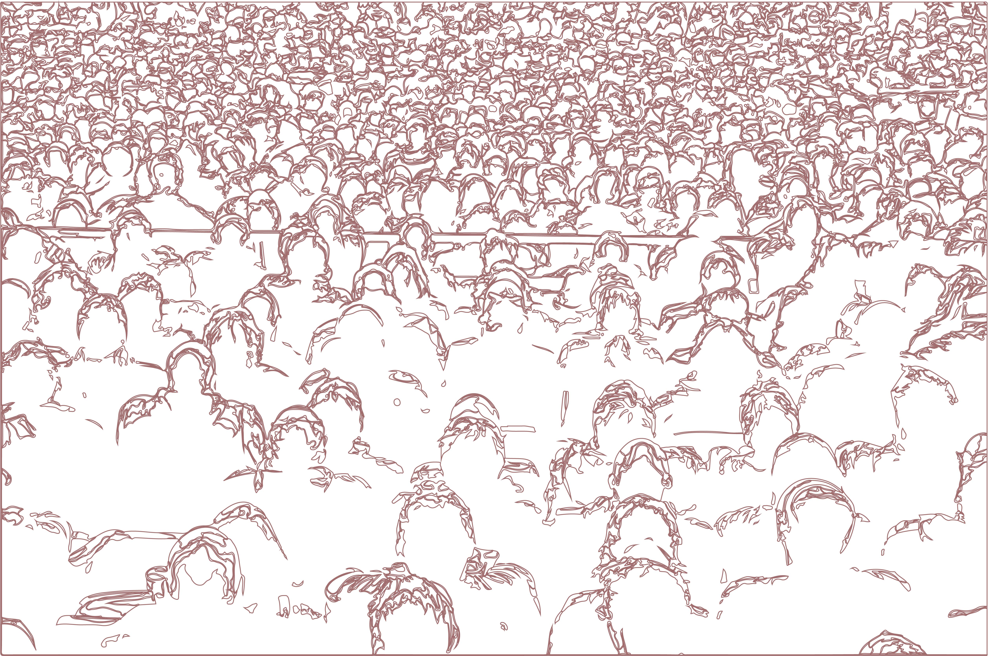
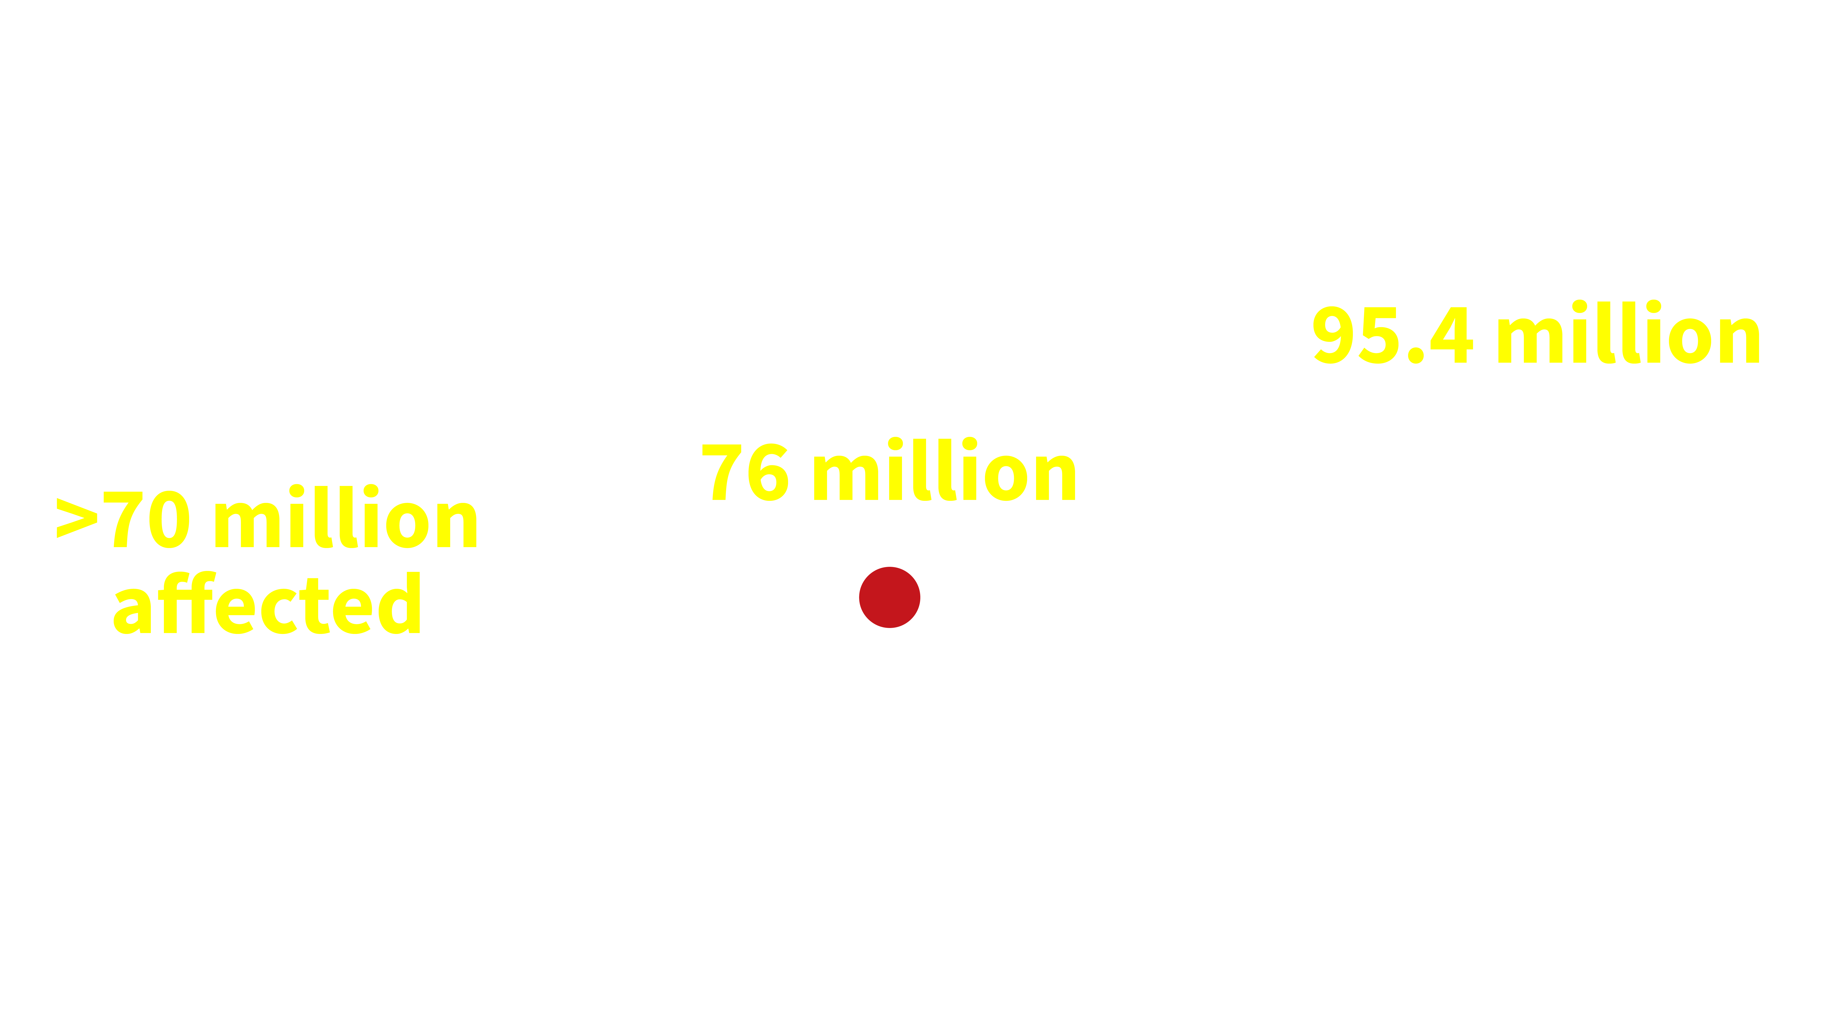






Glaucoma is the #1 cause of preventable irreversible blindness.
7.7
million
people have
moderate or severe distance
vision impairment or blindness from glaucoma
No. of people estimated to have glaucoma is expected to increase
Vision Loss Expert Group of the Global Burden of Disease Study. Lancet Global Health 2020.

Slide 4
How Glaucoma may affect your vision?
- Part I -

Slide 5

What if all you could see was…
…this?

Slide 6
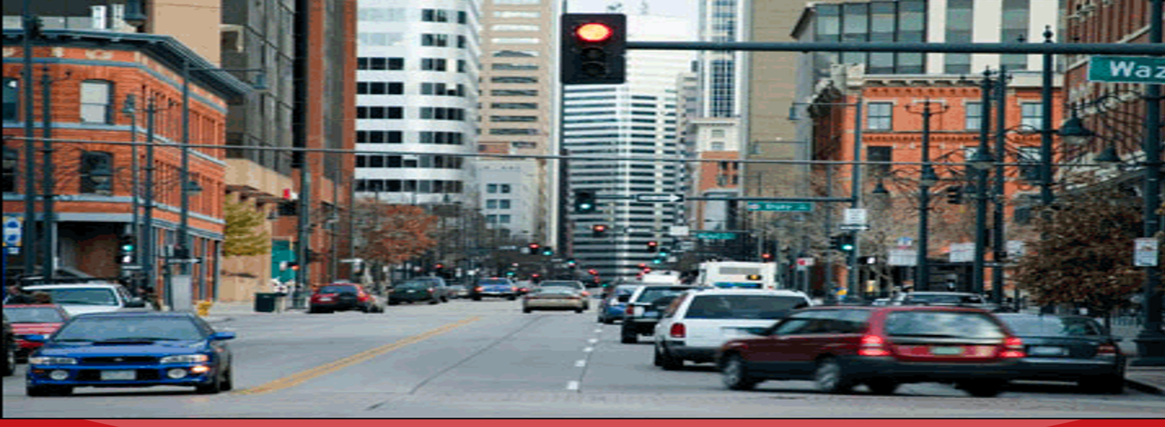
When you should be
seeing this?

Slide 7

How Glaucoma affects your vision?
Dark areas are commonly used to describe vision loss due to glaucoma…

Slide 8
But most glaucoma patients describe a blurred vision or missing parts

Slide 9
How Glaucoma may affect your vision?
- Part II -

Slide 10
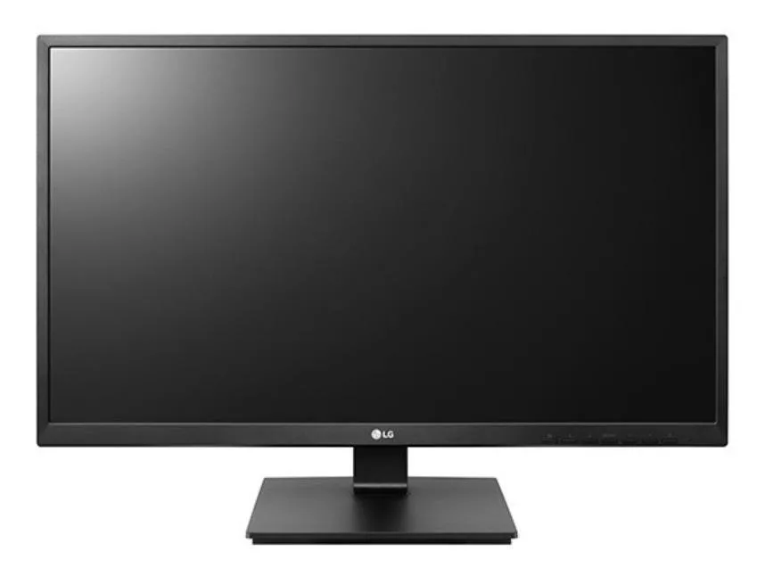
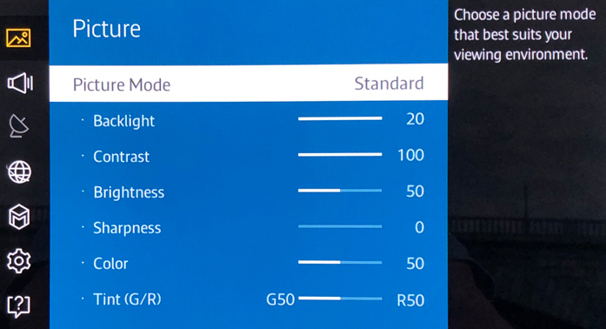
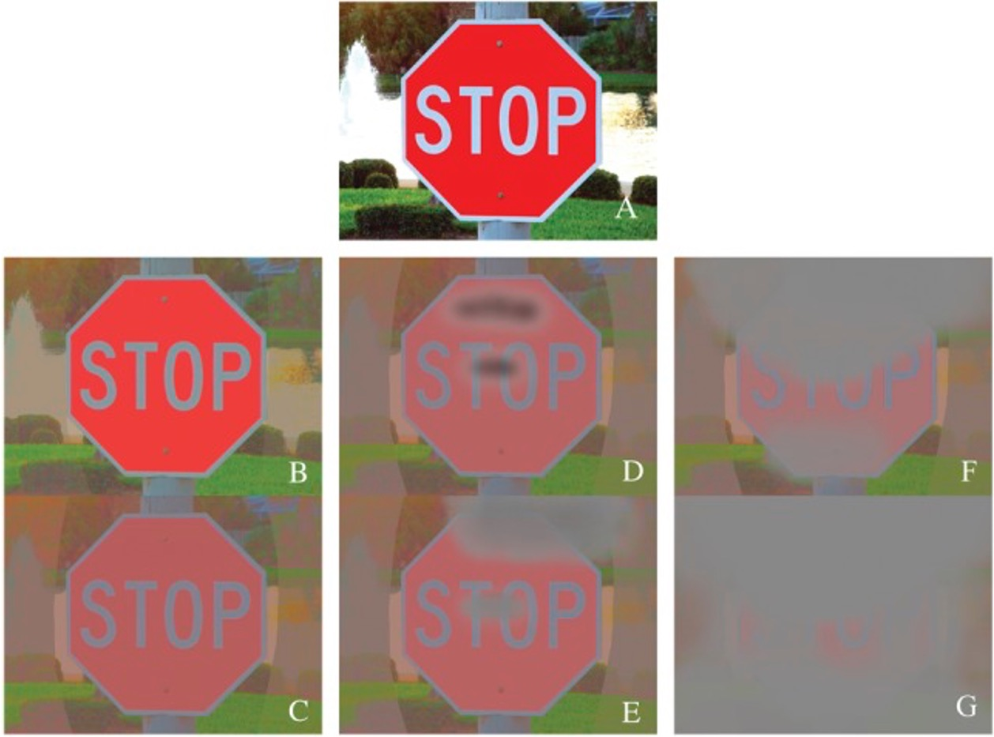
Contrast and Glaucoma?
Progressive loss
of contrast
sensitivity
in advanced
Glaucoma
NORMAL VISION
AREAS THAT CANNOT BE SEEN
Hu CX, et al. Am J Med Sci. 2014; 348(5): 403–409.

Slide 11
How Glaucoma may affect your vision?
- Part III -

Slide 12
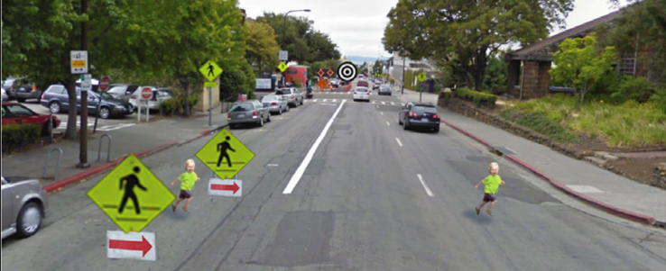
Please look straight to the bulls eye – at the blue arrow
Whitney D, Levi DM. Trends Cogn Sci. 2011 Apr;15(4):160-8.

Slide 13
While still looking at the bulls eye, can you see the child on the right side of your screen?
Whitney D, Levi DM. Trends Cogn Sci. 2011 Apr;15(4):160-8.

Slide 14
While still looking at the bulls eye, can you see the child on the left side?
Whitney D, Levi DM. Trends Cogn Sci. 2011 Apr;15(4):160-8.

Slide 15
It is more difficult to note the child on the left due to a phenomenon called visual crowding – which may be more pronounced in glaucoma patients.
Whitney D, Levi DM. Trends Cogn Sci. 2011 Apr;15(4):160-8.

Slide 16
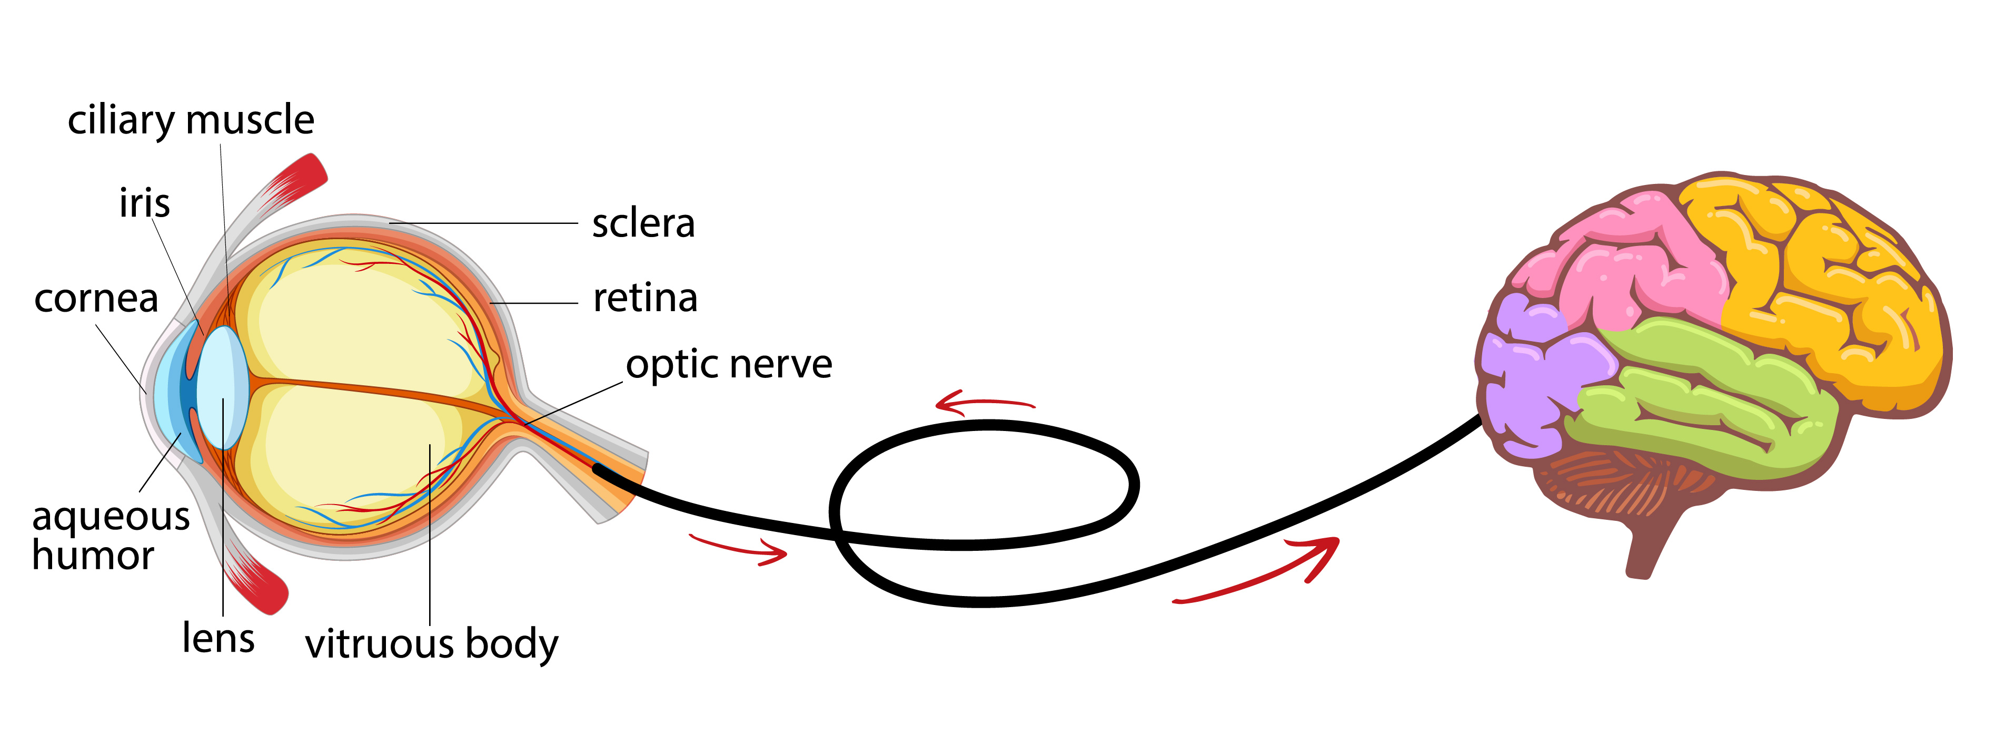
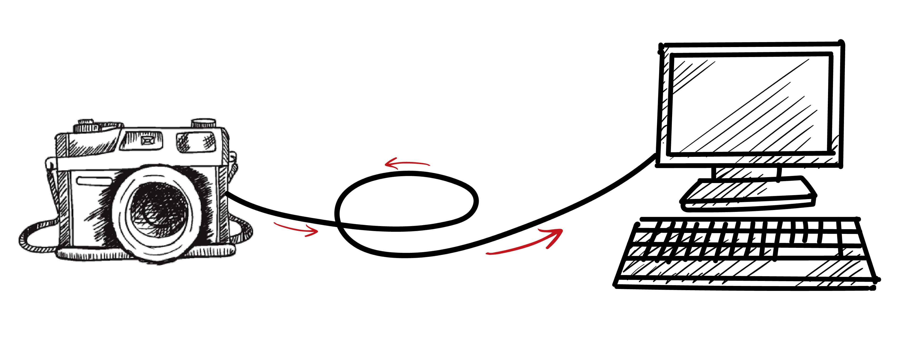
What is Glaucoma anyway?
The optic nerve comprises of millions of nerve fibers that carry signals of what we see.
It runs from the eye to the brain.
… similar to how the information from a camera is transmitted to a monitor screen!

Slide 17
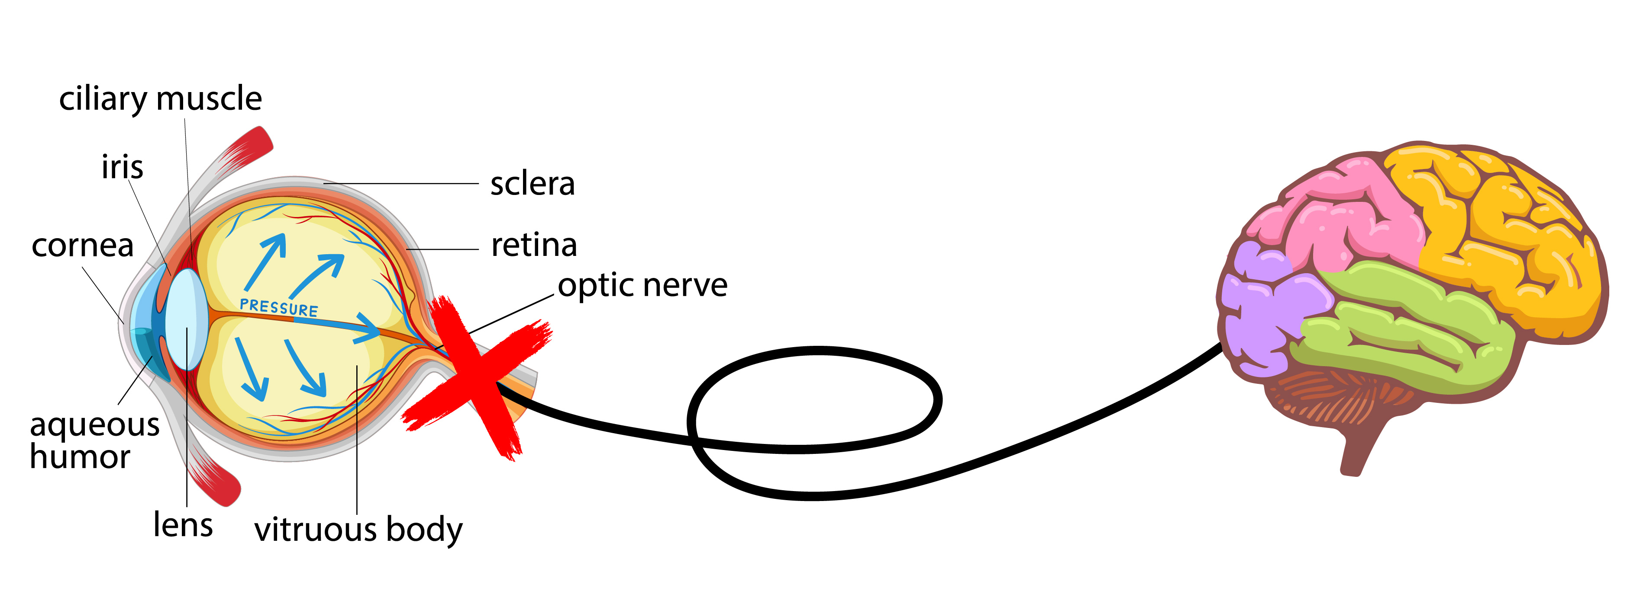
What is Glaucoma anyway?
In glaucoma, the nerve fibers in the optic nerve are progressively damaged.
… Like a wire that becomes progressively frayed
and thinner.

Slide 18
Glaucoma treatment
aims to reduce the risk of further optic nerve damage by reducing
the eye pressure

Slide 19
How does Glaucoma affect individual’s lives?

Slide 20
“Need more light to see…”
“Letters
appear faded when
reading”
Glaucoma patients…
“Difficulty seeing objects at the sides”
“Some areas are darker or missing”
Hu CX, et al. Am J Med Sci. 2014; 348(5): 403–409.
“Vision is blurry”

Slide 21


How does glaucoma affect these individuals’ lives?
As the glaucoma progresses, it can impact:
Driving, walking, venturing from home, reading
Seeing at night, adjusting to different levels of illumination, judging distances
Seeing peripheral objects, and moving objects coming from the side
Motor vehicle accidents and injuries related to falls are potentially serious consequences
They may not be able to …
They may be at risk of…
Falls
Mental
Health
issues
Drive
safely
Work/ do certain jobs
Perceive colors normally
Ramulu PY, et al. Ophthalmology. 2012; 119(6): 1159-1166.
Goldberg I, et al. J Glaucoma. 2009; 18(1): 6-12.
Haymes SA, et al. Invest Ophthalmol Vis Sci. 2007; 48(3): 1149-1155.

Slide 22
Falls, injuries and
poorer quality of life
“A greater likelihood of bumping into
objects while walking”
“Visual field loss from glaucoma is
associated with a higher risk of falling”
Lower quality of life from the fear of falls
and decreased independence
Haymes SA, et al. Invest Ophthalmol Vis Sci. 2007; 48(3): 1149-1155.
Lamoureux EL, et al. Invest Ophthalmol Vis Sci. 2008; 49(2): 528-533.
Freeman EE, et al. Ophthalmology. 2008; 115(2):233-238.
McKean-Cowdin R, et al. Ophthalmology. 2008; 115(6): 941-948.e1.
Friedman DS, et al. Ophthalmology. 2007; 114(12): 2232-2237.

Slide 23
Mental health
burden of glaucoma
13.0–30% prevalence of anxiety in glaucoma patients
10.9-24.7% prevalence of depression in glaucoma patients
Most qualitative studies have reported that
glaucoma patients interpret their disease
as contributing to anxiety and/or depression
Moussavi, S. et al. Lancet. 2007; 370(9590): 851-858.
Zhang, X. et al. Am J Ophthalmol. 2017; 183: 37-41.
Wilson MR, et al. Ophthalmology. 2002; 109(5): 1018-1022.
Wang SY, et al. Am J Ophthalmol. 2012; 154(3): 436-444.e432.
Rezapour J, et al. BMC Ophthalmol. 2018; 18(1): 157.

Slide 24
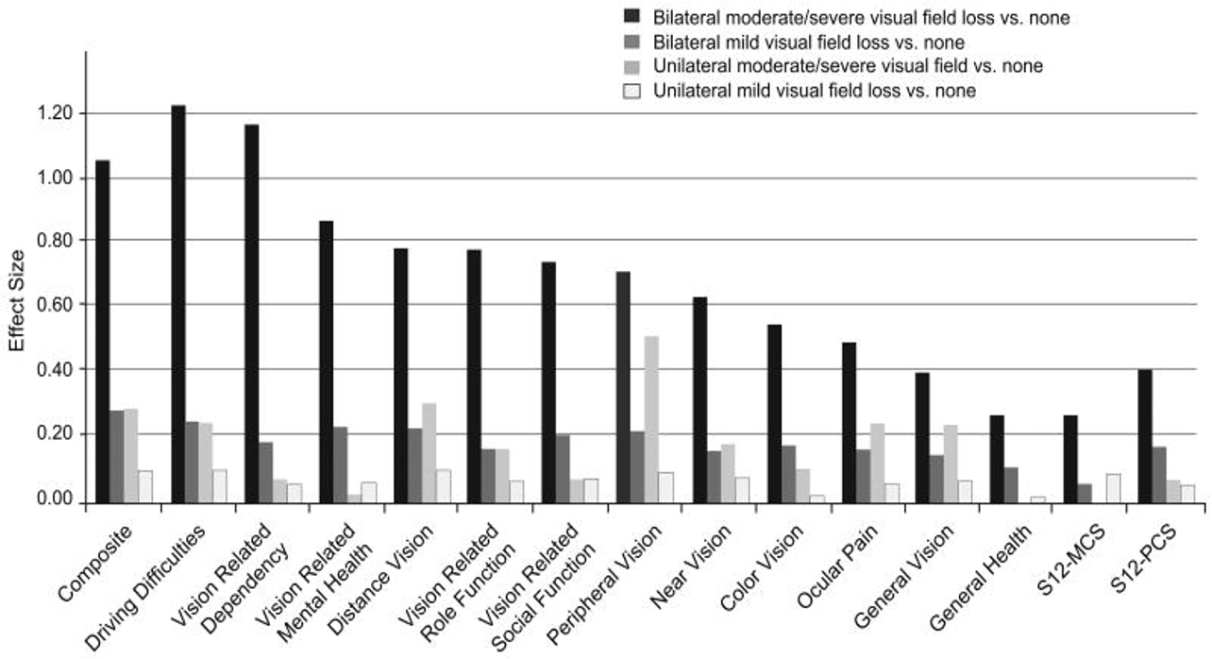
The more advanced the glaucoma is, the worse the visual field loss, the greater the effect the disease has on their daily life and activities
McKean-Cowdin R, et al. Am J Ophthalmol. 2007; 143(6): 1013-23.

Slide 25

Patients with advanced glaucoma only see a part of the whole picture.
They eventually go blind.
As the disease progresses,
the area that they can
see becomes
progressively smaller.

Slide 26
What are the risk of blindness from glaucoma?

Slide 27

Glaucoma accounts for
8% of the blindness in the world.
WHO Global Data 2012
Only 8%?
Sounds like there are other more
important causes of blindness we should
pay more attention to.
But…

Slide 28



At the end of life,
what % of glaucoma patients are blind?
24.1% are
blind in one eye
10.6% are
blind in both eyes
Mokhles P, et al. Acta Ophthalmolgica. 2017; 95(1): 10-11.

Slide 29
If glaucoma affects one’s vision so much, why are people not started on treatment earlier?

Slide 30
If glaucoma affects one’s vision so much,
why are people not started on treatment earlier?
Many remain undiagnosed
How many?
Who can get glaucoma?
> 1/3 of glaucoma cases remain undiagnosed.
Estimated 3% of the global population over 40 years of age currently has glaucoma, the majority of whom are undiagnosed.
Anyone!
Of any age (even children),
race or nationality
Whitson, JT. Expert Opin. Pharmacother. 2007; 8(18): 3237-3249.
Varma R, et al. Am J Ophthalmol. 2014; 152(4): 515-522.

Slide 31
Most people are not aware that they have problems with their vision and do not see a doctor.
Why are people
not diagnosed with
glaucoma earlier?
Early visual field defects mean that 40% of the nerve fibers are already irreversibly damaged!
Glaucoma has
no symptoms in
the early stages!
Quigley, HA. Lancet. 2011; 377(9774): 1367-1377.
Sommer, et al. Arch. Ophthalmol. 1991; 109(1): 77-83.

Slide 32

Glaucoma is often undetected until there is
extensive visual field loss
… by which time it is too late.
“Doctor,
I realized I cannot see.
What can I do to
regain my vision?”
“Unfortunately, your vision cannot be improved. We will start you on treatment to preserve your remaining vision.”
This is why glaucoma
is known as the
‘silent thief of sight’

Slide 33
Glaucoma is a chronic disease
It can be treated but not cured or reversed
Its effects are not limited to the individual.
It is a significant public health issue.

Slide 34
Glaucoma has an impact on
the rest of society! ROAD SAFETY!
Drivers with mild-to-moderate visual field loss from
glaucoma (compared with age-matched controls)
Impaired driving performance
Less safe
Significantly more problems with observation,
maintaining lane position and approach and planning
“…made significantly more errors at traffic light-controlled
and give-way (yield) intersections.”
“Importantly,
the consequences of errors in these traffic situations are likely to involve multiple road users (vehicles and pedestrians) and have significant safety consequences.”
Wood JM, et al. PLoS One. 2016; 11(7): e0158318.

Slide 35
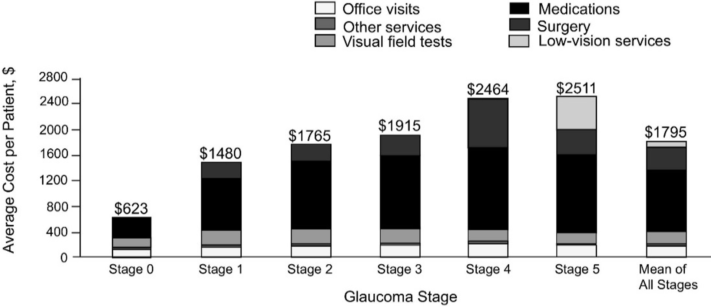
Glaucoma has an impact on the rest of society!
Economic burden
With increased disease severity,
the financial burden of glaucoma increases.
BY HOW MUCH?
4-fold increase in direct ophthalmology-related
costs from early to end-stage glaucoma
Asymptomatic
ocular hypertension /
Earliest glaucoma
Advanced
glaucoma
End-stage
glaucoma
(blindness)
Lee PP, et al. Arch Ophthal. 2006; 124(1): 12-19.

Slide 36
Glaucoma has an impact on the rest of society!
Economic burden
If all glaucoma patients were treated,
the true societal costs would be…
U.S.A.
US $2.9 billion for
2 million glaucoma patients
Australia
Aus $144.2 million for 300,000 glaucoma patients
Varma R, et al. Am J Ophthalmology. 2011; 152(4): 515-522.

Slide 37
Fortunately, blindness is preventable
if glaucoma is detected and treated earlier

Slide 38
Getting tested is important!
Visit your Ophthalmologist
So, get tested! If you have glaucoma, is best to detect it as early as possible.
There are available treatments to control the disease and prevent further damage!

Slide 39
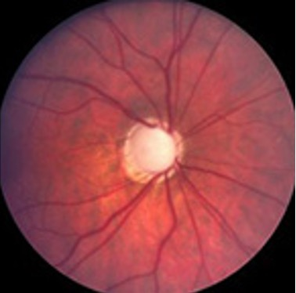
What can be done to relieve the
global burden imposed by glaucoma?
1.
Optimize detection / screening protocols. GET TESTED!!
2.
Implementation of cost-effective screening programs in all regions of the world, especially developing regions
Prevent / reduce vision loss from glaucoma
3.
Optimise glaucoma treatment options (medications, laser, surgery)
Minimise / stop glaucoma progression
4.
Develop new therapeutics (eg. stem cell research)
Reverse the ‘irreversible’ vision loss from glaucoma

Slide 40
What can be done to relieve the
global burden imposed by glaucoma?
Unfortunately, current funding is inadequate.

Slide 41
Acknowledgements – Images
https://www.aao.org/eye-health/diseases/glaucoma-vision-simulator
https://www.google.com/url?sa=i&url=https%3A%2F%2Fwww.vectorstock.com%2Froyalty-free-vector%2Fblind-man-stick-figure-walking-with-a-white-cane-vector-31902257&psig=AOvVaw2b0pWQAZROczCMNCnwF42h&ust=1620056683897000&source=images&cd=vfe&ved=0CAIQjRxqFwoTCLDjytCrq_ACFQAAAAAdAAAAABAE
https://www.google.com/url?sa=i&url=https%3A%2F%2Fwww.glaucoma.org%2Fglaucoma%2Fanatomy-of-the-eye.php&psig=AOvVaw0QsKfdYj2A4-_2mybJfZ6Z&ust=1620056840839000&source=images&cd=vfe&ved=0CAIQjRxqFwoTCMjskJmsq_ACFQAAAAAdAAAAABAJ
https://www.google.com/url?sa=i&url=https%3A%2F%2Fen.wikipedia.org%2Fwiki%2FOccipital_lobe&psig=AOvVaw0RgZwxZwWgF6iYDDOrUO2L&ust=1620057392410000&source=images&cd=vfe&ved=0CAIQjRxqFwoTCNDtwKOuq_ACFQAAAAAdAAAAABAE
https://www.google.com/url?sa=i&url=https%3A%2F%2Fwww.nicepng.com%2Fourpic%2Fu2q8y3a9u2o0u2y3_camera-drawing-png-camera-drawing%2F&psig=AOvVaw0x3JQJLzaupFfPDNUqJjd7&ust=1620056975062000&source=images&cd=vfe&ved=0CAIQjRxqFwoTCLCI69qsq_ACFQAAAAAdAAAAABAX
https://www.google.com/url?sa=i&url=http%3A%2F%2Fgetdrawings.com%2Fcomputer-screen-drawing&psig=AOvVaw1LzzA2rfGWSvGSdmwx_Ff_&ust=1620057306000000&source=images&cd=vfe&ved=0CAIQjRxqFwoTCPim5_ytq_ACFQAAAAAdAAAAABAD
https://tiel1600.wordpress.com/2018/01/02/glaucoma-increased-eye-pressure/
https://www.google.com/url?sa=i&url=https%3A%2F%2Fwww.shutterstock.com%2Fimage-vector%2Fwarning-steep-downhill-sign-vector-1882274386&psig=AOvVaw1KO0H0UDjKxAcJIZyNpwKY&ust=1620058990479000&source=images&cd=vfe&ved=0CAIQjRxqFwoTCIjqpZ20q_ACFQAAAAAdAAAAABAK
https://cdn.who.int/media/docs/default-source/infographics-pdf/world-vision-infographic-final.pdf?sfvrsn=85b7bcde_2
Whitney, D., & Levi, D. M. (2011). Visual crowding: a fundamental limit on conscious perception and object recognition. Trends in Cognitive Sciences, 15(4), 160–168. https://doi.org/10.1016/j.tics.2011.02.005
https://www.google.com/url?sa=i&url=http%3A%2F%2Fclipart-library.com%2Fclipart%2F1476043.htm&psig=AOvVaw3rAzIpp_bCy7aV9frKsyxW&ust=1620627054729000&source=images&cd=vfe&ved=0CAIQjRxqFwoTCLjr1bT4u_ACFQAAAAAdAAAAABAD
https://www.google.com/url?sa=i&url=https%3A%2F%2Fstock.adobe.com%2Fsearch%3Fk%3Drobber%2520cartoon&psig=AOvVaw2a9q90aHFvz4sfnHclBI7D&ust=1621230357145000&source=images&cd=vfe&ved=0CAIQjRxqFwoTCPDT-Py_zfACFQAAAAAdAAAAABAE
https://www.google.com/url?sa=i&url=https%3A%2F%2Fwww.illustrationsof.com%2F433588-royalty-free-blind-clipart-illustration&psig=AOvVaw1jIgcYAsdQHNTwzWUKhWaq&ust=1621230606411000&source=images&cd=vfe&ved=0CAIQjRxqFwoTCKDXgefAzfACFQAAAAAdAAAAABAK
https://www.google.com/url?sa=i&url=https%3A%2F%2Fwww.easylinedrawing.com%2Fhow-to-draw-a-cartoon-car-step-by-step%2F&psig=AOvVaw2nNjEi91qLE0ONlkiNSJge&ust=1620627782693000&source=images&cd=vfe&ved=0CAIQjRxqFwoTCOC155f7
https://www.google.com/url?sa=i&url=https%3A%2F%2Fwww.dreamstime.com%2Fillustration%2Fstop-security-cartoon.html&psig=AOvVaw2m8iR6tqDUfZljcHkaLYNk&ust=1621237532352000&source=images&cd=vfe&ved=0CAIQjRxqFwoTCLCi5MzazfACFQAAAAAdAAAAABAJ
https://www.google.com/imgres?imgurl=https%3A%2F%2Fwww.pngfind.com%2Fpngs%2Fm%2F178-1788173_clipart-desktop-computer-animation-desktop-computer-hd-png.png&imgrefurl=https%3A%2F%2Fwww.pngfind.com%2Fmpng%2FmhhTom_clipart-desktop-computer-animation-desktop-computer-hd-png%2F&tbnid=0qYkK4Fq_pGIdM&vet=12ahUKEwjg85fw-7vwAhWKPCsKHR6bBQ8QMyg3egQIARBi..i&docid=367m5WIUiR7TQM&w=840&h=640&q=computer%20animation&hl=en&ved=2ahUKEwjg85fw-7vwAhWKPCsKHR6bBQ8QMyg3egQIARBiu_ACFQAAAAAdAAAAABAE
https://st2.depositphotos.com/4356917/6429/v/600/depositphotos_64292935-stock-illustration-flowers-with-happy-smiling-faces.jpg
https://cdn4.iconfinder.com/data/icons/old-man-elderly-injured-injury-pain/197/old-man-pain-10-512.png
https://banner2.cleanpng.com/20180508/bdw/kisspng-sadness-stock-photography-depression-royalty-free-5af1263fa7fa03.2488389315257534076881.jpg
https://www.pngitem.com/pimgs/m/7-78539_clip-art-cartoon-cars-crashing-car-accident-clipart.png
http://st2.depositphotos.com/1504872/8305/v/450/depositphotos_83058918-Cartoon-ambulance-car-isolated.jpg
https://www.glaucoma.org/uploads/optic-nerve-comparison_290.jpg

