Slide 1


42nd WGA Information and Planning Exchange
(IPE) meeting
Sunday, August 18, 2024

Slide 2

Welcome
Ningli Wang, MD PhD
President

Slide 3

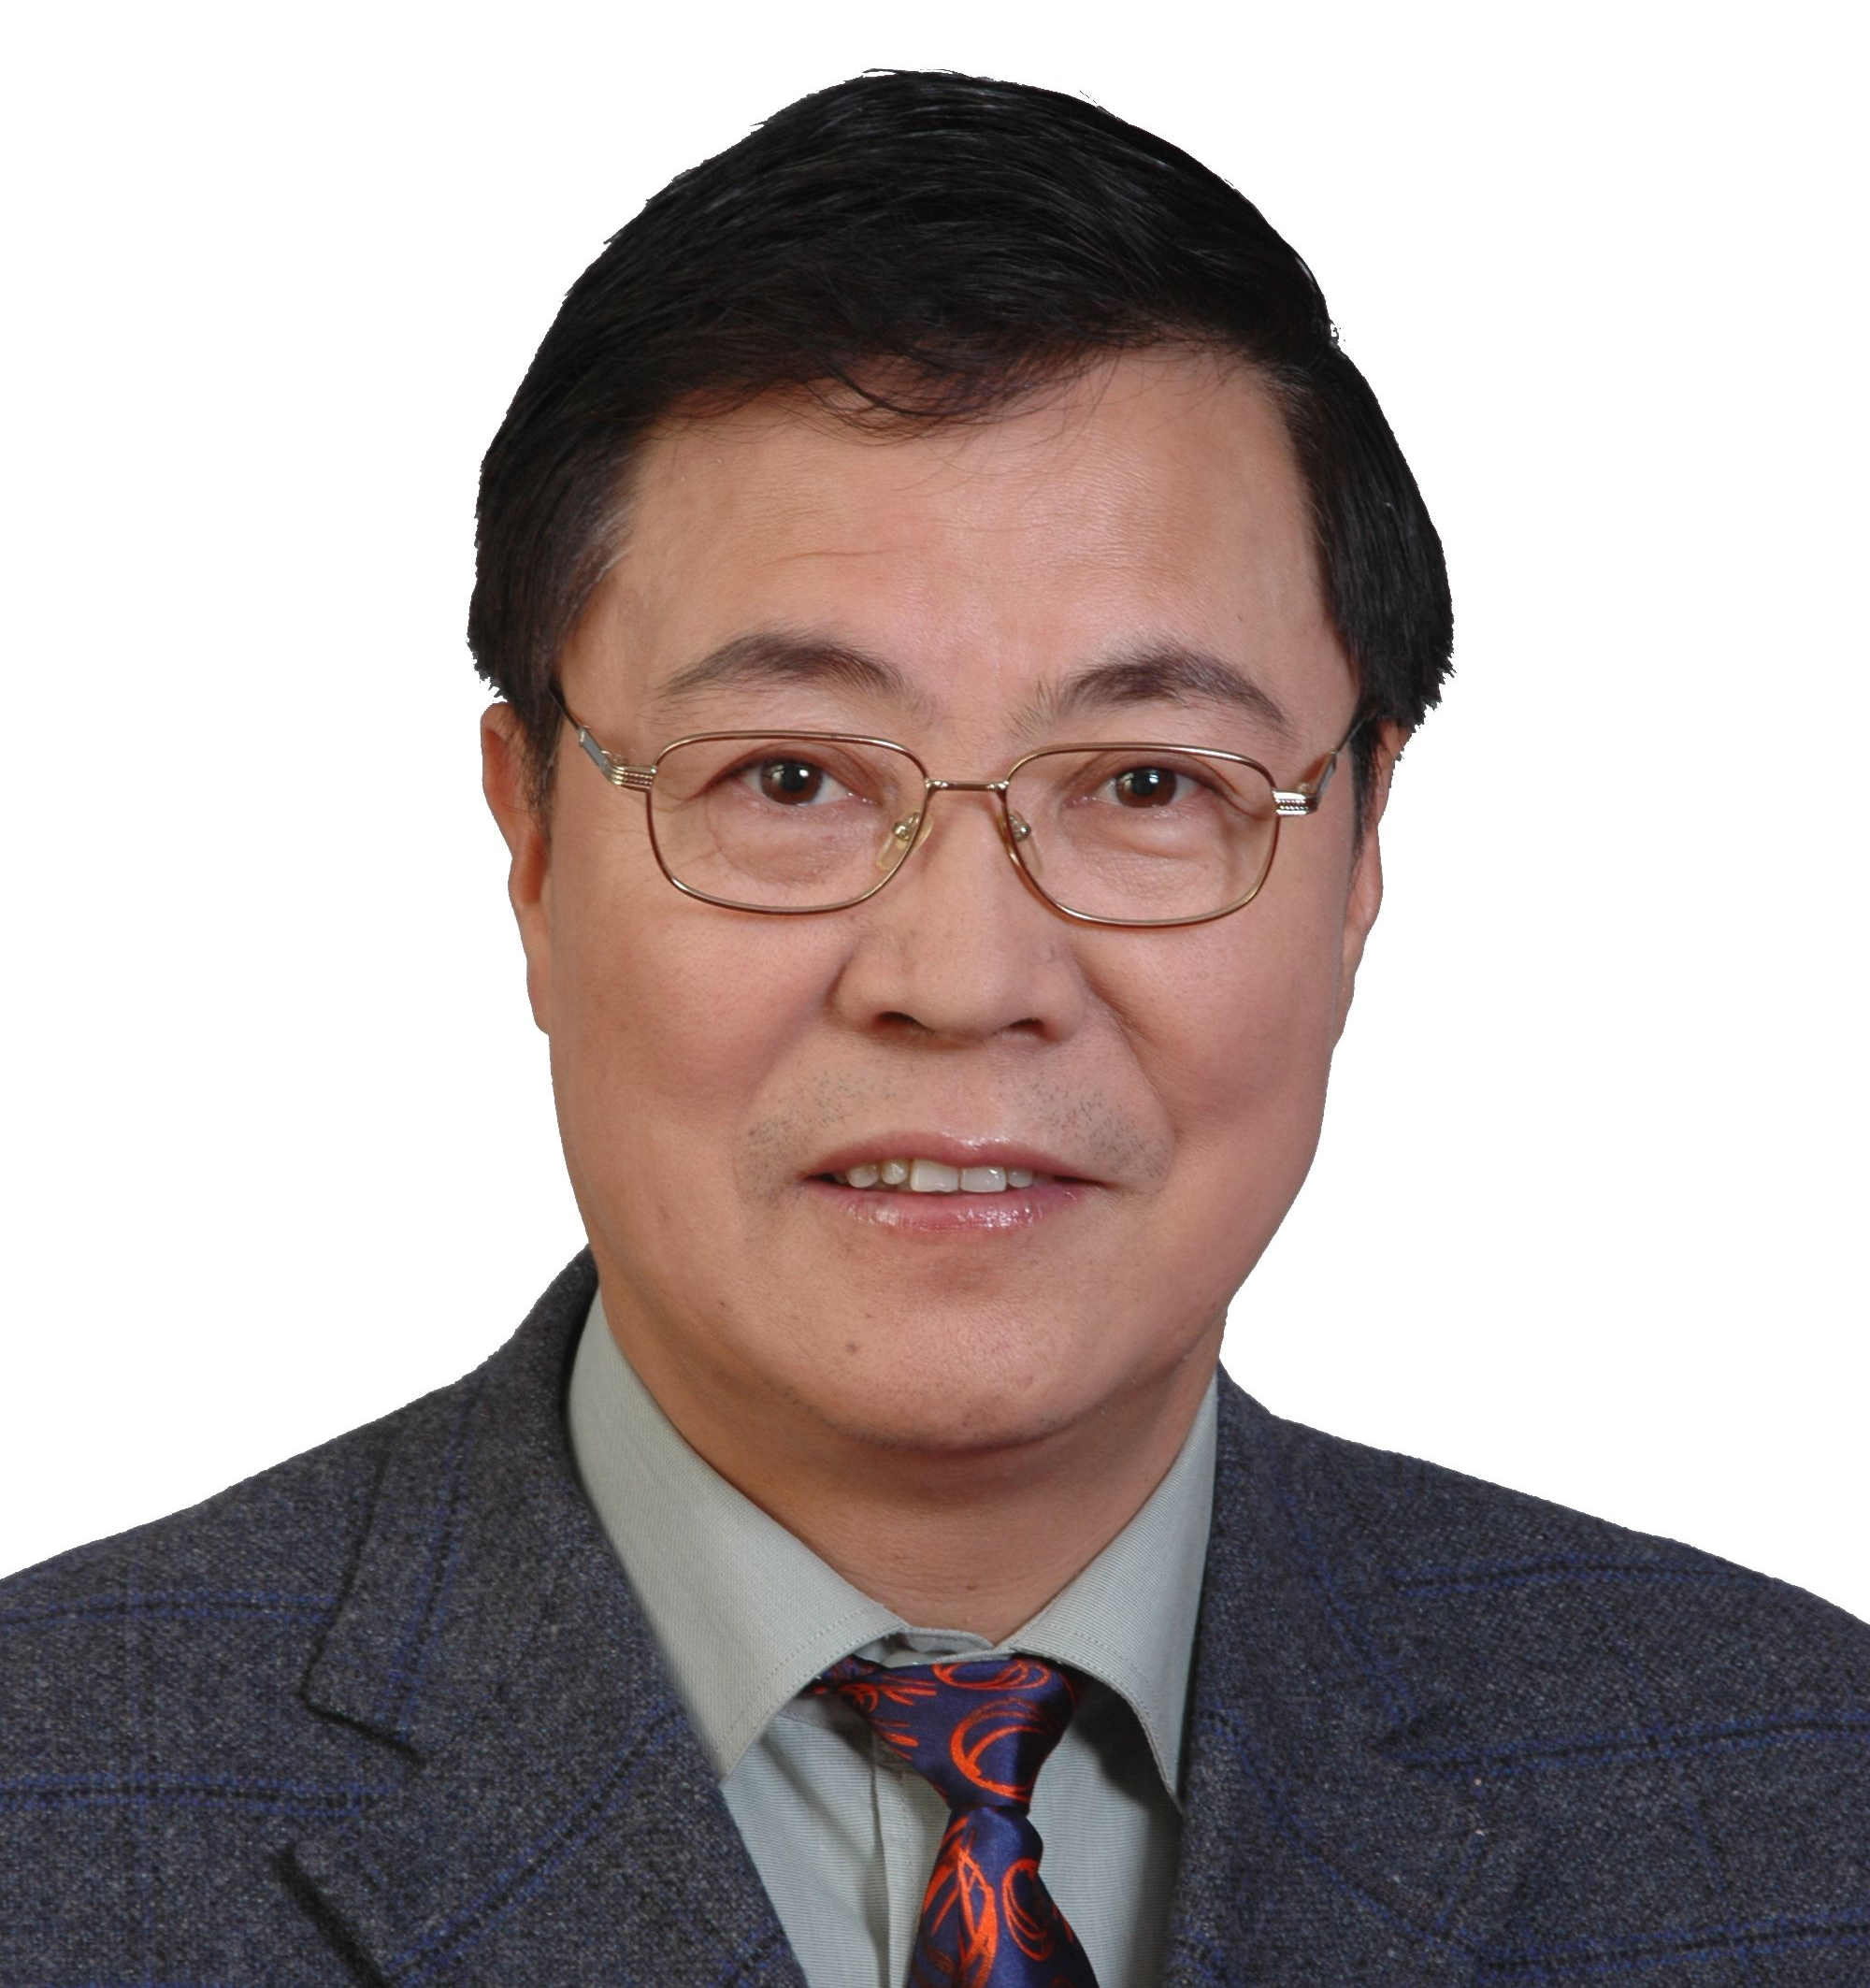
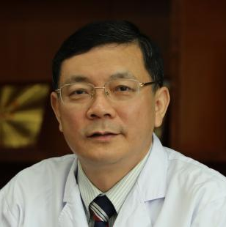
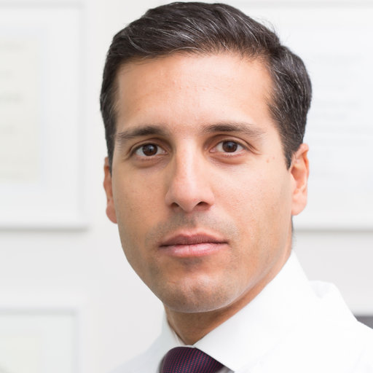
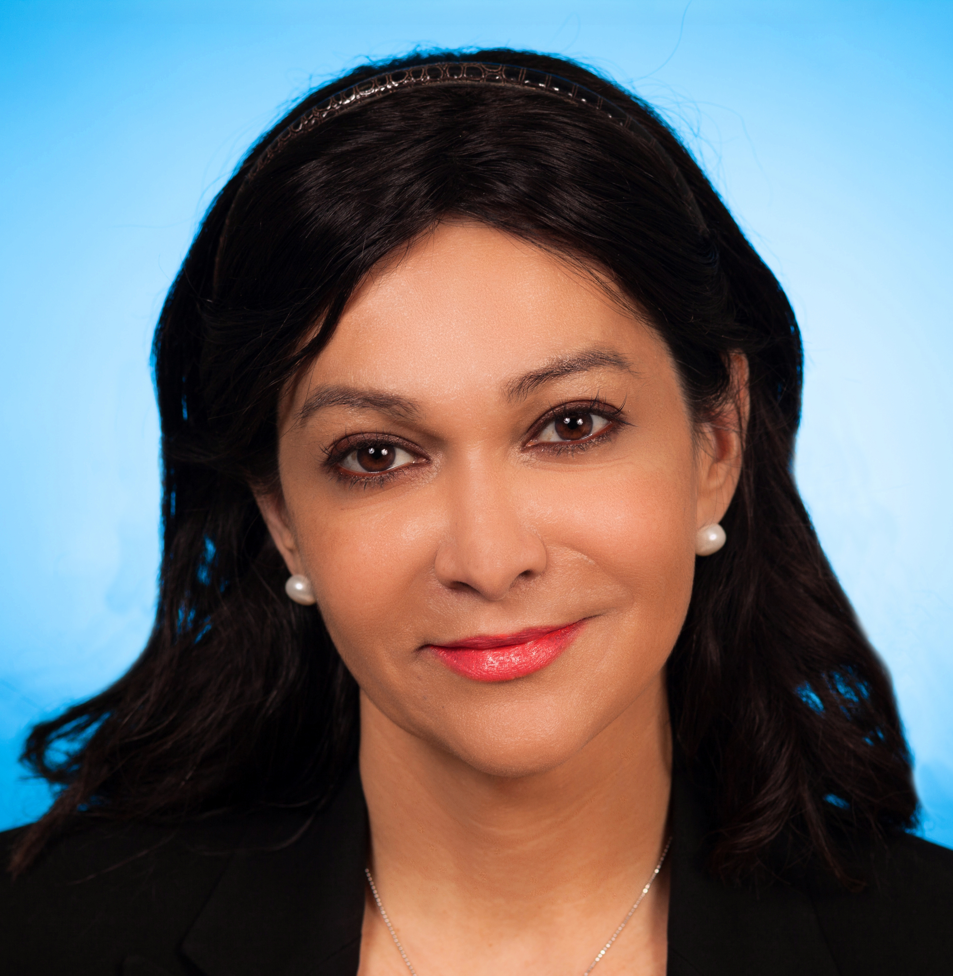
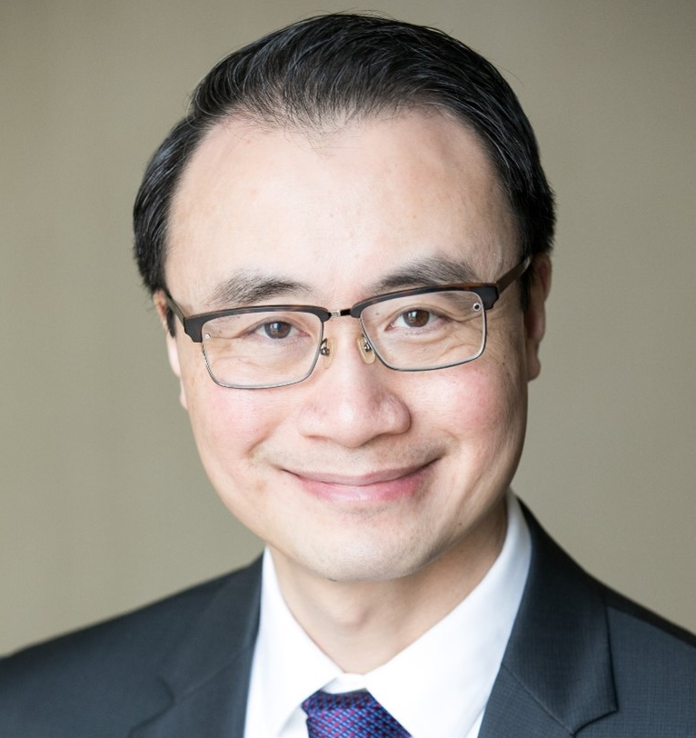

Executive Committee
The Executive Committee actively sets policy and ensures that the WGA has adequate resources to carry out its mission, and that its activities and expenses align with its mission focus.
Ningli Wang (CN)
President
Xuyang Liu (CN)
Associate Executive Vice President
Kaweh Mansouri (CH)
Executive Vice President
Neeru Gupta (CA)
Immediate Past President
Arthur Sit (US)
Treasurer
Fabian Lerner (AR)
Past Past President

Slide 4
Board of Governors
The Board of Governors is responsible for defining the WGA’s mission and values and for providing overall leadership and strategic direction.
Ningli Wang, China
Neeru Gupta, Canada
Arthur Sit, United States
Fabian Lerner, Argentina
Makoto Aihara, Japan
Nkiru Kizor - Akaraiwe, Nigeria
Winifred Nolan, UK
Pradeep Ramulu, United States
Xinghuai Sun, China
Marcelo Hatanaka, Brazil
Jesus Jimenez Roman, Mexico
Tanuj Dada, India
Miriam Kolko, Denmark

Slide 5

Council
The general task of the Council is to provide expertise and institutional memory from previous leadership.
Makoto Araie, Japan
Tin Aung, Singapore
Jonathan Crowston, Singapore
Robert Fechtner, US
David Friedman, US
Jian Ge, China
Ivan Goldberg, Australia
Franz Grehn, Germany
Daniel Grigera, Argentina
Paul Healey, Australia
Peng Khaw, UK
Yoshi Kitazawa, Japan
Dennis Lam, Hong Kong
Jeffrey Liebmann, US
Olusola Olawoye, Nigeria
Ki Ho Park, South Korea
Norbert Pfeiffer, Germany
GC Sekhar, India
Tarek Shaarawy, Switzerland
Kuldev Singh, US
Kazuhisa Sugiyama, Japan
Clement Tham, Hong Kong
Remo Susanna Jr, Brazil
Ravi Thomas, Australia
Carlo Traverso, Italy
Ningli Wang, China
Robert Weinreb, US

Slide 6

Kaweh Mansouri, MD MPH
Executive Vice President

Slide 7

reaching over 20,000 individual and eye care professionals worldwide
91 glaucoma member societies

Slide 8




















Our WGA industry members
PLATINUM
SILVER
BRONZE
GOLD

Slide 9
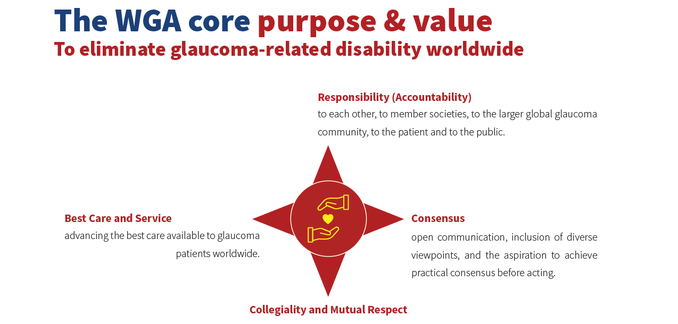

Slide 10
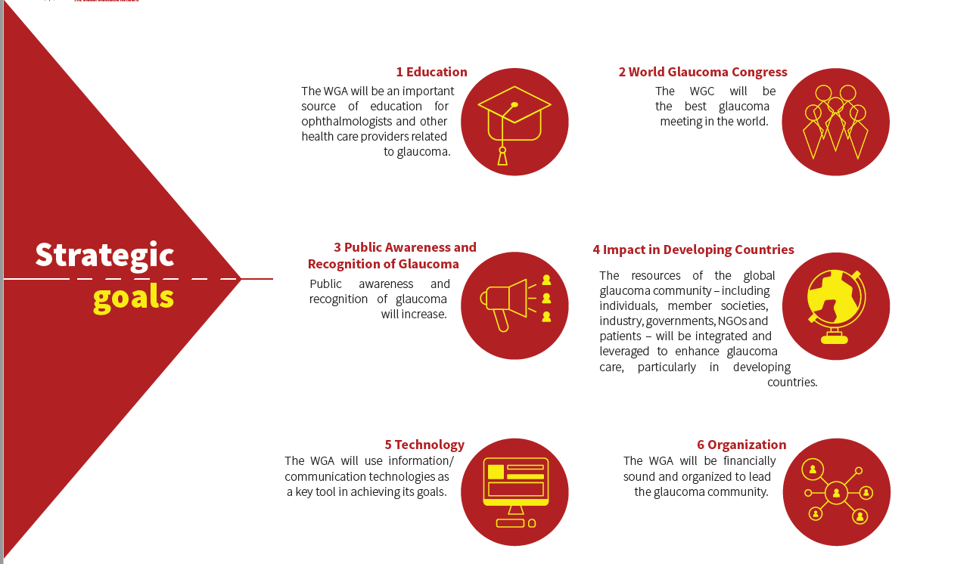

Slide 11


Slide 12

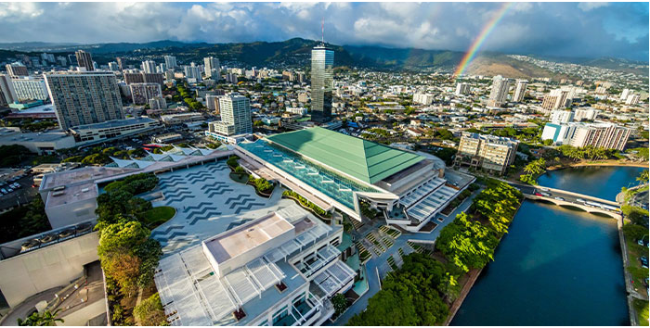

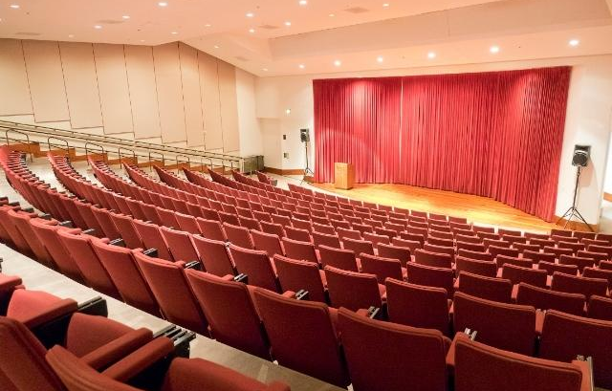
11th World Glaucoma Congress
SAVE THE DATE & JOIN US!
Dates: June 25-28, 2025
Venue: Hawaii Convention Center (HCC)
www.worldglaucomacongress.org.

Slide 13
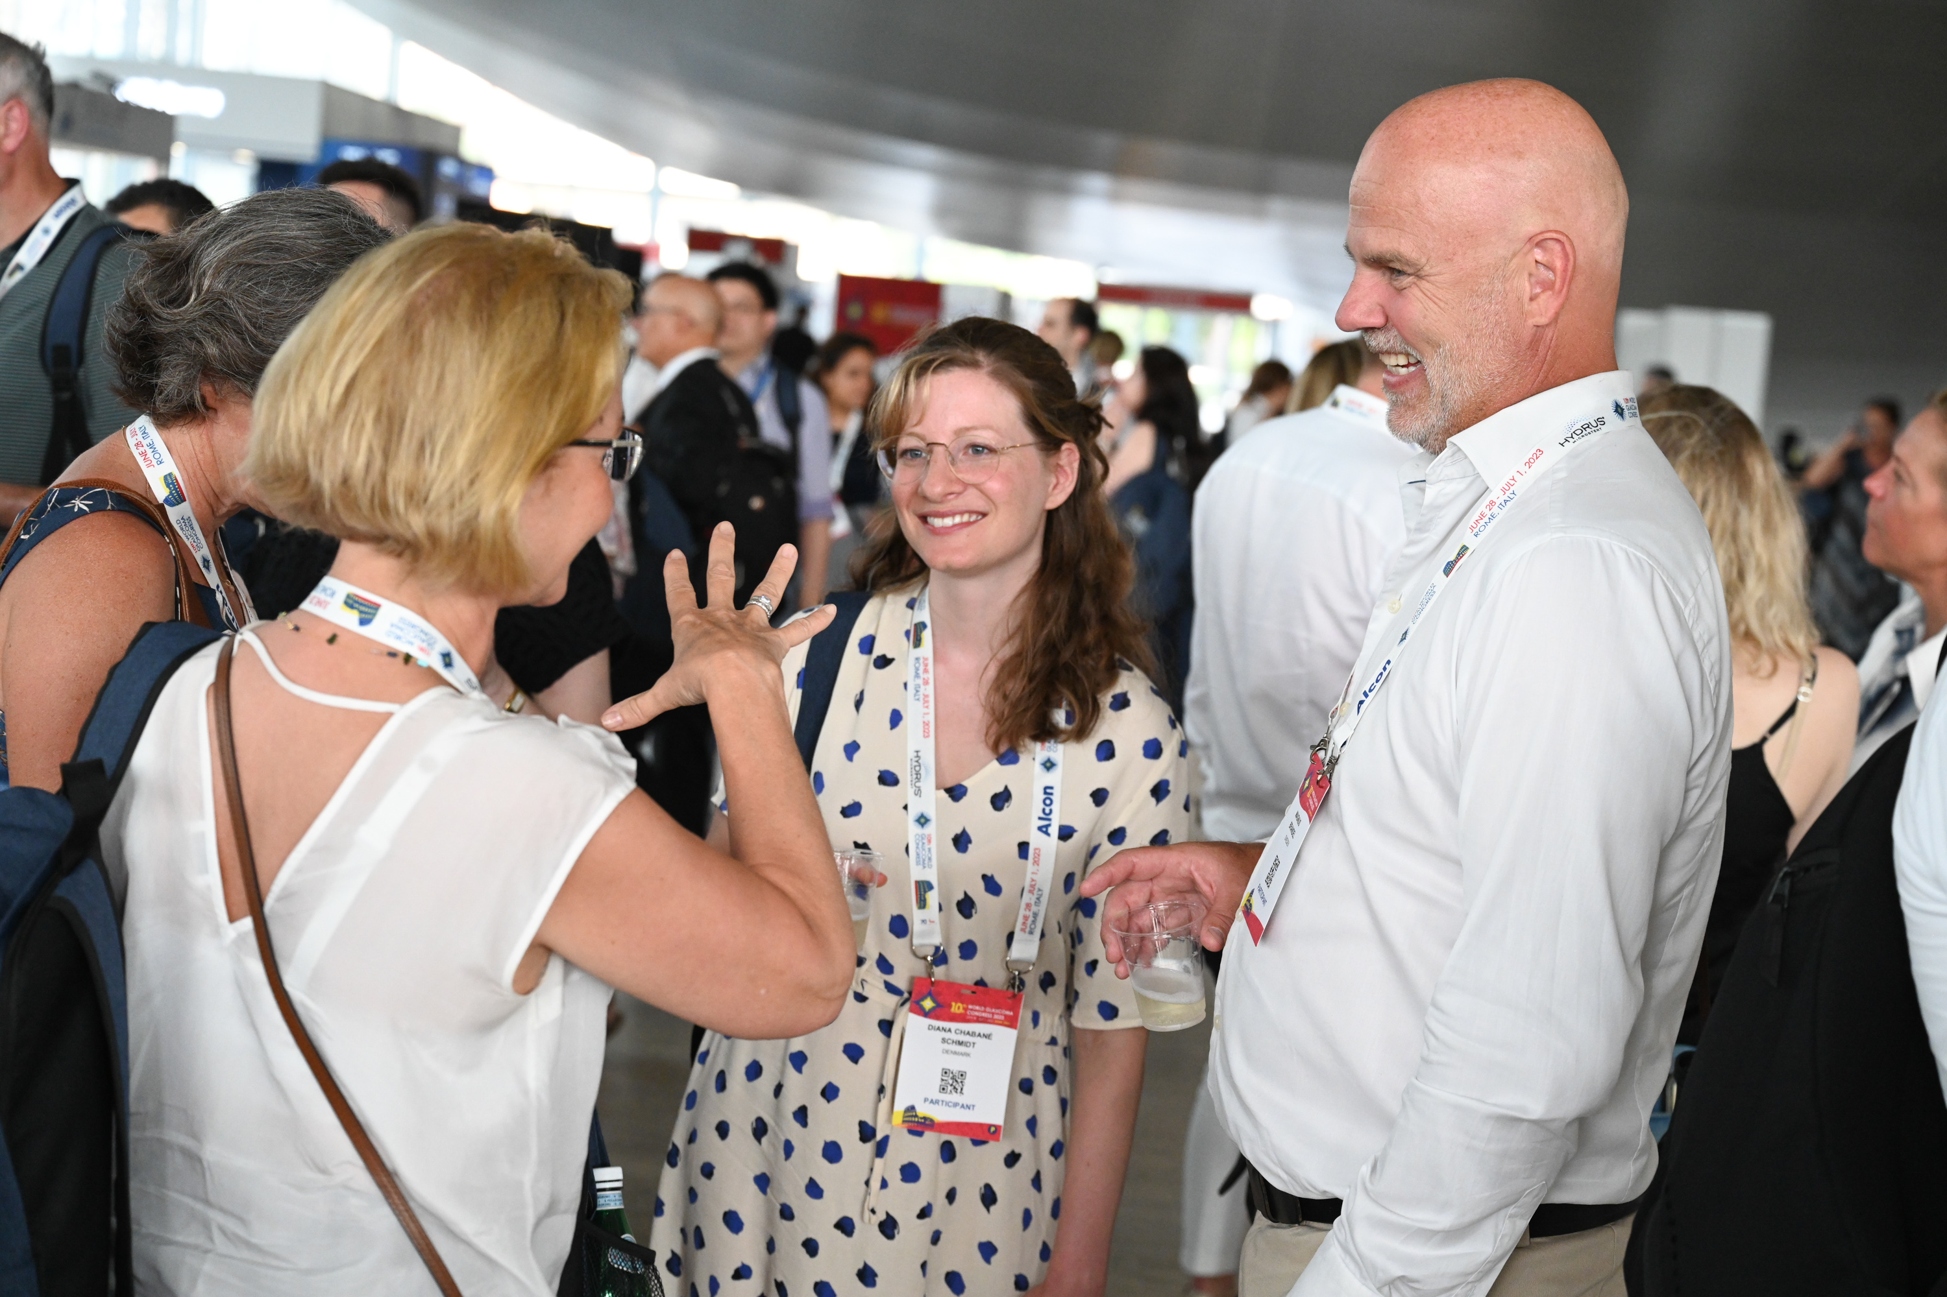
What can you expect?
Target the American and Asia-Pacific market
International attendees, 2500-3000 delegates expected
Exciting sponsorship opportunities including prime slots for industry satellites
56,000 sq feet / 5200 sqm available for exhibition
Special recognition for industry members
Networking

Slide 14
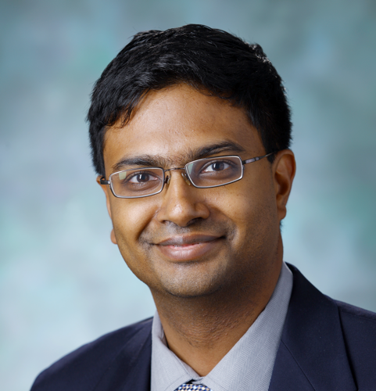



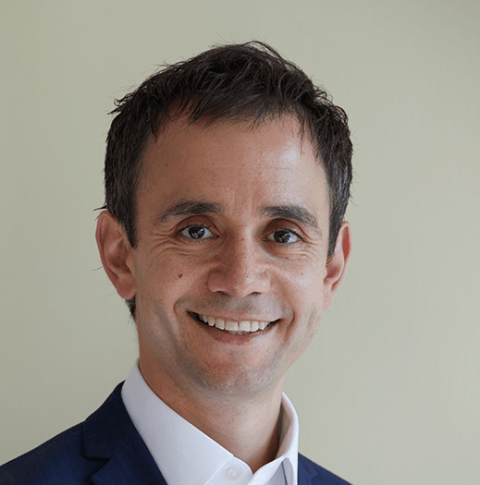
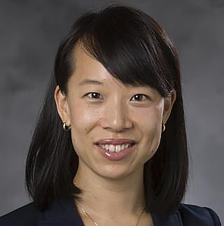
WGC-2025 Program Planning Committee
CO-CHAIR
CO-CHAIR
Pradeep Ramulu
USA
Tanuj Dada
India
VICE CHAIR
VICE CHAIR
VICE CHAIR
VICE CHAIR
Chelvin Sng
Singapore
Lisandro Sakata
Brazil
Anthony Khawaja
UK
Yvonne Ou
USA
Surgery
Clinical
Genetics
Basic Science

Slide 15
Hawaii Entry Requirement | VISA to the United States
We strongly advise that if you require a VISA to enter the United States, you begin the process as soon as possible.
More information about VISA application

Slide 16



Uniting for a Glaucoma-Free World
2 new World Glaucoma Week videos

Slide 17
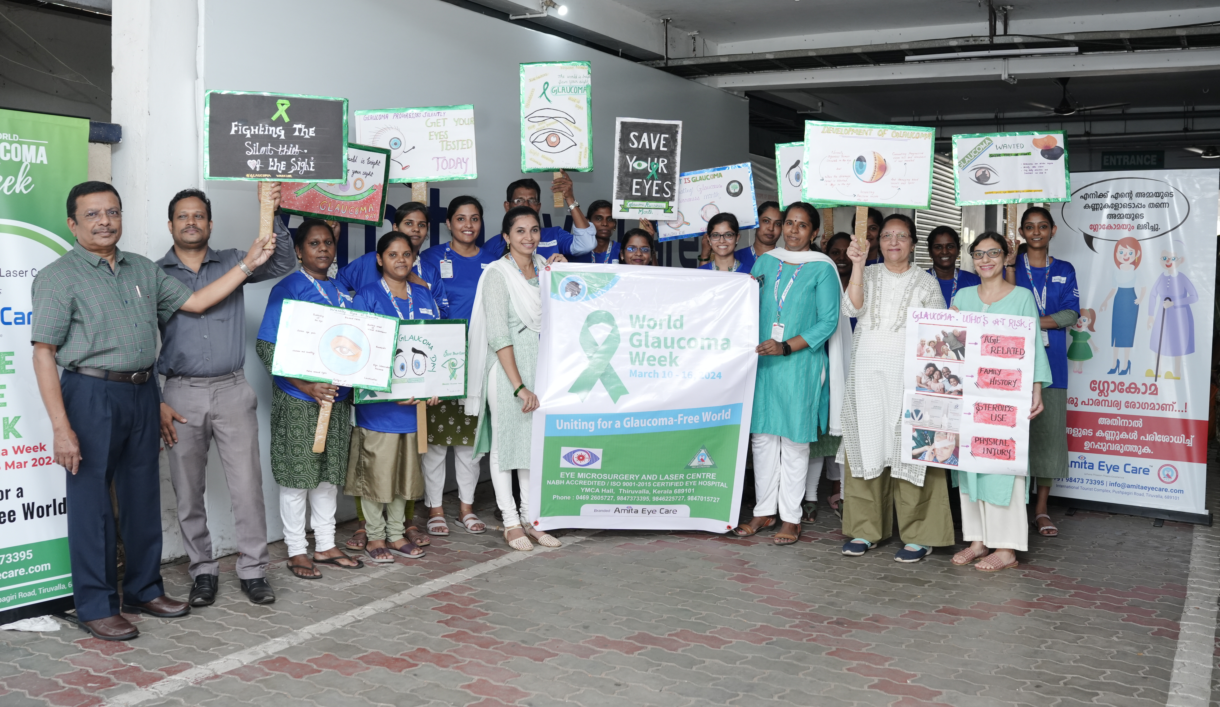
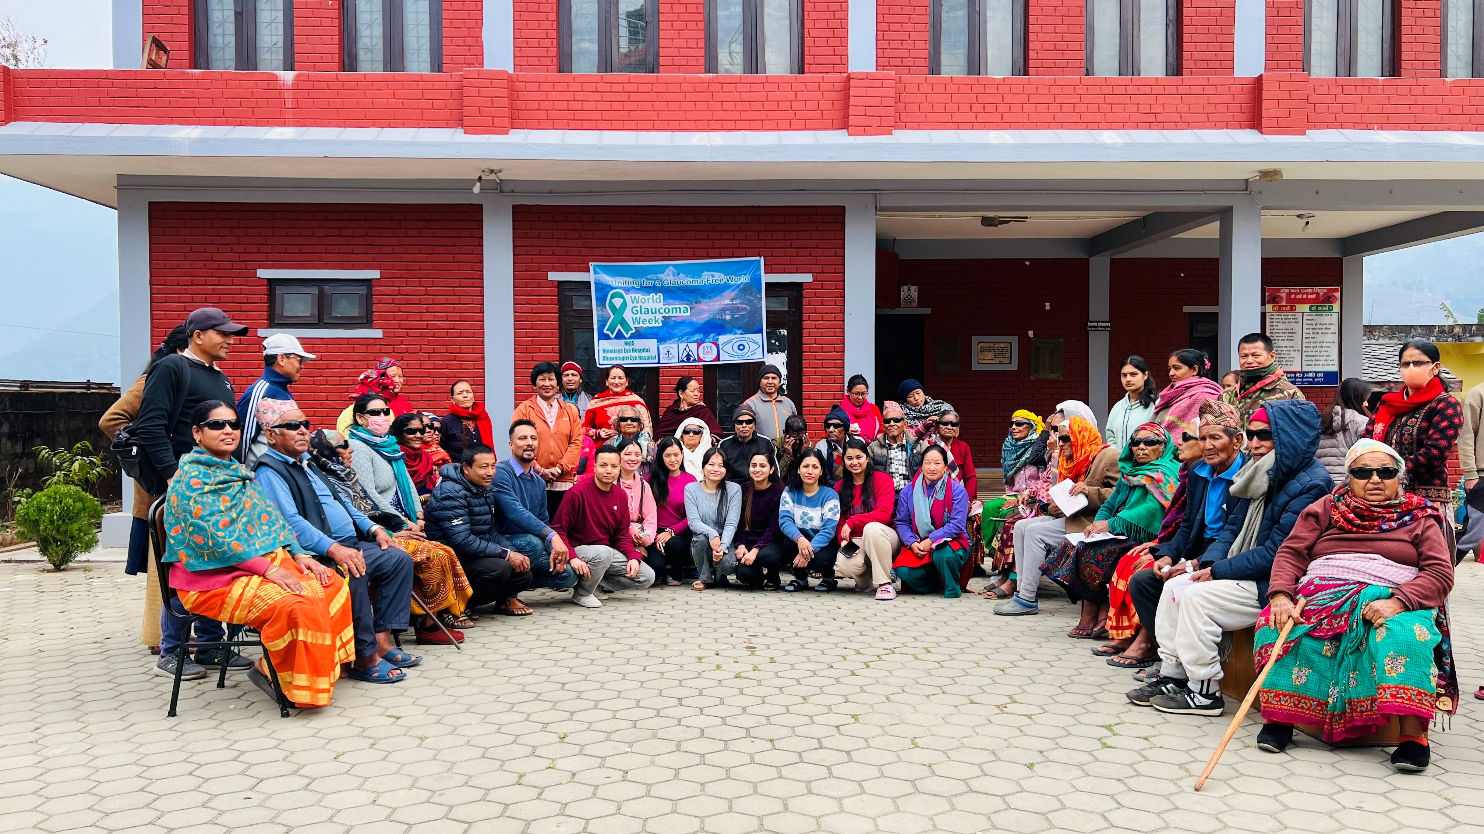

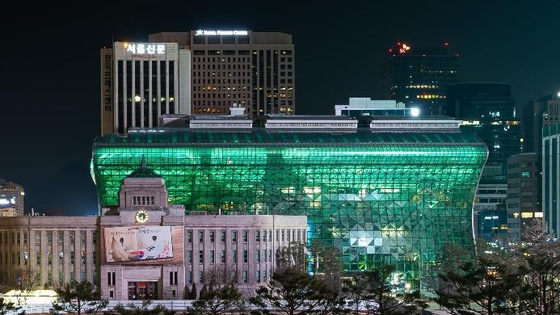
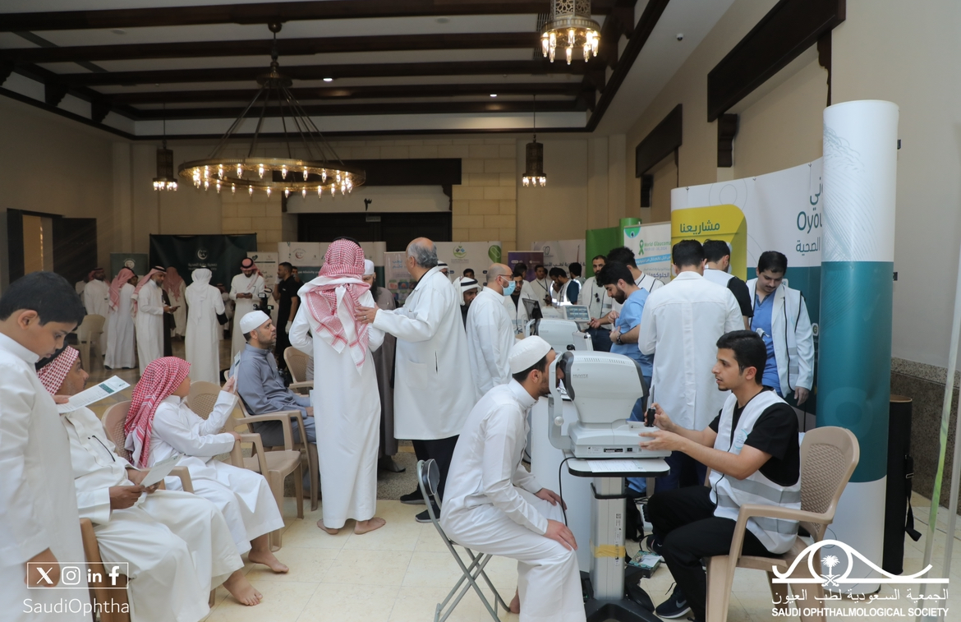
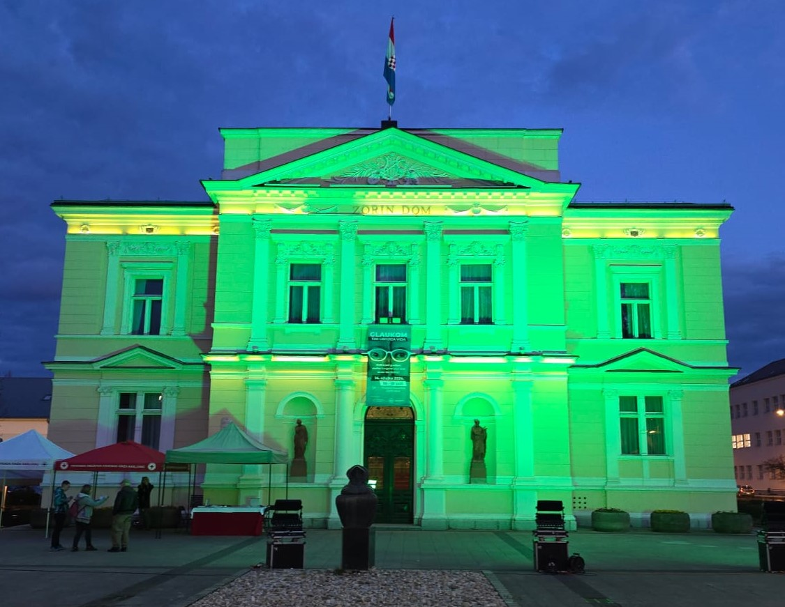
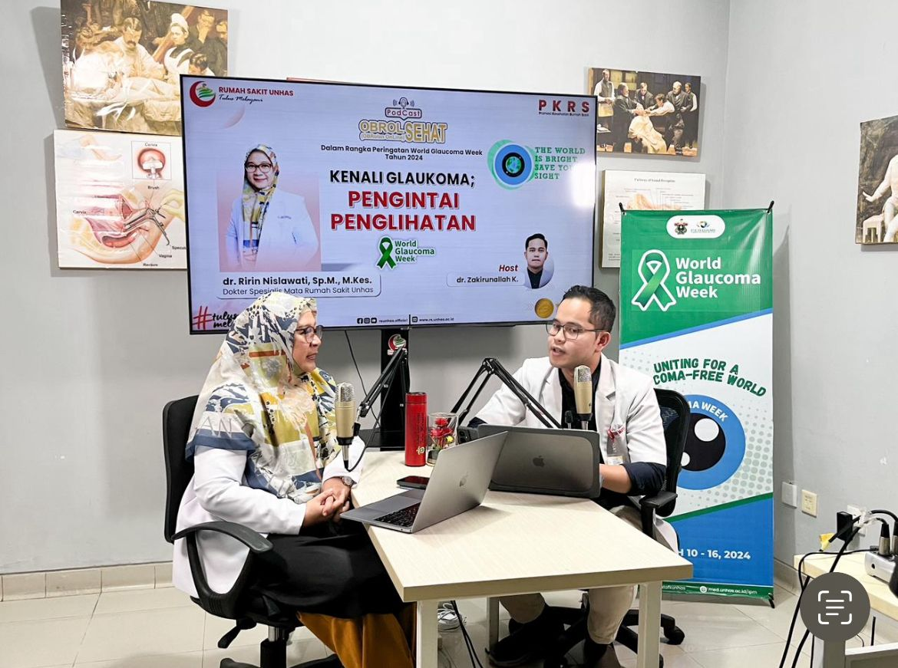
WGW2024 Activities

Slide 18

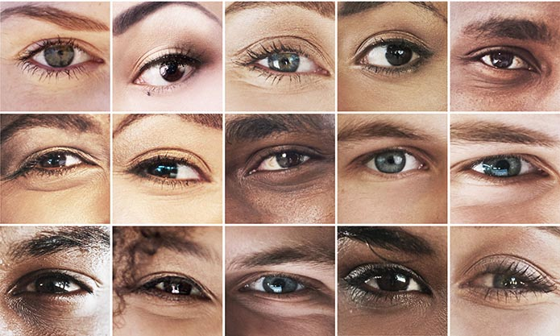

Next edition:
March 9-15, 2025

Slide 19




Keep up-to-date with WGA activities!
World Glaucoma Association
@WorldGlaucoma
World Glaucoma Association
@worldglaucoma
@worldglaucomaweek
FOLLOWERS
FOLLOWERS
FOLLOWERS
FOLLOWERS
8,200
2,380
2,360
1,600

Slide 20
Global Outreach Committee
Neeru Gupta, MD PhD MBA FRCSC DABO FARVO FCAHS
Chair, Global Outreach Committee

Slide 21

ICO-World Glaucoma Association 3 Month Fellowship Program
Young ophthalmologists from developing countries learn practical skills and broaden their perspectives of ophthalmology and glaucoma
ICO-WGA fellowship program has extended its application to Sub-Saharan Africa and Southeast Asia
In collaboration with

Slide 22
The WGA has supported
18 fellows from
12 countries in Africa
since 2017
10 confirmed Fellows for 2024

Slide 23
Education
Pradeep Ramulu MD PhD
Chair Education Committee

Slide 24
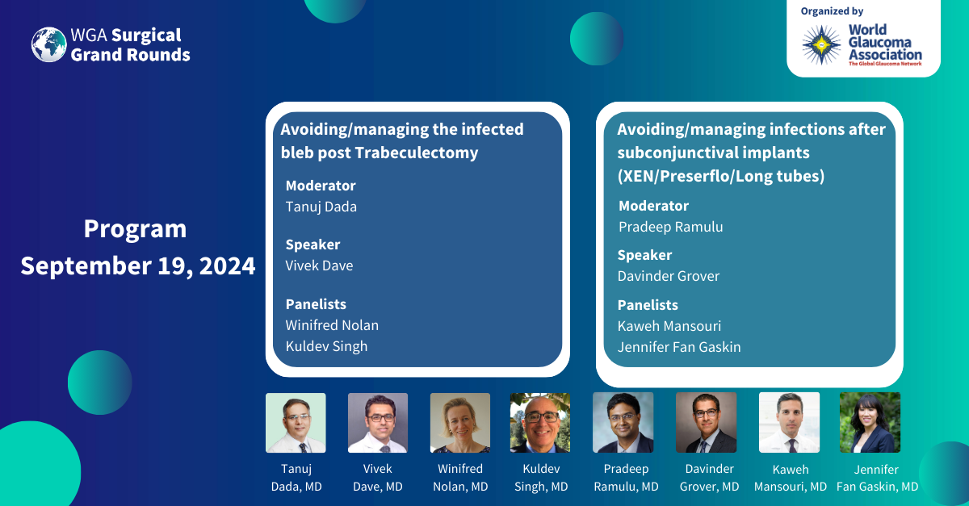
6th Surgical Grand Rounds – September 19, 2024

Slide 25



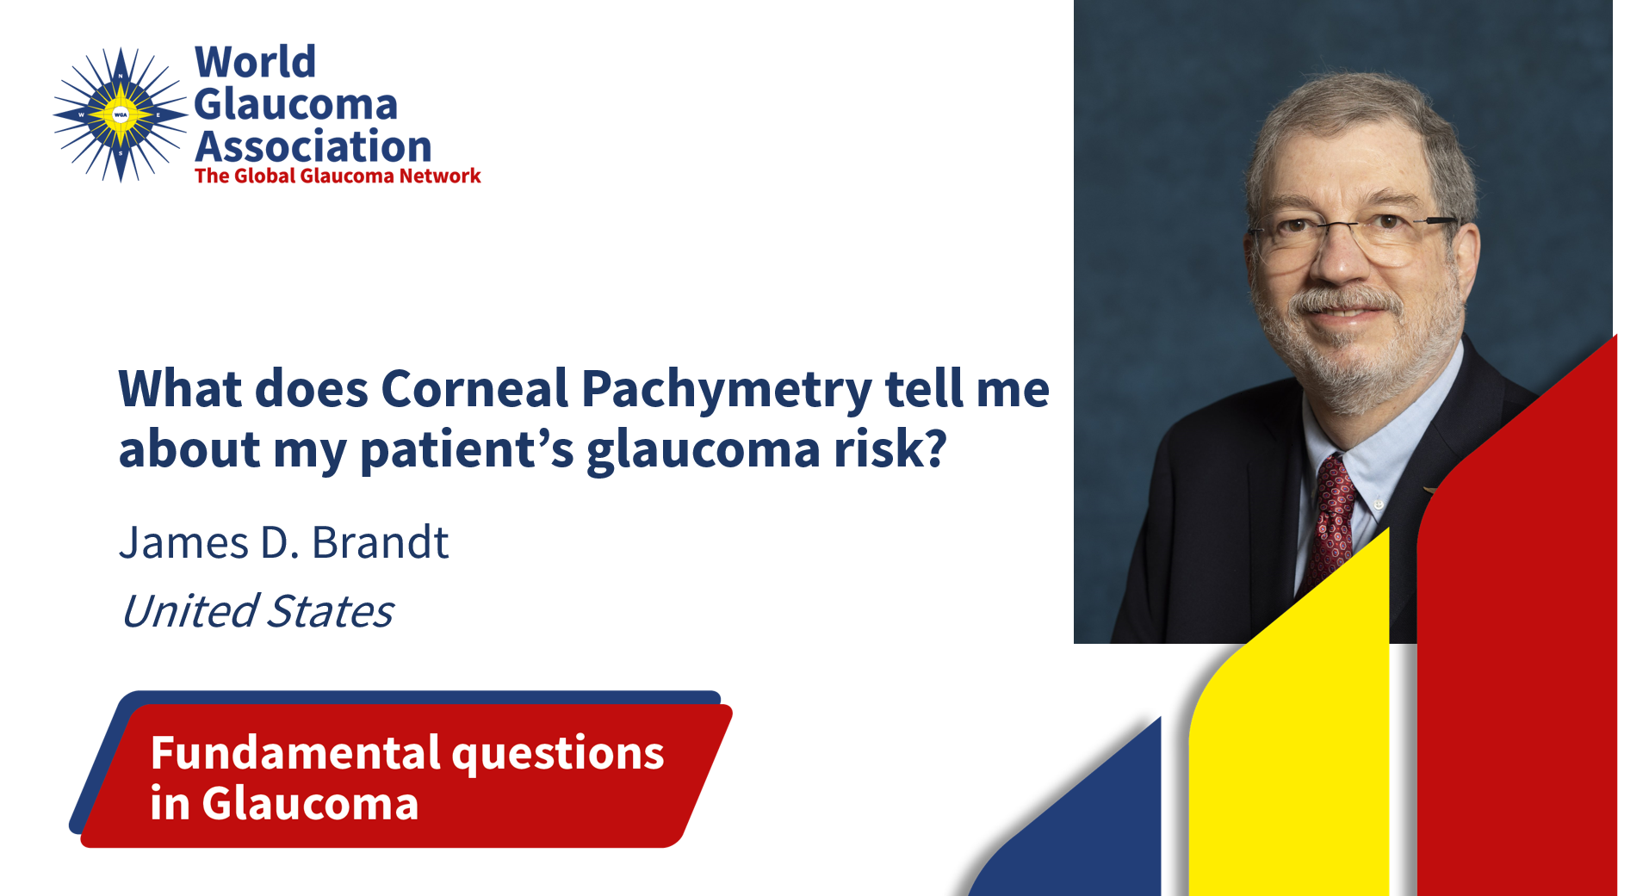
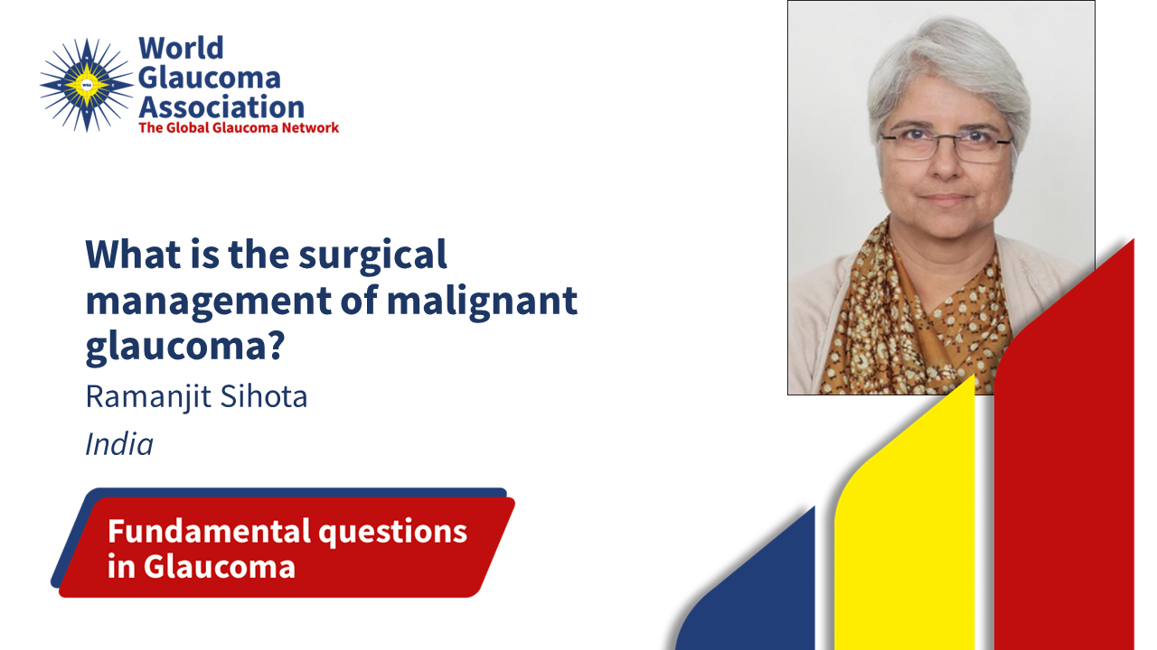

Fundamental Questions in Glaucoma - 2023

Slide 26


Fundamental Questions in Glaucoma - 2024
…and more topics

Slide 27
Basic and Continued Courses
All continued modules are available in English. Spanish and Portuguese translation is being developed.

Slide 28
Advanced Course in Glaucoma

Slide 29
1107 more participants than 2023

Slide 30
Journal of Glaucoma
Neeru Gupta, MD PhD MBA FRCSC DABO FARVO FCAHS
Chief Editor, Journal of Glaucoma

Slide 31
International Glaucoma Review
Kaweh Mansouri MD MPH
Executive Vice President

Slide 32
WGA Consensus Series 1-11
WGA Consensus Volume 11: Glaucoma Surgery - 2020
edited by: R.N. Weinreb, P. Ramulu, F. Topouzis, K.H. Park, K. Mansouri and S.F. Lerner
WGA Consensus Volume 10: Diagnosis of Primary Open Angle Glaucoma – 2016
edited by: R.N. Weinreb, D.F. Garway-Heath, C. Leung, F.A. Medeiros AND J. Liebmann
WGA Consensus Volume 9: Childhood Glaucoma - 2013
edited by: R.N. Weinreb, A.L. Grajewski, M. Papadopoulos, J. Grigg and S. Freedman
WGA Consensus Volume 8: Progression of Glaucoma - 2011
edited by: R.N. Weinreb, D.F. Garway-Heath, C. Leung, J.G. Crowston and F.A. Medeiros
WGA Consensus Volume 7: Medical Treatment of Glaucoma - 2010
edited by: R.N. Weinreb, M. Araie, R. Susanna Jr, I. Goldberg, C. Migdal and J. Liebmann
WGA Consensus Volume 6: Ocular Blood Flow in Glaucoma - 2009
edited by: R.N. Weinreb and A. Harris
WGA Consensus Volume 5: Glaucoma Screening - 2008
edited by: R.N. Weinreb, P.R. Healey and F. Topouzis
WGA Consensus Volume 4: Intraocular Pressure - 2007
edited by: R.N. Weinreb, J.D. Brandt, D.F. Garway-Heath and F.A. Medeiros
WGA Consensus Volume 3: Angle Closure and Angle Closure Glaucoma - 2006
edited by: R.N. Weinreb and D.S. Friedman
WGA Consensus Volume 2: Glaucoma Surgery - Open Angle Glaucoma - 2005
edited by: R.N. Weinreb and J.G. Crowston
WGA Consensus Volume 1: Glaucoma Diagnosis - Structure and Function - 2004
edited by: R.N. Weinreb and E.L. Greve

Slide 33
ANNOUNCING
WGA Consensus Volume 12
Angle Closure and Angle Closure Glaucoma
Chair
Robert N. Weinreb, MD
La Jolla, CA, USA
Executive co-Chair
Ben Xu MD, PhD
Los Angeles, CA, USA
co-Chairs
Tin Aung, MD, PhD
Singapore
Paul Foster, , MD, PhD
London, UK
David Friedman, MD, PhD
Boston, MA, USA
Xiulan Zhang, MD, PhD
Guangzhou, P.R. China

Slide 34




International Glaucoma Review
Official Journal of the World Glaucoma Association - Since 1999
Chief Editor
Contributing Editors
Christopher Leung (HK)
Kaweh Mansouri (CH)
Arthur Sit (US)
Robert N. Weinreb (US)
Published by Kugler Publications on behalf of the World Glaucoma Association.

Slide 35
What Makes IGR Unique?
IGR provides a reliable Glaucoma literature overview and critical review, which is a huge time saver to stay on top of the most significant glaucoma developments. IGR’s 4-level system for glaucoma literature works as follows:
1. More than 3,500+ glaucoma abstracts will be added to the IGR abstract database annually
2. The Editors Selection provides the most interesting & relevant abstracts with expert comments
3. Highlights are selected from the “Editors Selection”
4. News flashes provide the reader with super selected one liners
IGR production statistics
The average number of publications in Glaucoma is rapidly growing. IGR process 5-times more abstracts since 1999.
IGR database holds over 48,000 searchable and categorized abstracts.
Of these abstracts, more than 2,500 are commented on by 700+ international experts.

Slide 36
IGR Readership
Issues are distributed free of charge to all individual members of the 91 WGA affiliated glaucoma societies worldwide, representing over 20,000 glaucoma specialists.

Slide 37
Advertisements
IGR offers many advertisement opportunities , contact WGA Executive Office at info@worldglaucoma.org and obtain the IGR Media Kit 2024 for more information.

Slide 38
Closing
Ningli Wang, MD PhD
President

Slide 39
Next IPE Meeting
TBA

Slide 40
Thank you

