Slide 1


Board of Governors Meeting
Saturday, August 17, 2024

Slide 2
Welcome
Ningli Wang, MD PhD
President

Slide 3
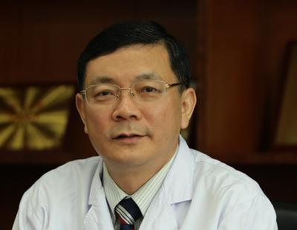
Professor Xuyang Liu – Associate EVP WGA
Doctor of Xiamen Eye Center
Vice Chairman, Chinese Glaucoma Society
Committee Member, Ophthalmology Branch of Chinese Medical Association
Former Chairman, Ophthalmologists Association of Shenzhen Medical Association

Slide 4


Minutes for Approval
Board of Governors Meeting
November 4, 2023

Slide 5
Report of the Executive Vice President
Kaweh Mansouri, MD MPH
Executive Vice President

Slide 6

WGC-2023 sessions recording
WGC-2023 sessions recording are now available on WGA Video Library.
Recordings are accessible with WGA#One account for WGC-2023 participants.

Slide 7



Uniting for a Glaucoma-Free World
2024 campaign received 5.5million impressions across WGA-WGW social media platforms.
Marks a 16% increase compared to 2023.

Slide 8




Top performing post

Slide 9
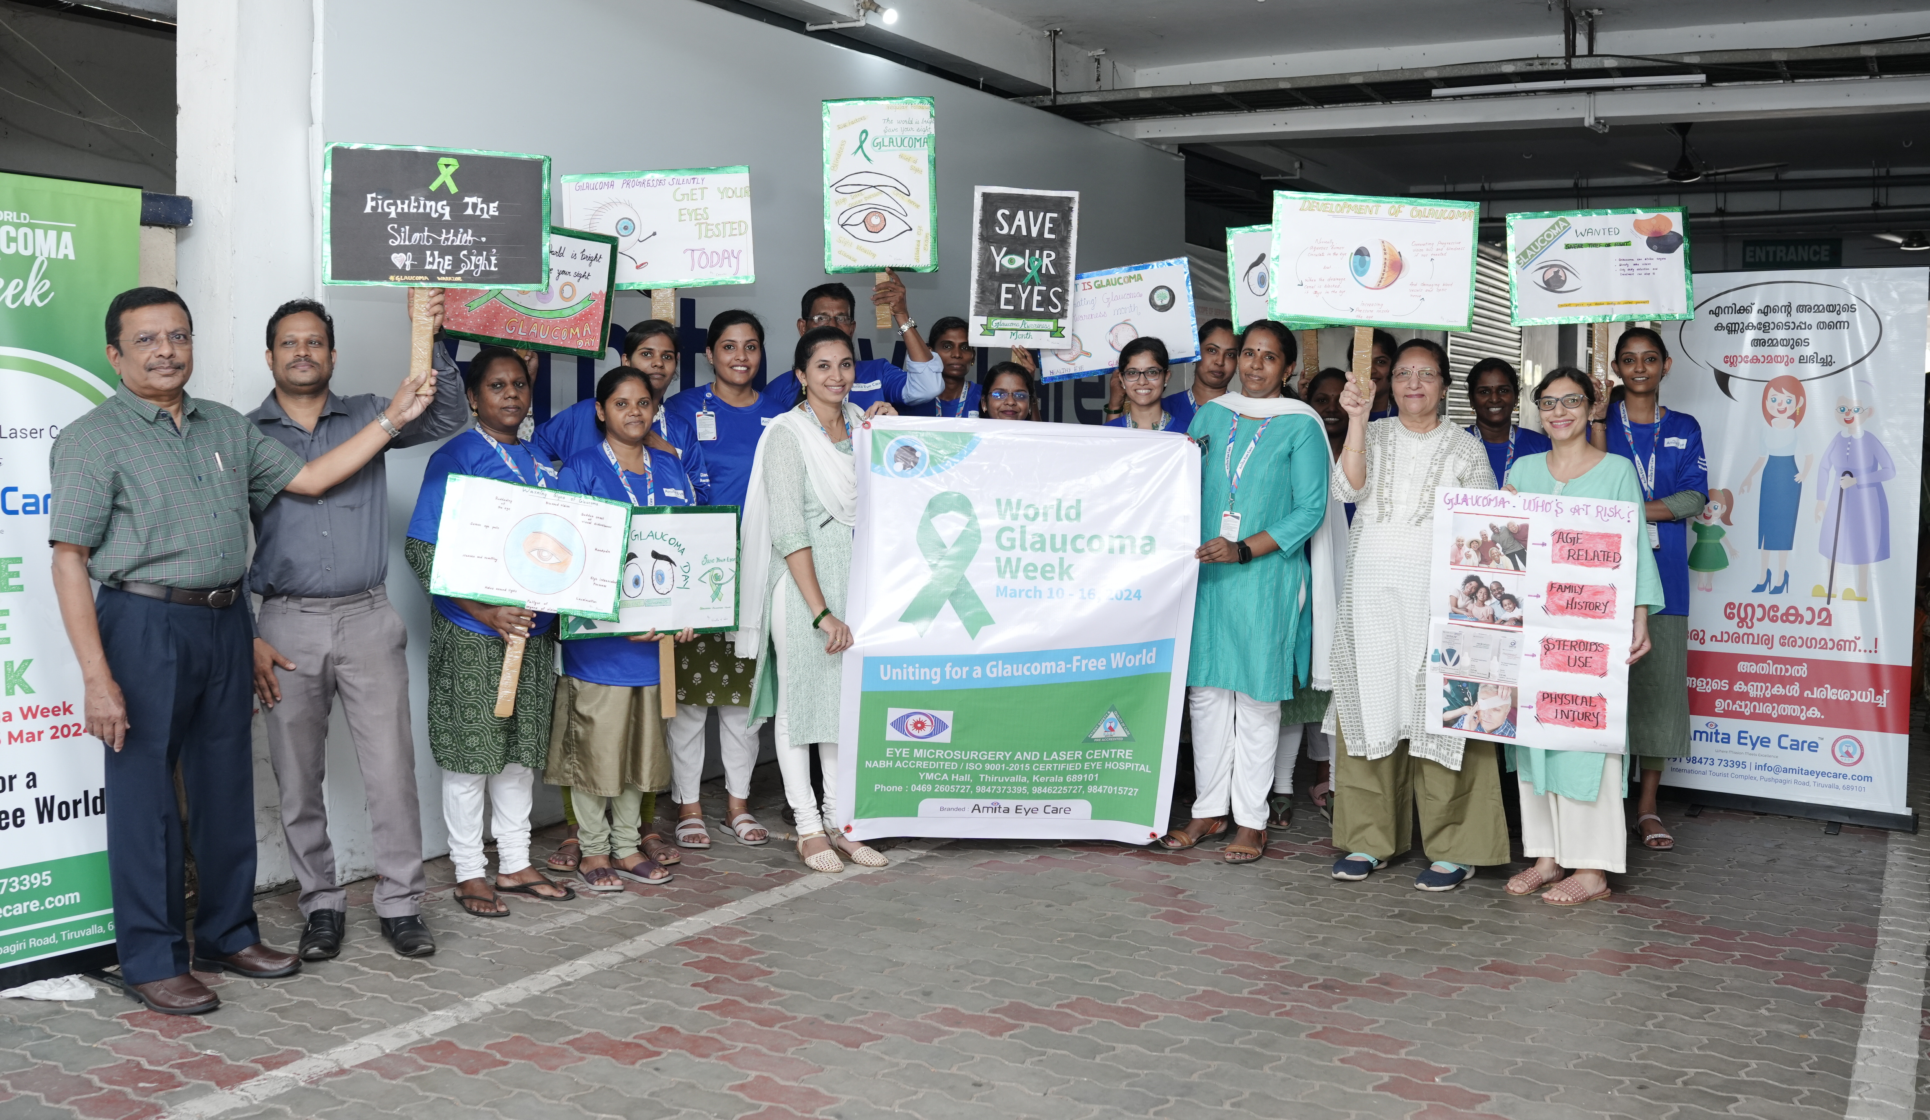
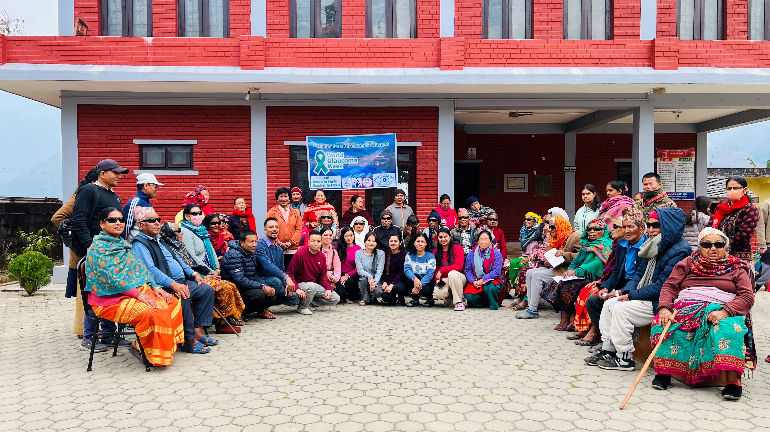
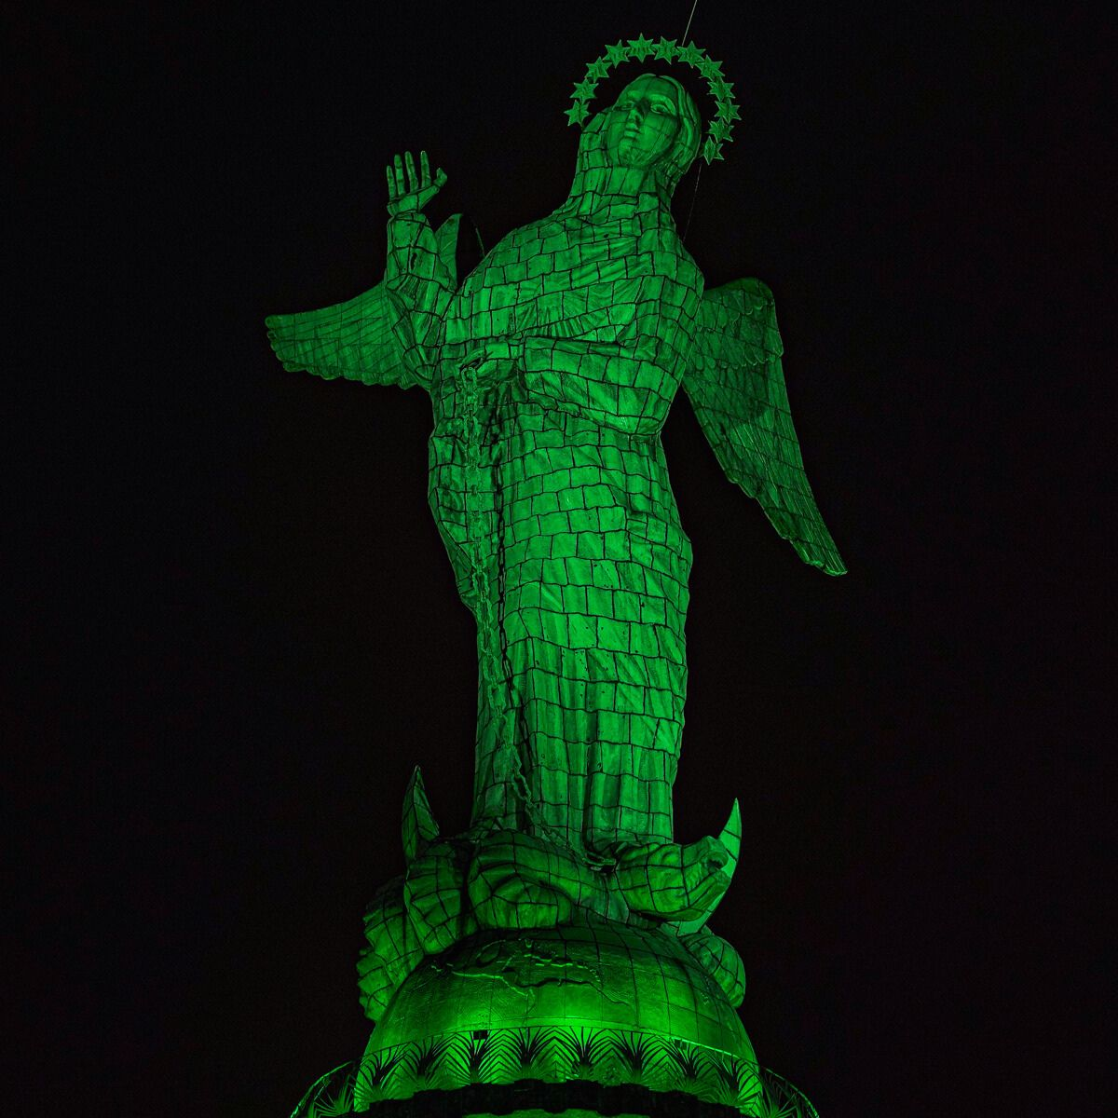
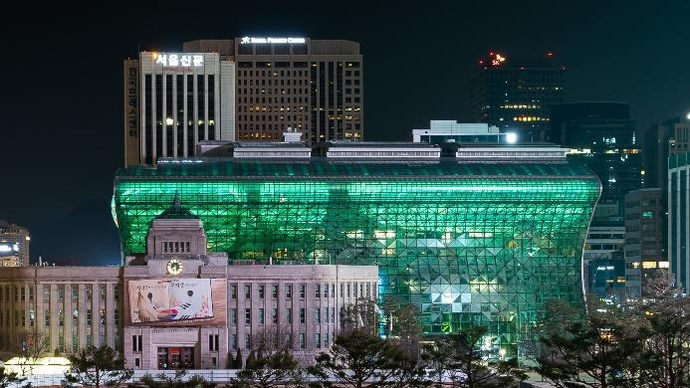
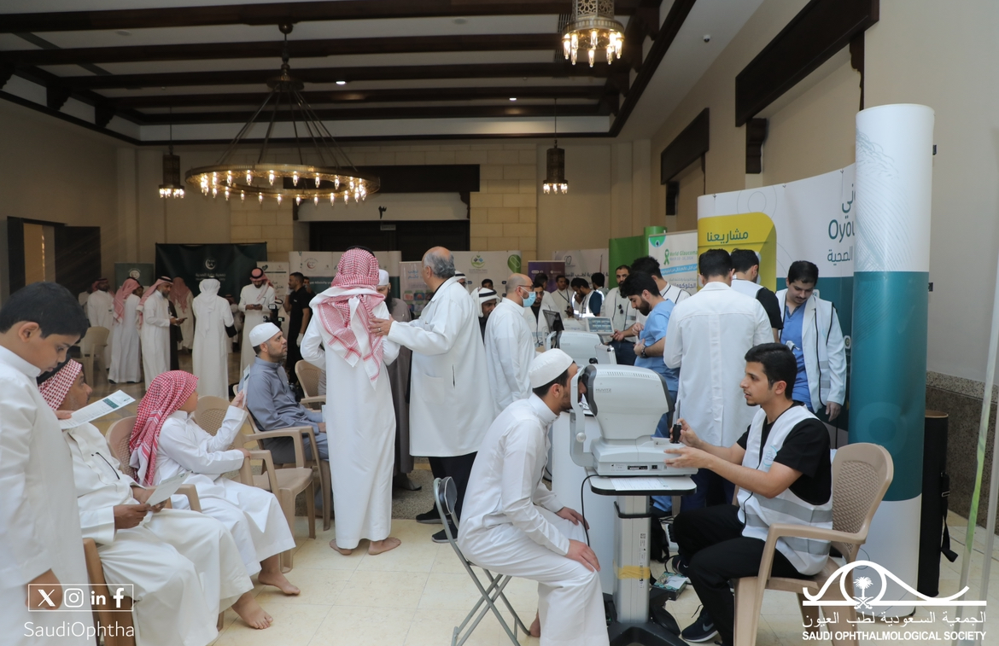
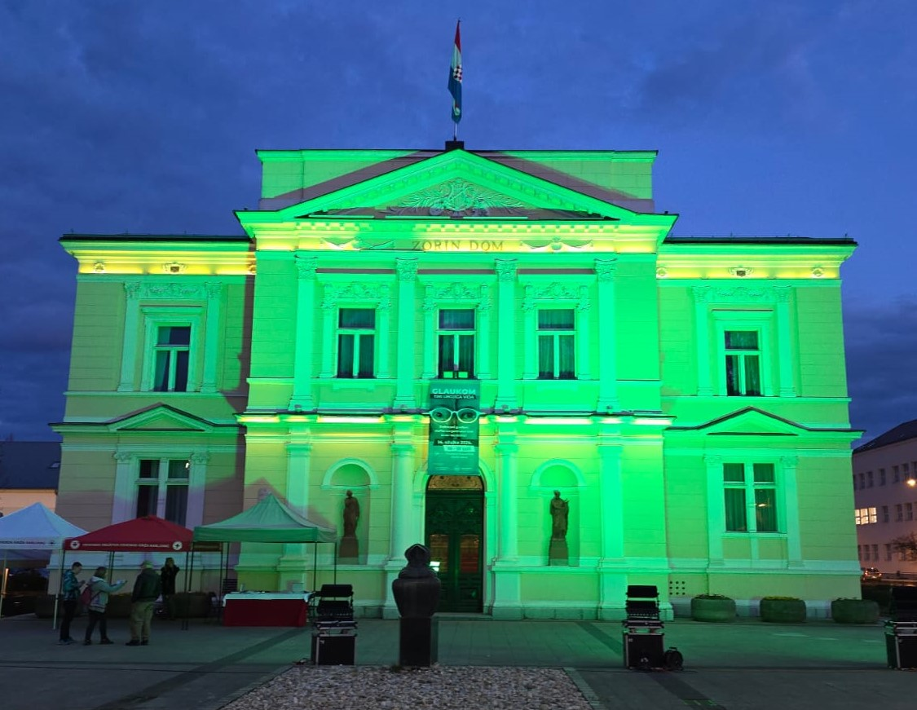
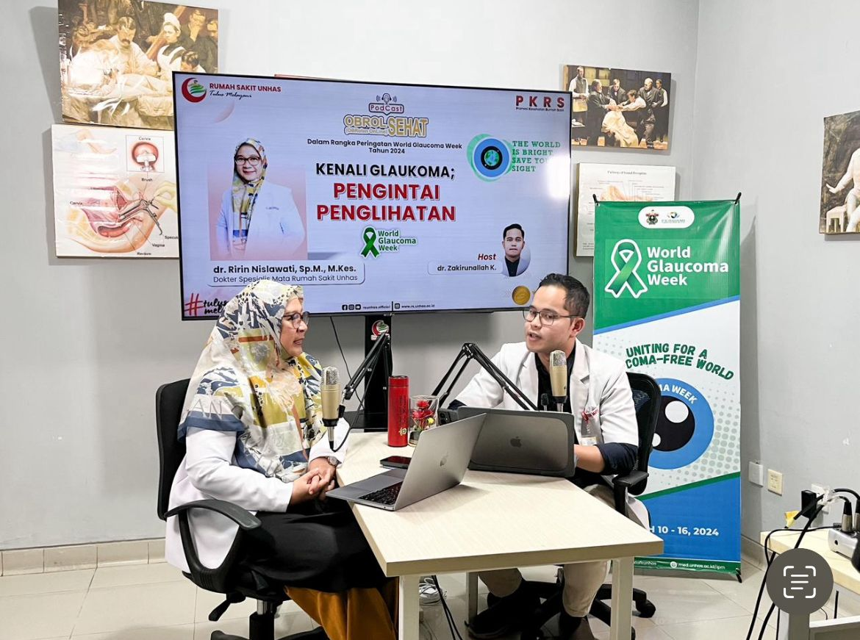
WGW2024 Activities

Slide 10

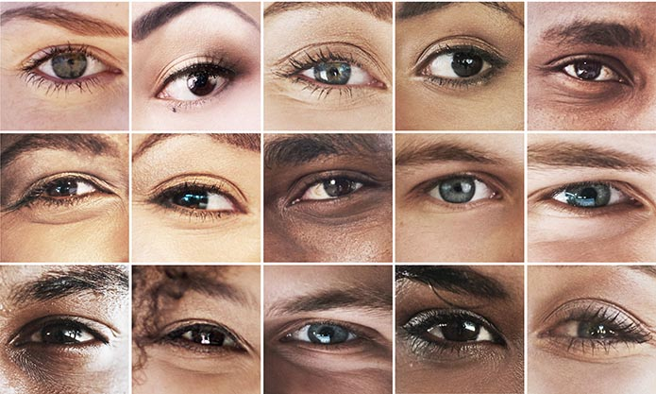

Next edition:
March 9-15, 2025

Slide 11
Finance Committee
“The Finance and Audit Committee will examine the accounts of the Association and shall make a report to the General Assembly, which will be communicated to the Board of Governors one month before the General Assembly convenes”
Proposal – Dissolution of the Finance Committee:
The Treasurer will be involved and be a member of the Audit Committee

Slide 12
Audit Committee
“The General Assembly shall, upon recommendation of the Board of Governors, elect an Audit Committee comprising of two (2) persons who are not necessarily associated with Members of the Association. The Chair should be a person from outside of the Board of Governors. Their term will be of two years, renewable.”
Recommendation – Composition of the Audit Committee:
a Chair
2 members
Treasurer (Arthur Sit)

Slide 13
Investment
World Glaucoma Foundation current assets 3,714,383 USD on 31.13.2023
Plan to invest 2,000,000 USD
Investigated to use Charles Schwab in a shorter safe investment

Slide 14

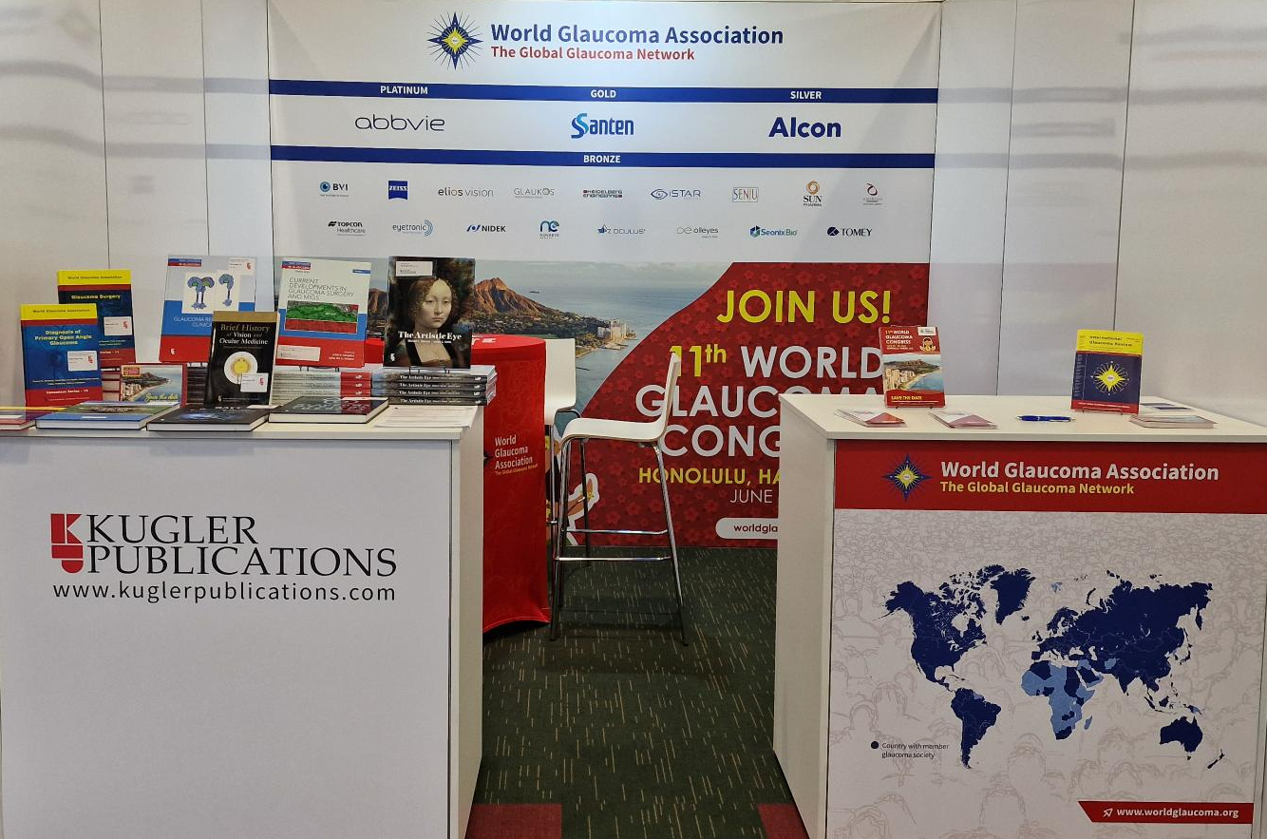
New Silver Industry Member
Bronze Member -> | Silver Member*
$ 8,500.00 | $ 35,000.00
*Confirmed, signed contract to be received.

Slide 15
Global Outreach Committee
Neeru Gupta, MD PhD MBA FRCSC DABO FARVO FCAHS
Chair, Global Outreach Committee

Slide 16

ICO-World Glaucoma Association 3 Month Fellowship Program
Young ophthalmologists from developing countries learn practical skills and broaden their perspectives of ophthalmology and glaucoma
ICO-WGA fellowship program has extended its application to Sub-Saharan Africa and Southeast Asia
In collaboration with

Slide 17
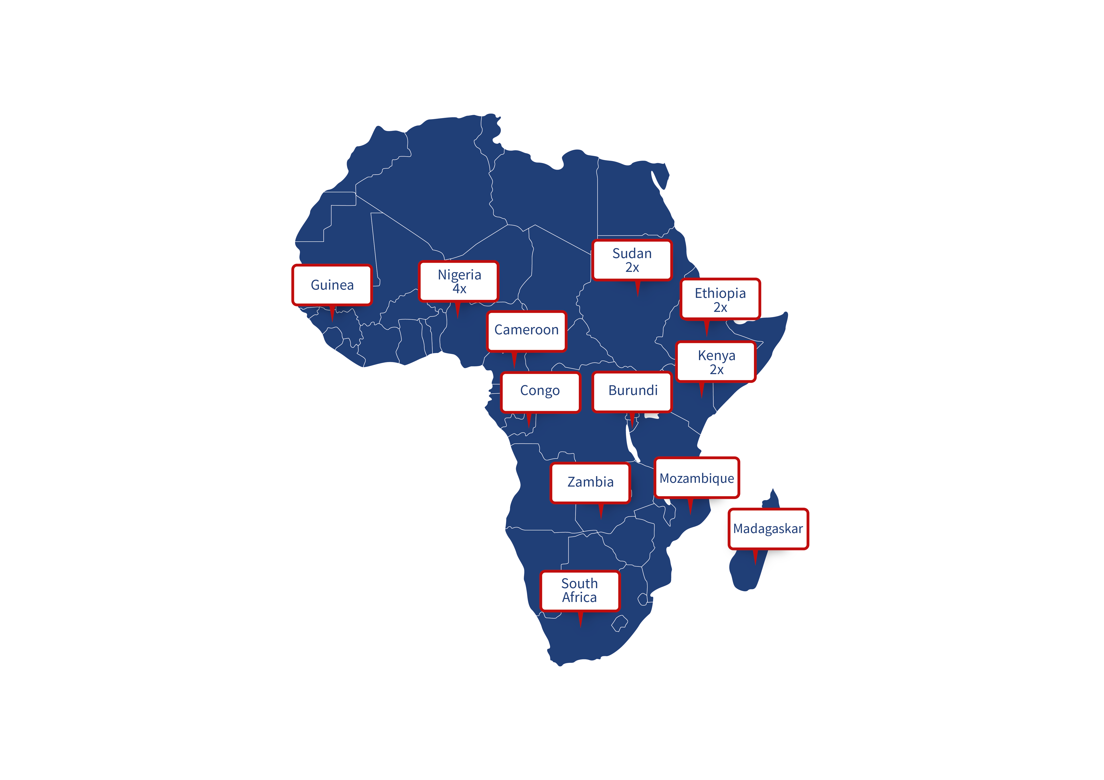
The WGA has supported
18 fellows from
12 countries in Africa
since 2017
10 confirmed Fellows for 2024

Slide 18
ICO-WGA Fellowship 2024
Fellows Name | Country | Host Country
Gifty Adom | Ghana | Phoenix, USA
Grace Nguyo | Kenya | Hyderabad, India
Rana Makki | Sudan | To be confirmed
Ammar Naiem | Sudan | To be confirmed
Habibat Daromosu | Nigeria | To be confirmed
Denis Erima | Uganda | To be confirmed
Nelly Gylene Fopoussi | Cameroon | To be confirmed
Temitope Mariam Gbadegesin | Nigeria | To be confirmed
Kiros Tesfay Berhe | Ethiopia | To be confirmed
Adnan Abdullah Yahya Alghobari | Yemen | To be confirmed

Slide 19
Treasurer & Finance Report
Arthur Sit, MD
Treasurer

Slide 20
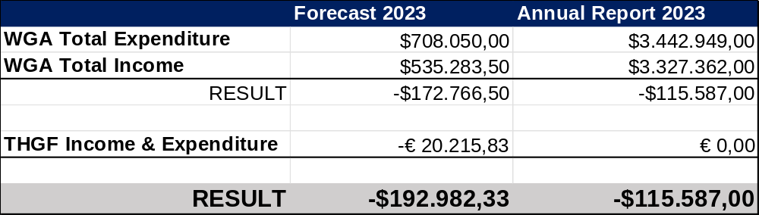
WGA 2023 Report
Notes:
Should this be discussed now?

Slide 21
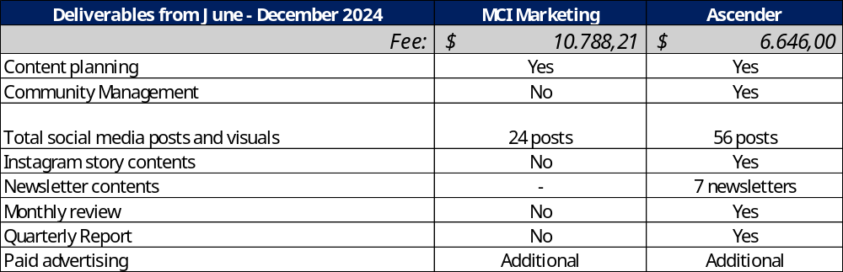
Social Media price comparison

Slide 22


Ascender
MCI Marketing

Slide 23
Education
Pradeep Ramulu, MD
Chair, Education Committee

Slide 24
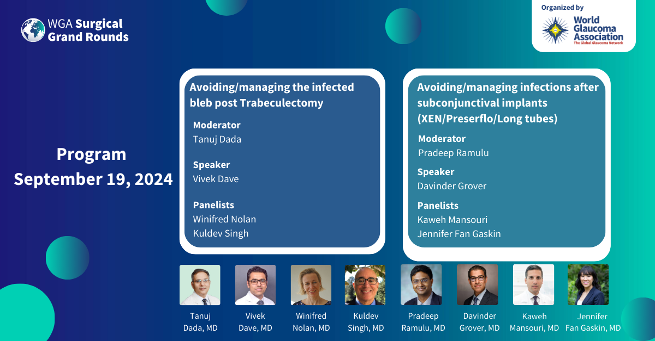
6th Surgical Grand Rounds – September 19, 2024

Slide 25
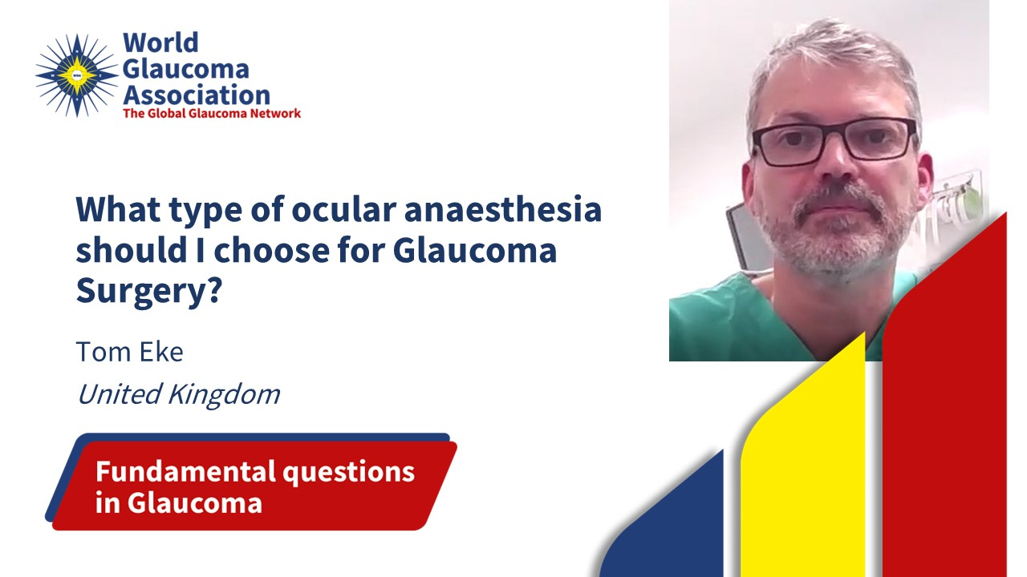
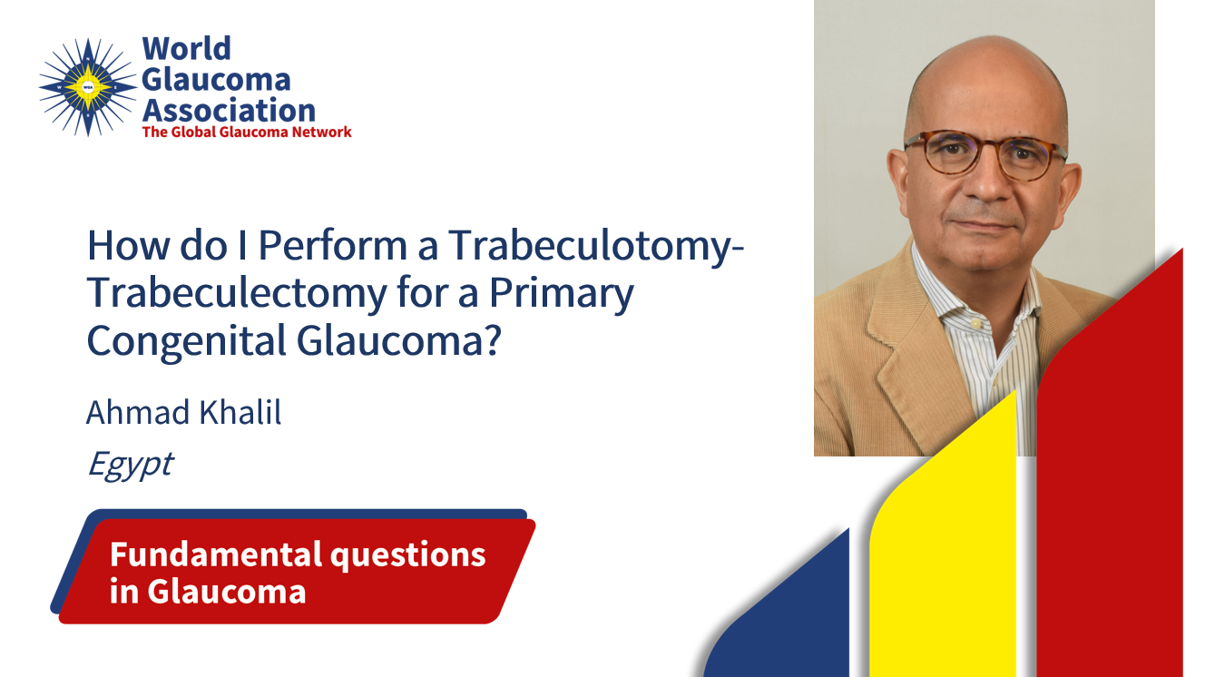
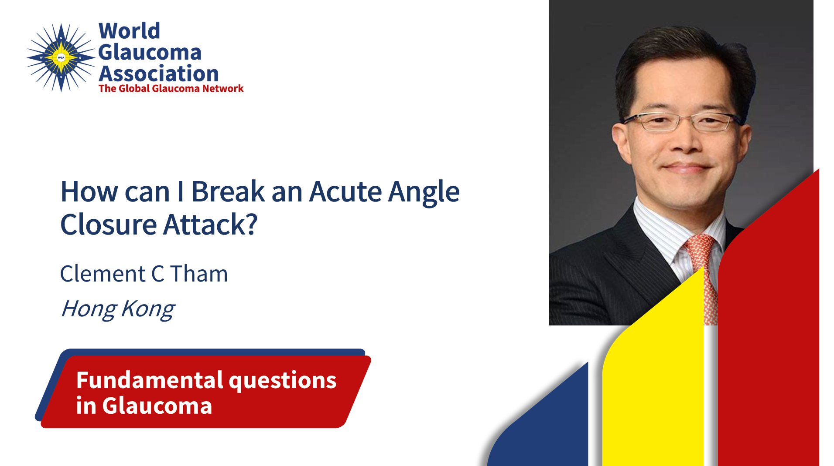
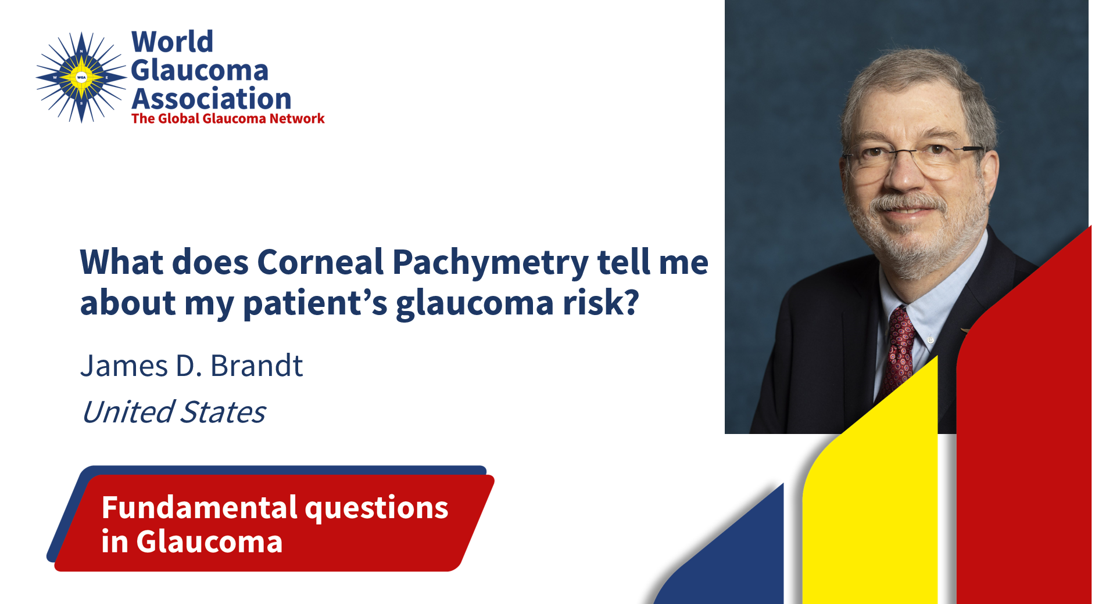
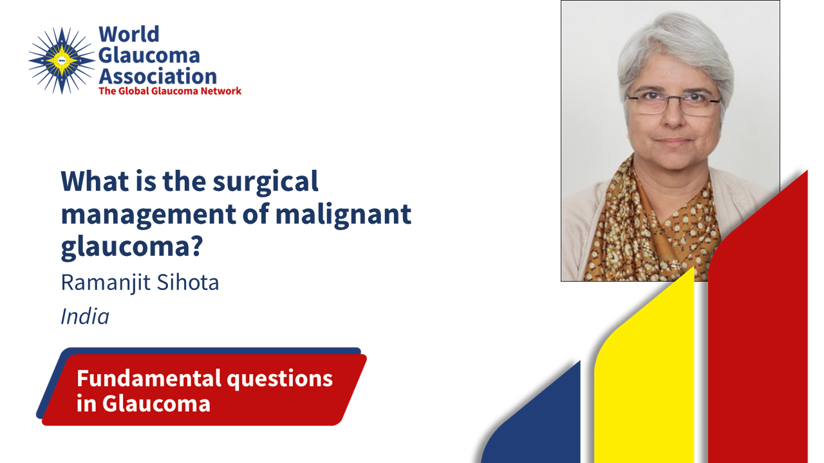
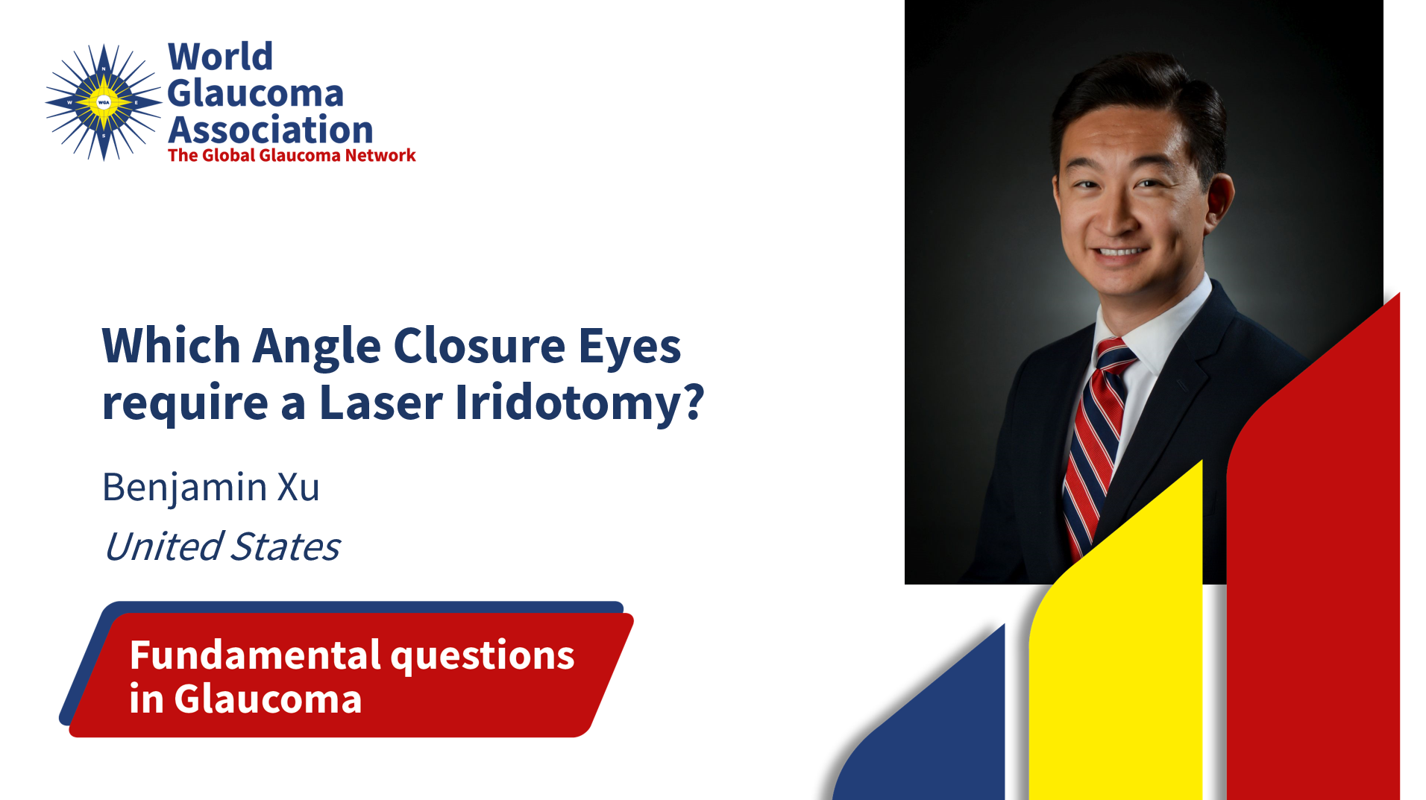
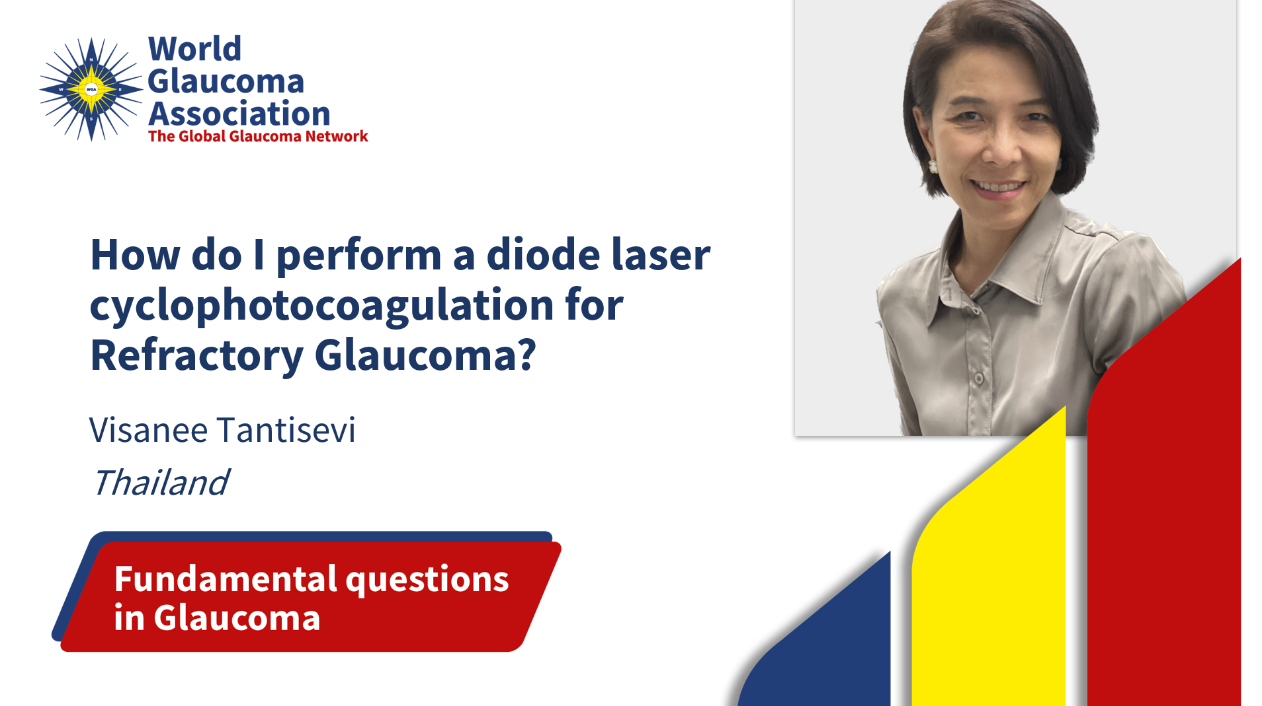


Fundamental Questions in Glaucoma - 2023

Slide 26

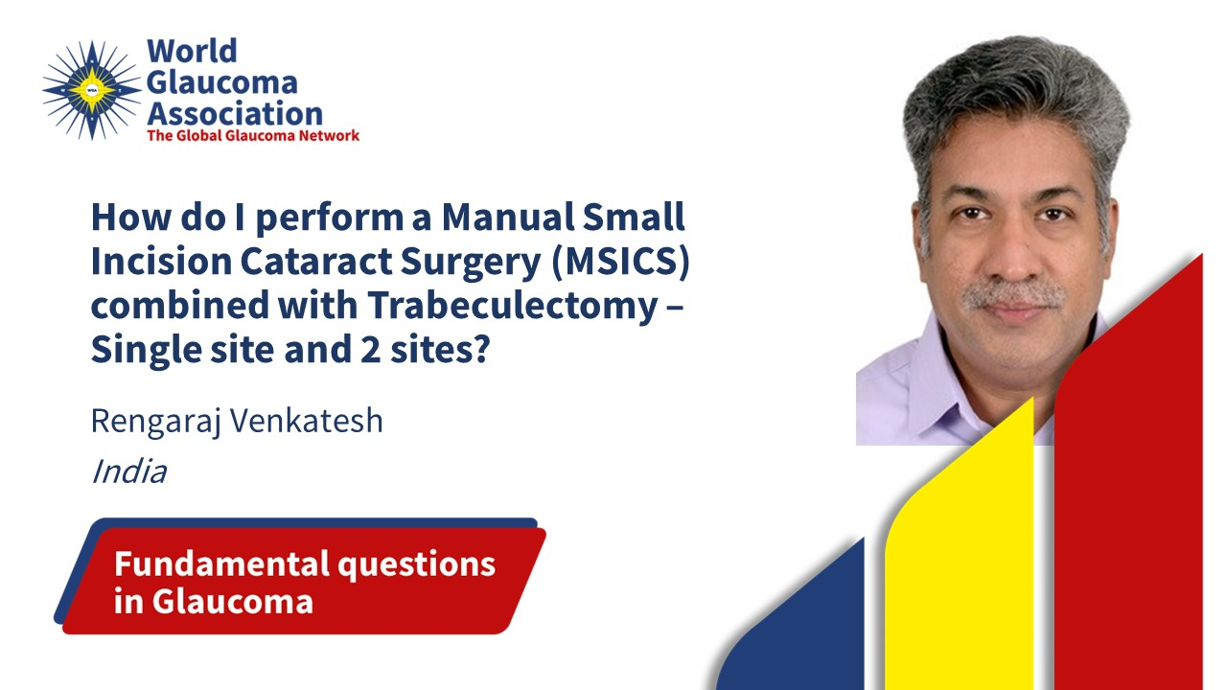
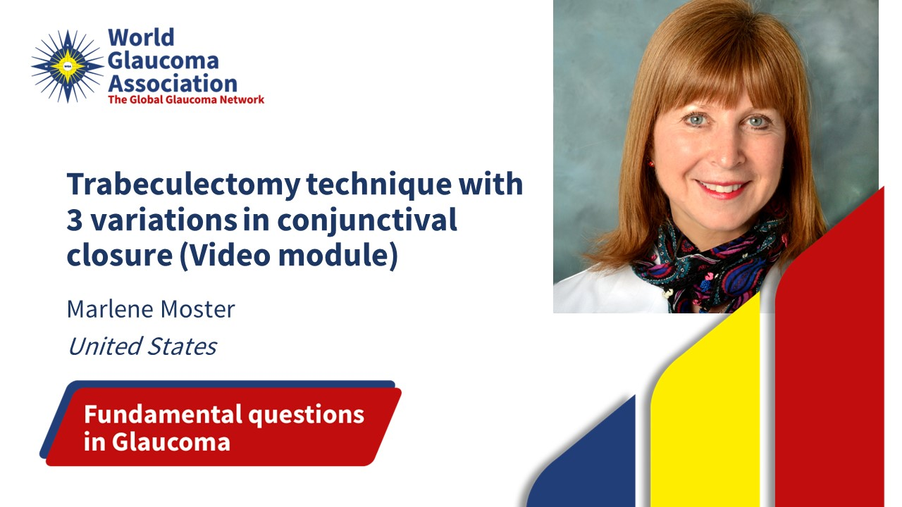

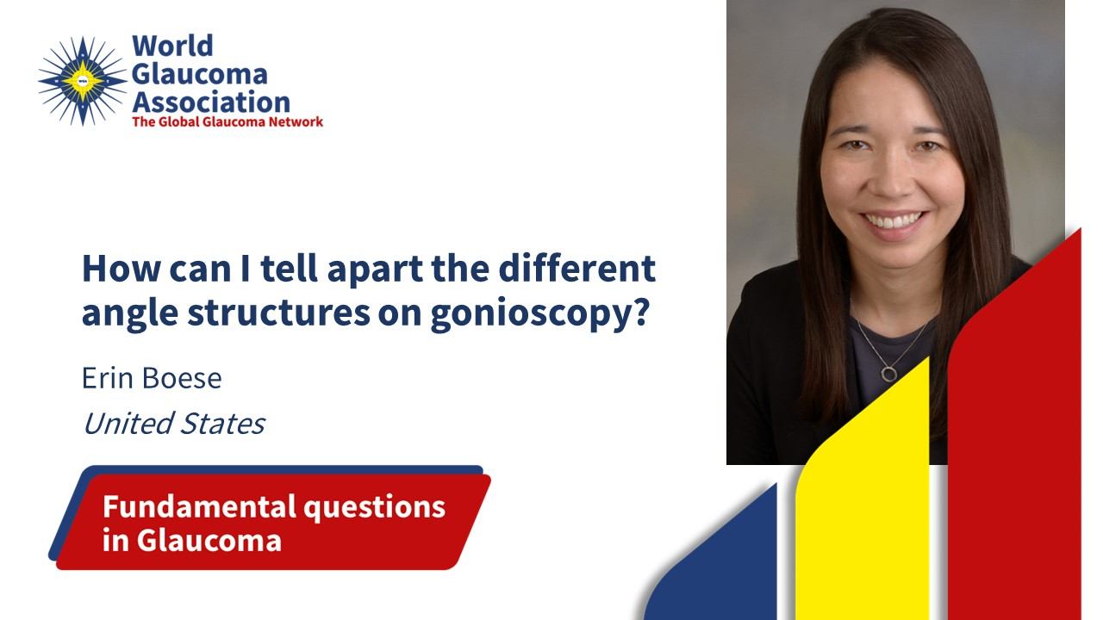

Fundamental Questions in Glaucoma - 2024
…and more topics

Slide 27
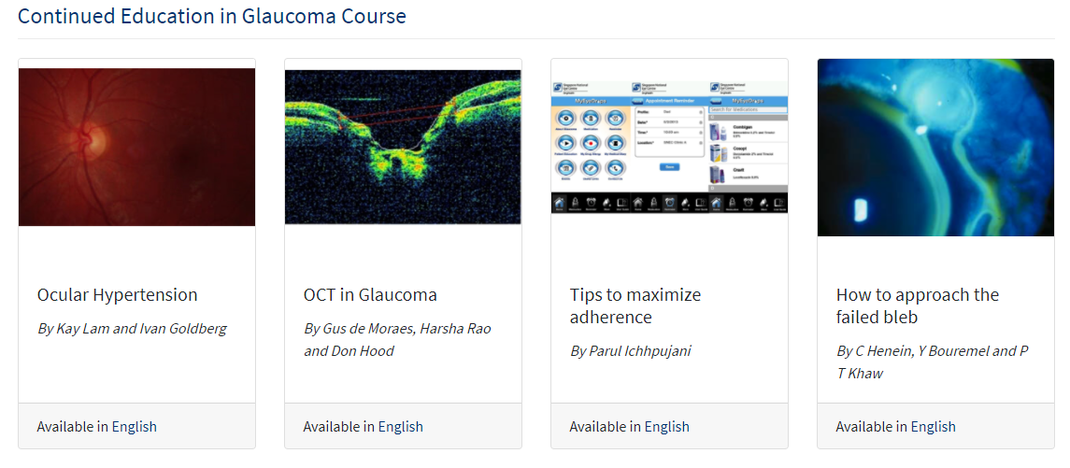
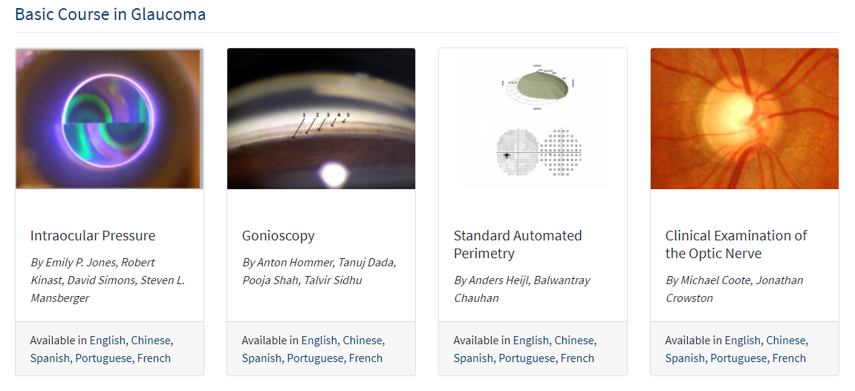
Basic and Continued Courses
All continued modules are available in English. Spanish and Portuguese translation is being developed.

Slide 28
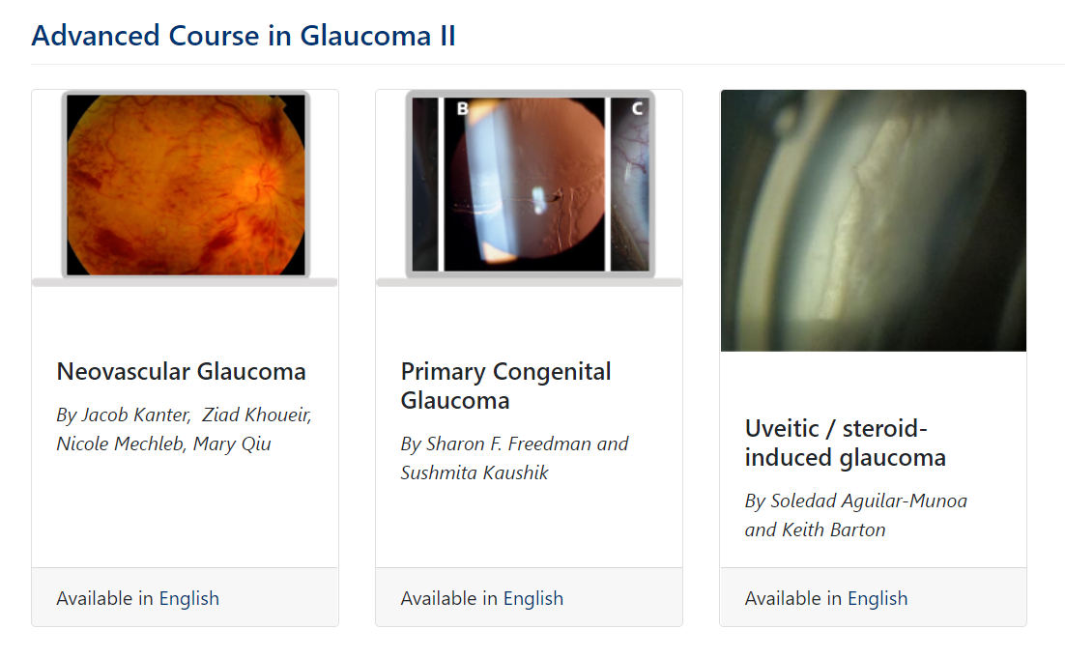
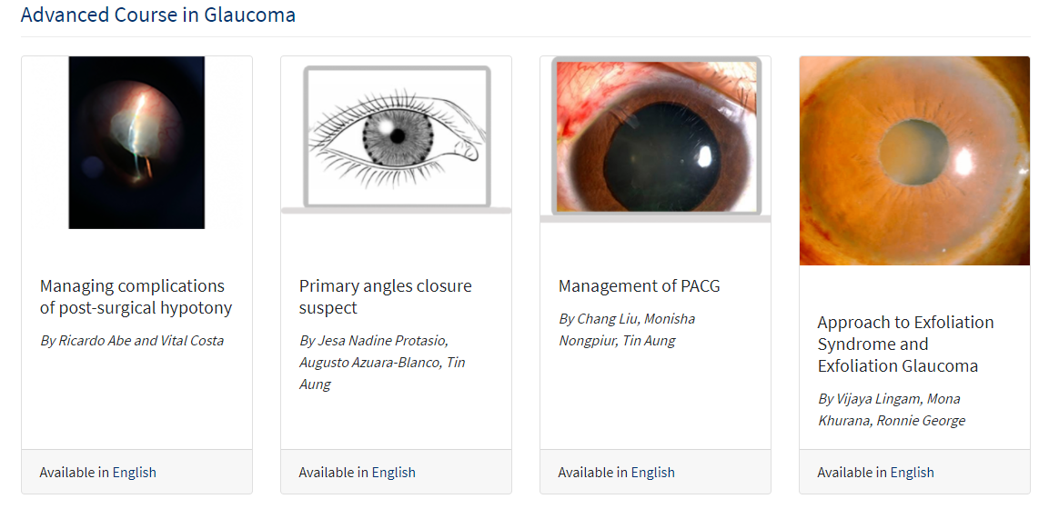
Advanced Course in Glaucoma

Slide 29
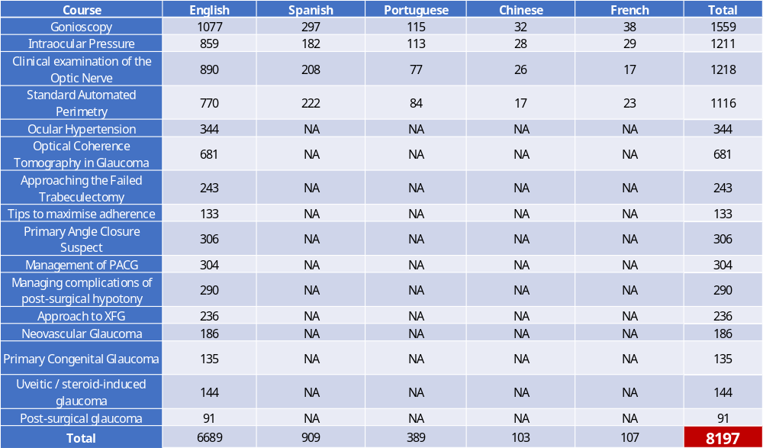
1107 more participants than 2023

Slide 30
International Glaucoma Review
Kaweh Mansouri, MD MPH

Slide 31

WGA Consensus Series 1-11
WGA Consensus Volume 11: Glaucoma Surgery - 2020
edited by: R.N. Weinreb, P. Ramulu, F. Topouzis, K.H. Park, K. Mansouri and S.F. Lerner
WGA Consensus Volume 10: Diagnosis of Primary Open Angle Glaucoma – 2016
edited by: R.N. Weinreb, D.F. Garway-Heath, C. Leung, F.A. Medeiros AND J. Liebmann
WGA Consensus Volume 9: Childhood Glaucoma - 2013
edited by: R.N. Weinreb, A.L. Grajewski, M. Papadopoulos, J. Grigg and S. Freedman
WGA Consensus Volume 8: Progression of Glaucoma - 2011
edited by: R.N. Weinreb, D.F. Garway-Heath, C. Leung, J.G. Crowston and F.A. Medeiros
WGA Consensus Volume 7: Medical Treatment of Glaucoma - 2010
edited by: R.N. Weinreb, M. Araie, R. Susanna Jr, I. Goldberg, C. Migdal and J. Liebmann
WGA Consensus Volume 6: Ocular Blood Flow in Glaucoma - 2009
edited by: R.N. Weinreb and A. Harris
WGA Consensus Volume 5: Glaucoma Screening - 2008
edited by: R.N. Weinreb, P.R. Healey and F. Topouzis
WGA Consensus Volume 4: Intraocular Pressure - 2007
edited by: R.N. Weinreb, J.D. Brandt, D.F. Garway-Heath and F.A. Medeiros
WGA Consensus Volume 3: Angle Closure and Angle Closure Glaucoma - 2006
edited by: R.N. Weinreb and D.S. Friedman
WGA Consensus Volume 2: Glaucoma Surgery - Open Angle Glaucoma - 2005
edited by: R.N. Weinreb and J.G. Crowston
WGA Consensus Volume 1: Glaucoma Diagnosis - Structure and Function - 2004
edited by: R.N. Weinreb and E.L. Greve

Slide 32
ANNOUNCING
WGA Consensus Volume 12
Angle Closure and Angle Closure Glaucoma
Chair
Robert N. Weinreb, MD
La Jolla, CA, USA
Executive co-Chair
Ben Xu MD, PhD
Los Angeles, CA, USA
co-Chairs
Tin Aung, MD, PhD
Singapore
Paul Foster, , MD, PhD
London, UK
David Friedman, MD, PhD
Boston, MA, USA
Xiulan Zhang, MD, PhD
Guangzhou, P.R. China

Slide 33


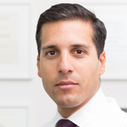
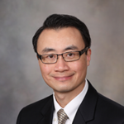
International Glaucoma Review
Official Journal of the World Glaucoma Association - Since 1999
Chief Editor
Contributing Editors
Christopher Leung (HK)
Kaweh Mansouri (CH)
Arthur Sit (US)
Robert N. Weinreb (US)
Published by Kugler Publications on behalf of the World Glaucoma Association.

Slide 34
What Makes IGR Unique?
IGR provides a reliable Glaucoma literature overview and critical review, which is a huge time saver to stay on top of the most significant glaucoma developments. IGR’s 4-level system for glaucoma literature works as follows:
1. More than 3,500+ glaucoma abstracts will be added to the IGR abstract database annually
2. The Editors Selection provides the most interesting & relevant abstracts with expert comments
3. Highlights are selected from the “Editors Selection”
4. News flashes provide the reader with super selected one liners
IGR production statistics
The average number of publications in Glaucoma is rapidly growing. IGR process 5-times more abstracts since 1999.
IGR database holds over 48,000 searchable and categorized abstracts.
Of these abstracts, more than 2,500 are commented on by 700+ international experts.

Slide 35
IGR Readership
Issues are distributed free of charge to all individual members of the 91 WGA affiliated glaucoma societies worldwide, representing over 20,000 glaucoma specialists.

Slide 36

Advertisements
IGR offers many advertisement opportunities , contact WGA Executive Office at info@worldglaucoma.org and obtain the IGR Media Kit 2024 for more information.

Slide 37
Journal of Glaucoma
Neeru Gupta, MD PhD MBA FRCSC DABO FARVO FCAHS
Chief Editor

Slide 38
Kaweh Mansouri, MD MPH
Executive Vice President

Slide 39


Slide 40
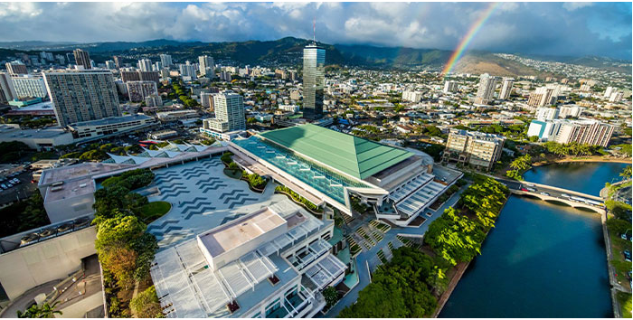
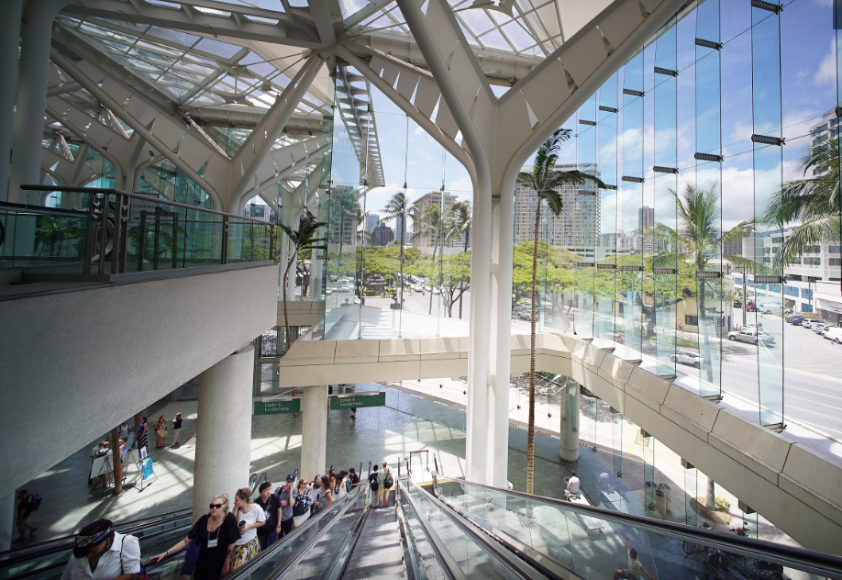
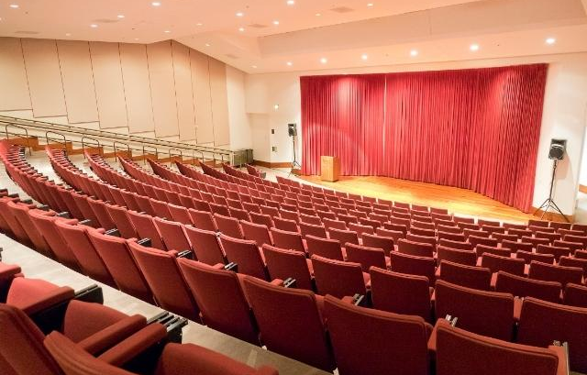
11th World Glaucoma Congress
SAVE THE DATE & JOIN US!
Dates: June 25-28, 2025
Venue: Hawaii Convention Center (HCC)
Registration and Abstract submission will open in September.
www.worldglaucomacongress.org.

Slide 41
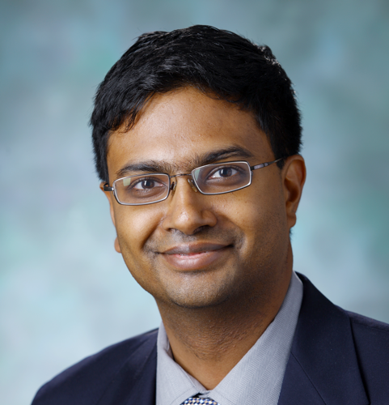

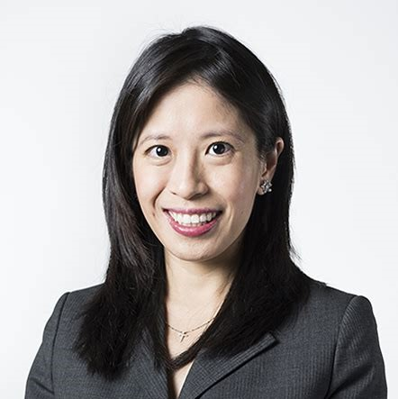
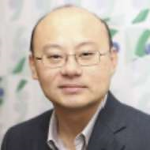
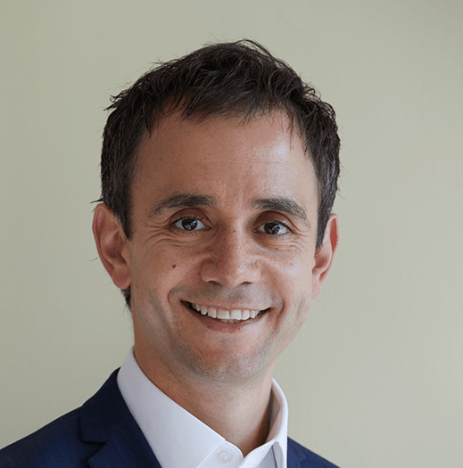
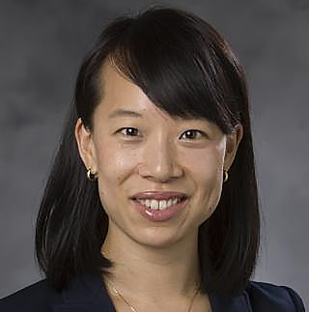
WGC-2025 Program Planning Committee
CO-CHAIR
CO-CHAIR
Pradeep Ramulu
USA
Tanuj Dada
India
VICE CHAIR
VICE CHAIR
VICE CHAIR
VICE CHAIR
Chelvin Sng
Singapore
Lisandro Sakata
Brazil
Anthony Khawaja
UK
Yvonne Ou
USA
Surgery
Clinical
Genetics
Basic Science

Slide 42
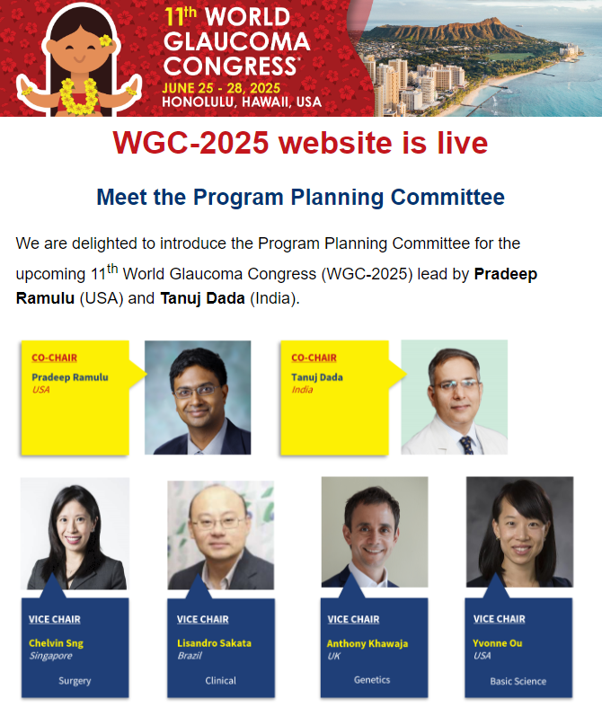

WGC-2025: Website and save the date
(The WGC 2025 website is up and running and safe the date have also been sent out)

Slide 43
Hawaii Entry Requirement | VISA to the United States
We strongly advise that if you require a VISA to enter the United States, you begin the process as soon as possible.
More information about VISA application

Slide 44
WGC-2027: Abu Dhabi
Suggested date: 21 – 24 April 2027
Venue: Abu Dhabi National Exhibition Centre (ADNEC) – 20 minutes away from the International Airport
Host: Emirates Society of Ophthalmology (want to become a WGA member first need to start a Glaucoma chapter)
Hotels: 2 Hotels connected to the congress venue and 4 within 3 min walking distance
Possible venues for President's dinner: Emirates Hotel, Fairmont, Ritz Carlton
Possible venues for Congress dinner: Sea World, Warner Bros and Yes Links

Slide 45
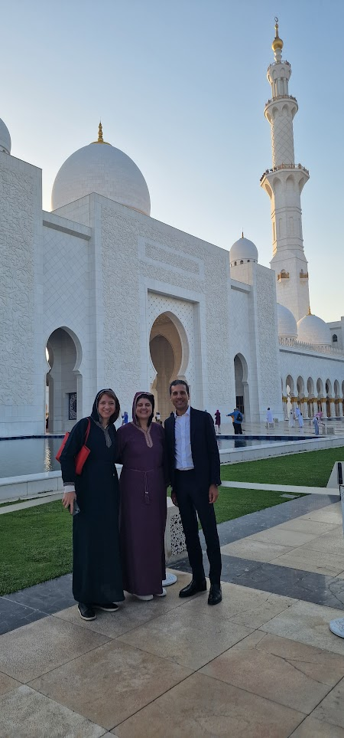
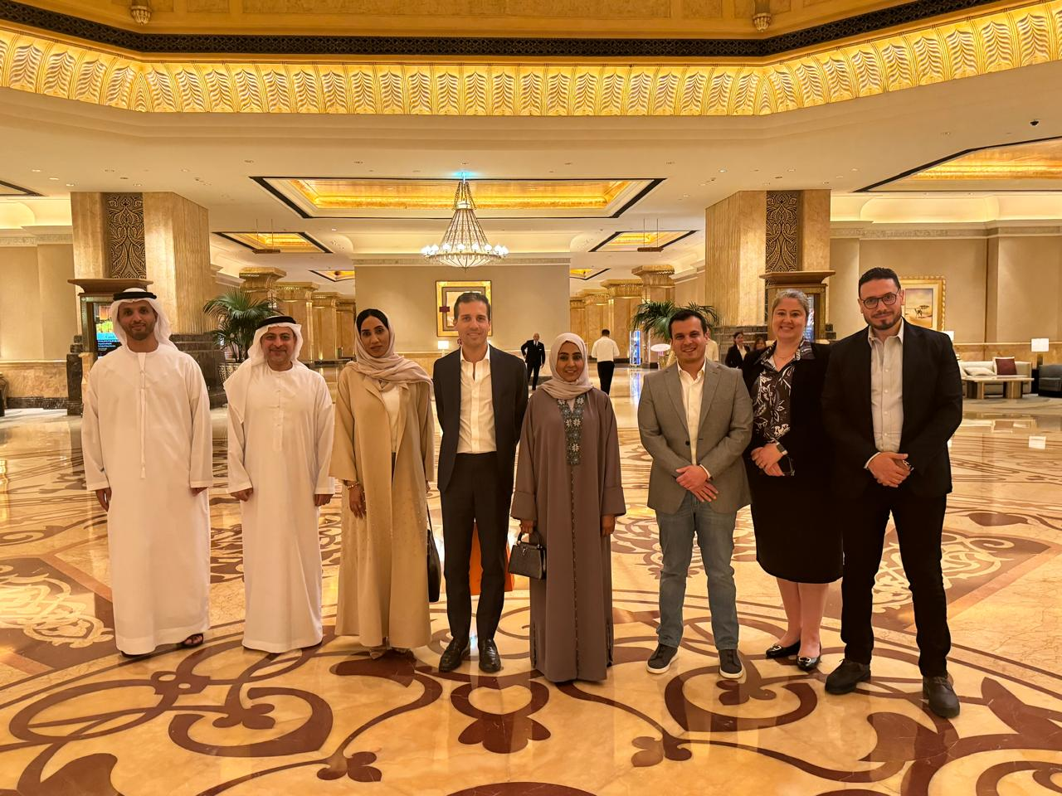
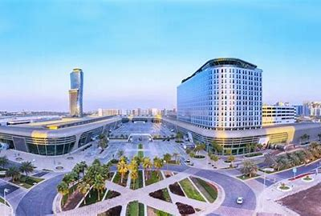

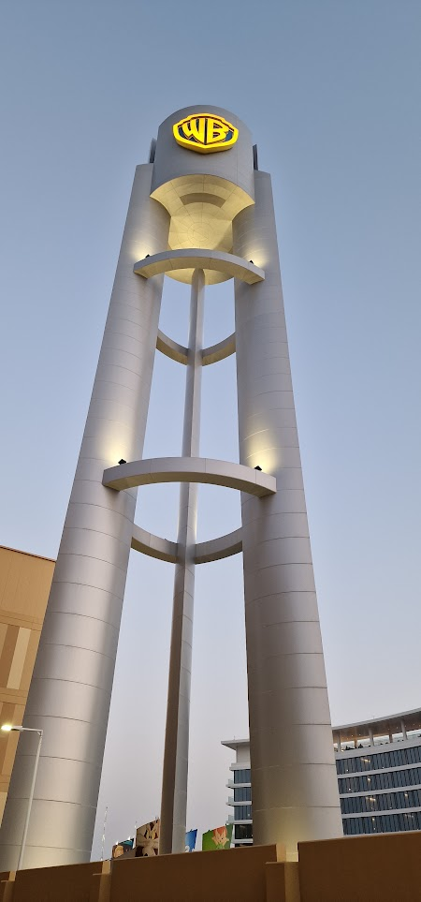

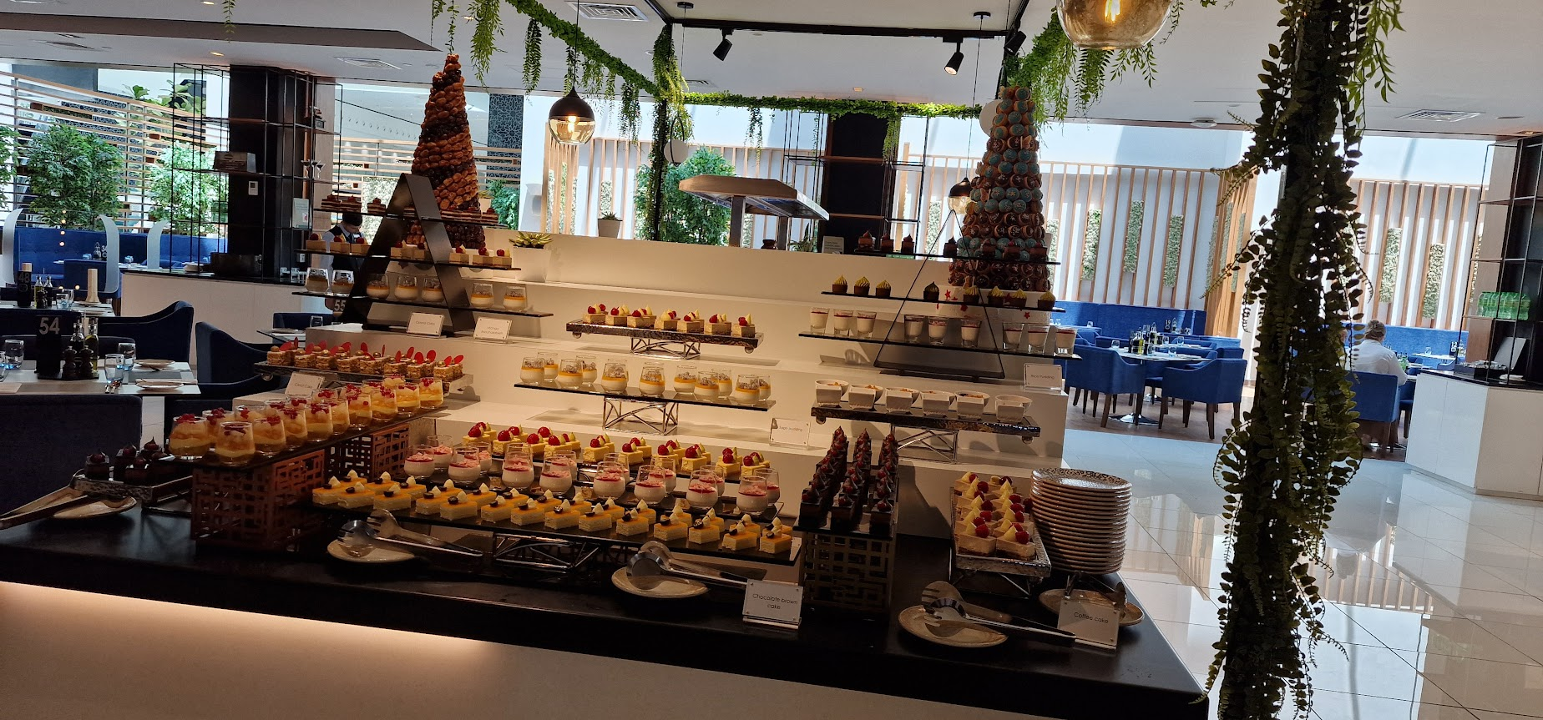
WGC-2027: Abu Dhabi (Site visit April 2024)

Slide 46
WGC-2027: Seoul
Suggested date: 7-10 July (rainy season)/ Alternative date suggested 20-25 September 2027 (conflict with ESCRS)
Venue: Coex Convention and Exhibition Center – 60 – 80 min from 2x international airports
Host: Korean Glaucoma Society
Hotels: many hotels within walking distance
Possible venues for President's dinner: TBA
Possible venues for Congress dinner: TBA

Slide 47
WGC-2027: Kyoto (Japan)
Japan- 2 bids Kyoto and Yokohama still requesting more information from them. The price difference very big between the two cities Yokohama is 270k more expensive
Suggested date: 7-10 April 2027 (when hosting in April no subsidies will be given) or 30 – 3 July
Venue: Kyoto International Conference Center – 75 minutes by train from the International airport
Host: Japanese Glaucoma Society
Hotels: The Prince Kyoto Takaragaike – within walking distance and 7 hotels within 20 min range from the venue
Possible venues for President's dinner: TBA
Possible venues for Congress dinner: Kyoto City Kyocera, Museum of Art or Daigoio Temple

Slide 48
WGC-2027: Yokohama (Japan)
Japan- 2 bids Kyoto and Yokohama still requesting more information from them. The price difference very big between the two cities Yokohama is 270k more expensive
Suggested date: 9 – 14 March 2027
Venue: Pacifico Yokohama – 30 min from Narita Airport
Host: Japanese Glaucoma Society
Hotels: Intercontinental Grand Yokohama is linked to the venue, many hotels within walking distance
Possible venues for President's dinner: TBA
Possible venues for Congress dinner: Osanbashi Hall, Marine Tower Yokohana and Sankeien Garden Kakushokaku

Slide 49
WGC-2027: Bahrain
Suggested date: March 2027 (no specific date) or September – February also option
Venue: Exibition World Bahrain– 30 min from Bahrain International Airport
Host: no local Society (supported by Local doctors)
Hotels: all hotels within 30 min driving. No hotels within walking distance
Possible venues for President's dinner: TBA
Possible venues for Congress dinner: TBA

Slide 50
WGC-2027
Any other suggestions?

Slide 51
Next Board Meeting
TBA October - Online

Slide 52
Thank you

