Slide 1


Executive Committee
Saturday, August 17, 2024

Slide 2
Welcome
Ningli Wang, MD PhD
President

Slide 3
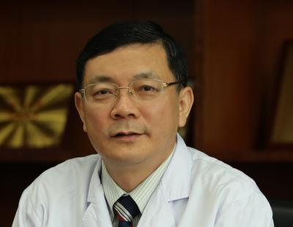
Professor Xuyang Liu – Associate EVP WGA
Doctor of Xiamen Eye Center
Vice Chairman, Chinese Glaucoma Society
Committee Member, Ophthalmology Branch of Chinese Medical Association
Former Chairman, Ophthalmologists Association of Shenzhen Medical Association

Slide 4
Kaweh Mansouri, MD MPH
Executive Vice President

Slide 5
Board of Governors nominations
“If the number of Governors decreases to less than 11 between General Assembly meetings, the Nominating Committee shall solicit nominations in the usual fashion to be approved by the General Assembly by electronic balloting. Nomination and election of Governors may occur annually.”

Slide 6
Overview of Current Governors
First Name | Last Name | Country | Appointment | Start of Term | End of Term | Term Duration
Tanuj | Dada | India | 1st Term | 01/01/2024 | 31/12/2026 | 3 years
Miriam | Kolko | Denmark | 1st Term | 01/01/2024 | 31/12/2026 | 3 years
Marcelo | Hatanaka | Brazil | 1st Term | 01/01/2024 | 31/12/2026 | 3 years
Jesus | Jimenez-Roman | Mexico | 1st Term | 01/01/2024 | 31/12/2026 | 3 years
Nkiru | Kizor - Akaraiwe | Nigeria | 2nd term | 01/01/2020 | 31/12/2025 | 3 years
Pradeep | Ramulu | USA | 2nd term | 01/01/2020 | 31/12/2025 | 3 years
Xinghuai | Sun | China | 2nd term | 01/01/2020 | 31/12/2025 | 3 years
Makoto | Aihara | Japan | 1st term | 01/01/2022 | 31/12/2024 | 3 years
Winnie | Nolan | United Kingdom | 1st term | 01/01/2022 | 31/12/2024 | 3 years

Slide 7
Appointment process Board of Governors
“The Nominating Committee shall solicit nominations from the General Assembly, the Board of Governors for Governors, and the Executive Committee to be approved by the General Assembly.
Candidates for the Board of Governors should be familiar with the Association, have contributed to it actively, and have a strong track record in glaucoma research and teaching. The Nominating Committee shall nominate the officers of the organization apart from the Past-President and the Past-Past-President, to be approved by majority vote of the Board of Governors.
No member of the Nominating Committee shall nominate more than two candidates for the Board of Governors. The nominations shall be certified by the President, the Executive Vice-President, and the Associate Executive Vice-President who shall send written notice of the nominations to the Board of Governors at least sixty (60) days prior to the meeting at which such officers and committee members are to be elected.”

Slide 8
Recommendation for Election of new Governors
Recommendation – Election for new Governors:
Elect three (3) new Governors for the Board of Governors
Elect a President Elect
Notes:
Regulations:
'perform all powers, duties and responsibilities usually incident to the Office of Treasurer; and be the chair of the Finance and Audit Committee.’
Statutes:
'The Chair should be a person from outside of the Board of Governors. Their term will be of two years, renewable.'

Slide 9
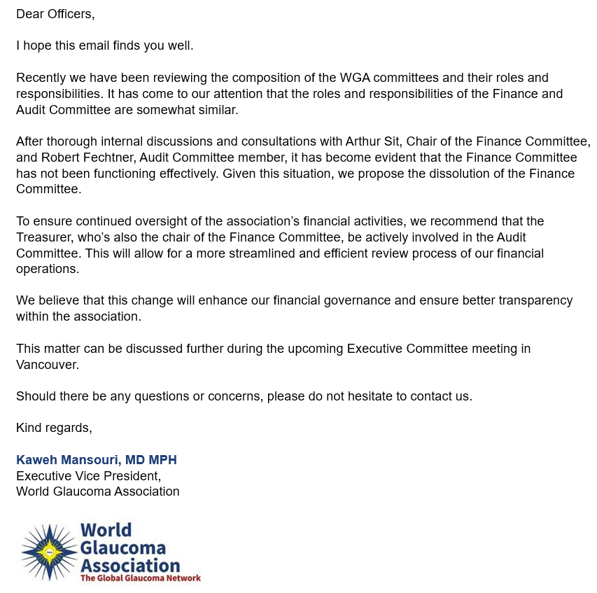
Finance Committee
“The Finance and Audit Committee will examine the accounts of the Association and shall make a report to the General Assembly, which will be communicated to the Board of Governors one month before the General Assembly convenes”

Slide 10
Overview of Current Finance Committee Members
First Name | Last Name | Country | Appointment | Start of Term
Arthur | Sit | USA | Chair | 01/06/2017
Keith | Martin | Australia | Co-Chair | 01/01/2015
Paul | Healey | Australia | Member | 01/01/2015
Kaweh | Mansouri | Switzerland | Member | 01/01/2015
Clement Cy | Tham | China (HK) | Member | 01/06/2017
To ensure WGA remains financially secure, effective, and appropriate
To develop investment strategy
To develop a comprehensive budget

Slide 11
Vote for Dissolution of the Committee
Proposal – Dissolution of the Finance Committee:
The Treasurer will be involved and be a member of the Audit Committee
Notes:
Regulations:
'perform all powers, duties and responsibilities usually incident to the Office of Treasurer; and be the chair of the Finance and Audit Committee.’
Statutes:
'The Chair should be a person from outside of the Board of Governors. Their term will be of two years, renewable.'

Slide 12

Audit Committee
“The General Assembly shall, upon recommendation of the Board of Governors, elect an Audit Committee comprising of two (2) persons who are not necessarily associated with Members of the Association. The Chair should be a person from outside of the Board of Governors. Their term will be of two years, renewable.”

Slide 13
Overview of Current Audit Committee Members
First Name | Last Name | Country | Appointment | Start of Term | End of Term | End of Term explanation
Anja | Tuulonen | Finland | Member | 01/06/2017 | 06/02/2024 | Decided to step down prior to end of term
Robert | Fechtner | USA | Member | 01/01/2015 | - | -
Tanuj | Dada | India | Chair | 01/01/2015 | 01/01/2024 | Appointed as Governor in the Board of Governors
To maintain the oversight of WGA’s accounting, and financial reporting process
To maintain the oversight of WGA’s risk identification, assessment and management program
To maintain the oversight of WGA’s compliance with applicable legal and regulatory requirements

Slide 14
Appointment process Audit Committee members
“The General Assembly shall, upon recommendation of the Board of Governors, elect a Finance and Audit committee comprising of two (2) persons who are not necessarily associated with Members of the Association. The Chair should be a person from outside of the Board of Governors. Their term will be of two years, renewable.”
Recommendation – Composition of the Audit Committee:
a Chair
2 members
Treasurer (Arthur Sit)

Slide 15
Investment
World Glaucoma Foundation current assets 3,714,383 USD on 31.13.2023
Plan to invest 2,000,000 USD
Investigated to use Charles Schwab in a shorter safe investment

Slide 16
Investment Policy
1. Purpose
The purpose of this Investment Policy is to establish guidelines for managing the investment funds of The World Glaucoma Association (WGA). The primary objectives of the investment funds are to generate returns to support the month-to-month expenses of WGA and to invest in committee activities.
2. Scope
This policy applies to all investment activities carried out by WGA.
3. Investment Objectives
To achieve a stable and reasonable rate of return on investments.
To ensure sufficient liquidity to meet the month-to-month operational expenses.
To align investment activities with the goals and mission of WGA.
4. Investment Authority
The WGA Foundation Board holds the authority to oversee and make decisions regarding investment activities. All investment documents and decisions require the approval and signature of the WGA Foundation Board.
5. Investment Strategy
The investment strategy will be conservative, prioritising capital preservation and liquidity.
Investments may include but are not limited to bonds, fixed deposits, and other low-risk financial instruments.
The investment portfolio will be diversified to minimise risks.
6. Monitoring and Reporting
The investment portfolio will be monitored on a quarterly basis to ensure alignment with the investment objectives.
A report of the investment performance will be presented to the WGA Foundation Board during the quarterly meetings.
7. Amendments
This policy may be amended by the WGA Foundation Board and Executive Committee as necessary to ensure it remains aligned with the association's objectives and financial needs.

Slide 17
Commercial Register
Timeline | Steps taken by the Executive Office
Beginning 2022 | The new WGA Executive Committee member should have been updated into the Zug Register of Commerce
End of 2022 | Resignation letter of Drs. Paul Healey and Tin Aung, Power of Attorney letter for current WGA President at the time were submitted to grant joint signature rights.
2023 | The Commercial Register submission was declined by the Swiss Authority due to incomplete required documents. The former lawyer was unresponsive and no progress on the Commercial Register.
End of 2023 - present | The new lawyer has direct contact with the case manager at the Commercial Register to grant the current WGA President and Treasurer joint signature rights. Once all documents received from all parties, the application will be resubmitted.

Slide 18


Slide 19
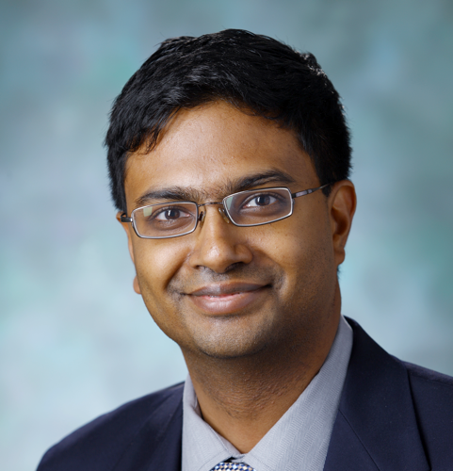

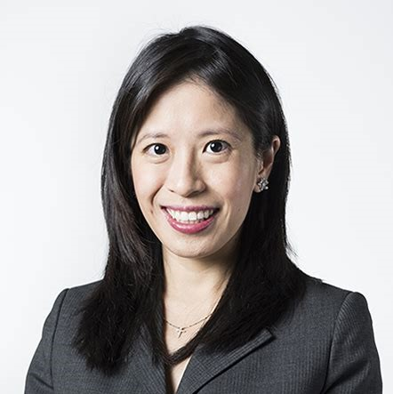
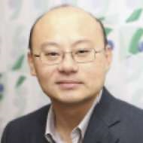
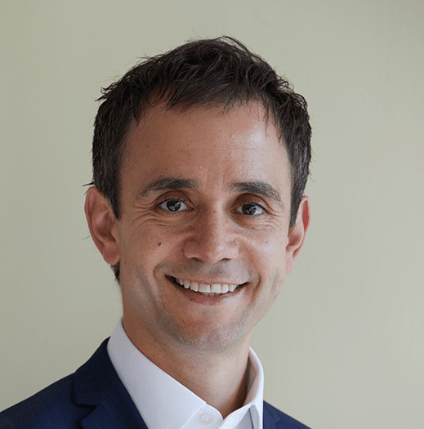
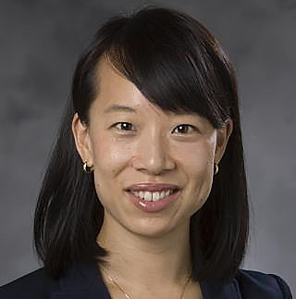
WGC-2025 Program Planning Committee
CO-CHAIR
CO-CHAIR
Pradeep Ramulu
USA
Tanuj Dada
India
VICE CHAIR
VICE CHAIR
VICE CHAIR
VICE CHAIR
Chelvin Sng
Singapore
Lisandro Sakata
Brazil
Anthony Khawaja
UK
Yvonne Ou
USA
Surgery
Clinical
Genetics
Basic Science

Slide 20


WGC-2025: Website and save the date
(The WGC 2025 website is up and running and safe the date have also been sent out)

Slide 21
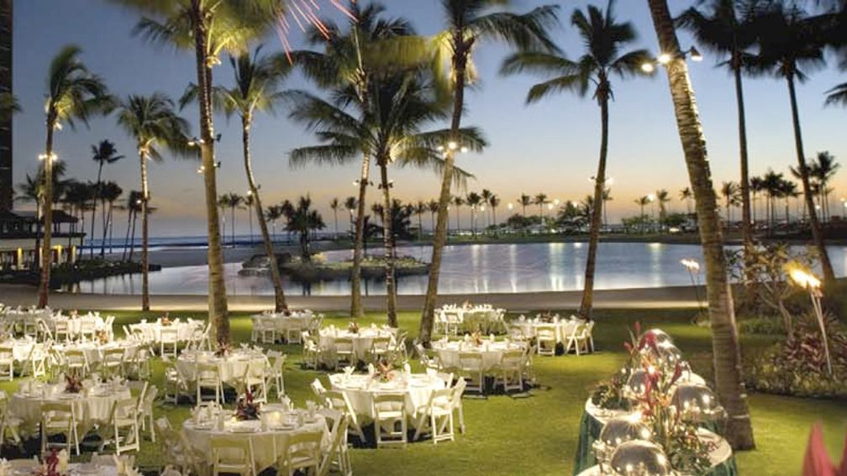

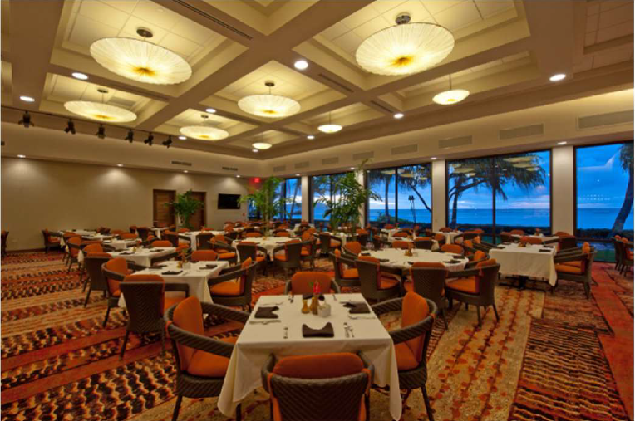
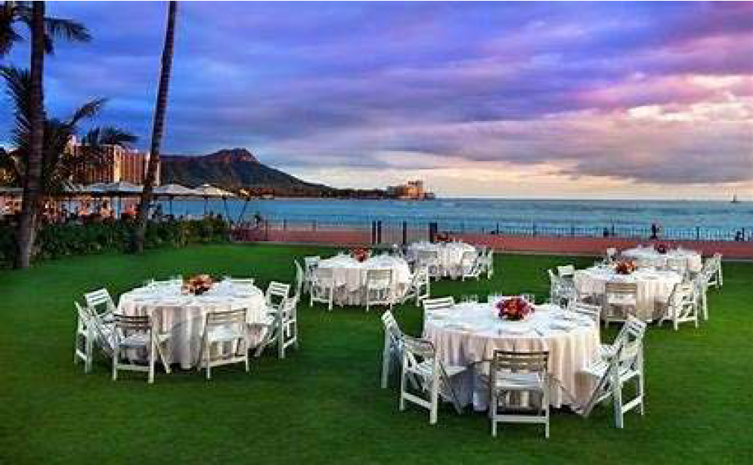
WGC-2025 Social program
(In the process of finalising the venues)
Congress Dinner – Hilton Grand Garden
Waialae Country club or Royal Hawaiian Hotel

Slide 22
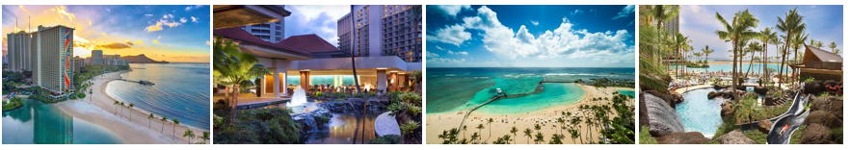
WGC-2025 Hotel - Hilton Hawaiian Village
In the process to finalise the contract for the hotel

Slide 23
Draft Congress Budget
Budget based on 2500 delegates (average of Melbourne 2019 with 2000 pax and Rome 2023 with 3100 pax)
Currency: USD & EUR
INCOME
Registration fees increased by 5% compared to 2023 to incorporate the 5% GET we might need to pay (TBD)
Congress dinner ticket increased to 150 USD (instead of 70 EUR in Rome) / for faculty 75 USD (instead of 30 EUR)
Industry: estimate 1,2 millions income (above 2019 Melbourne but below 2023 Rome)

Slide 24
Registration fee
DESCRIPTION |  | WGC-2025 | WGC-2025 | WGC-2023 | WGC-2021 | WGC-2019 | WGC-2017 | WGC-2015 |  | 2024-2025
 |  | USD VAT not applicable, sales tax TBD | EUR VAT not applicable, sales tax TBD | Fees incl 22% VAT | Fees incl 21% VAT | Fees incl 10% VAT | Fees incl 24% VAT | Fees (no VAT Hong-Kong) |  | AGS | ARVO | AAO
REGISTRATIONS - FULL CONFERENCE PASSES
Participants | Early Bird | $750,00 | € 695,00 | € 660,00 | € 149,00 | € 574,75 | € 600,00 | € 639,00 |  | $700,00 | $655,00 | $1.075,00
 | Regular | $875,00 | € 810,00 | € 770,00 | € 199,00 | € 650,38 | € 700,00 | € 745,00 |  | $800,00 | $530,00 | $1.125,00
 | Late | $995,00 | € 925,00 | € 880,00 | € 249,00 | € 756,25 | € 800,00 | € 850,00 |  | $800,00 | $585,00 | $1.175,00
Affiliated glaucoma society members | Early Bird | $650,00 | € 610,00 | € 580,00 | € 99,00 | € 499,13 | € 525,00 | € 531,00 |  | $500,00 | $370,00 | $200,00
 | Regular | $820,00 | € 760,00 | € 720,00 | € 149,00 | € 605,00 | € 650,00 | € 691,00 |  | $600,00 | $815,00 | $225,00
 | Late | $995,00 | € 925,00 | € 880,00 | € 199,00 | € 756,25 | € 800,00 | € 850,00 |  | $600,00 | $870,00 | $250,00
Students | Early Bird | $195,00 | € 180,00 | € 170,00 | € 49,00 | € 151,25 | € 150,00 | € 159,00 |  | free | $395,00 | $75,00
 | Regular | $220,00 | € 200,00 | € 190,00 | € 79,00 | € 166,38 | € 175,00 | € 191,00 |  | free | $505,00 | $75,00
 | Late | $260,00 | € 230,00 | € 220,00 | € 99,00 | € 195,42 | € 200,00 | € 212,00 |  | free | $525,00 | $75,00
Nurses, orthoptists | Early Bird | $390,00 | € 360,00 | € 340,00 | € 79,00 | € 302,50 | n/a | n/a |  | n/a | n/a | n/a
 | Regular | $420,00 | € 390,00 | € 370,00 | € 99,00 | € 332,75 | n/a | n/a |  | n/a | n/a | n/a
 | Late | $500,00 | € 460,00 | € 440,00 | € 129,00 | € 393,25 | n/a | n/a |  | n/a | n/a | n/a
Research scientists | Early Bird | $390,00 | € 360,00 | € 340,00 | € 79,00 | € 302,50 | n/a | n/a |  | n/a | n/a | $75,00
 | Regular | $420,00 | € 390,00 | € 370,00 | € 99,00 | € 332,75 | n/a | n/a |  | n/a | n/a | $75,00
 | Late | $500,00 | € 460,00 | € 440,00 | € 129,00 | € 393,25 | n/a | n/a |  | n/a | n/a | $75,00
Optometrists | Early Bird | $390,00 | € 360,00 | € 340,00 | € 79,00 | € 393,25 | n/a | n/a |  | n/a | n/a | n/a
 | Regular | $420,00 | € 390,00 | € 370,00 | € 99,00 | € 242,00 | n/a | n/a |  | n/a | n/a | n/a
 | Late | $500,00 | € 460,00 | € 440,00 | € 129,00 | n/a | n/a | n/a |  | n/a | n/a | n/a
Discounted Rate for Ophthalmologist from Low Income Countries* | Early Bird | $250,00 | € 230,00 | n/a | n/a | n/a | n/a | n/a |  | n/a | n/a | n/a
 | Regular | $290,00 | € 270,00 | n/a | n/a | n/a | n/a | n/a |  | n/a | n/a | n/a
 | Late | $320,00 | € 295,00 | n/a | n/a | n/a | n/a | n/a |  | n/a | n/a | n/a
Notes:
Post-covid, inflation

Slide 25
Registration fee
Congress dinner ticket:
  For regular delegates: 150 USD (was 70 EUR in 2023)
  Reduced fee: 75 USD (was 35 EUR) for PPC (co)chairs, PPC members, Local Org. Com, Founders, Board of governors
  → It has been agreed to not provide a reduced fee for Faculty in 2025. They are already entitled to a complimentary registration for the congress and attendance to the WGA Presidents Dinner. If they wish to also attend the congress dinner, they can register and pay the regular fee (150 USD).
Notes:
Post-covid, inflation

Slide 26

Current contract
Signed in 2018
THGF & MCI The Netherlands
Fee structure
Fee for the bi-annual congress, being 8 % of the total congress income, with a minimum of €145,000.
Commission share of 50% of hotel commissions.
Notes:
Post-covid, inflation

Slide 27
MCI Fee: past 10 years
 | WGC-2015 Hong Kong | WGC-2017 Helsinki, Finland | WGC-2019 Melbourne, Australia | WGC-2021 Virtual | WGC-2023 Rome, Italy | WGC-2025 Hawaii, USA
MCI Fee (based on 8% of congress income) | € 145.643,00 | € 183.300,79 | € 169.355,03 | € 182.996,57 | € 196.358,64 | € 198.947,20
MCI Hours |  | 5550 | 5400 | 4400 | 3900 | 4300
Per Hour |  | € 33 per hour | € 31 per hour | € 41 per hour | € 50 per hour | € 46 per hour
Notes:
Contribution per hour

Slide 28
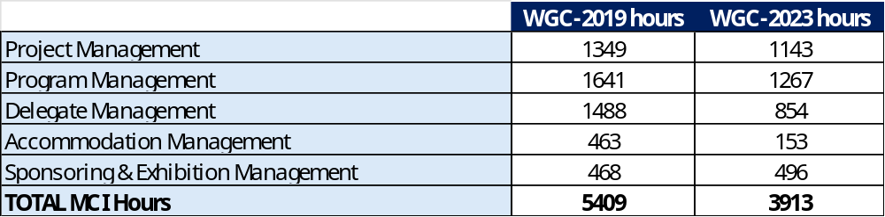
MCI Hours: breakdown of 2019 & 2023
Notes:
Contribution per hour

Slide 29
MCI Fee: projection
 | Current fee | New fee
WGC-2025 | Variable: 8% of congress income € 198.947,20 | Fixed : € 145.000,00 Variable: 6,5% of congress income Estimate: € 161.839,60 € 306.839,60
MCI Hours | 4300 | 4300
Per Hour | € 46 per hour | € 71 per hour
Notes:
Contribution per hour

Slide 30
WGC-2027: Abu Dhabi
Suggested date: 21 – 24 April 2027
Venue: Abu Dhabi National Exhibition Centre (ADNEC) – 20 minutes away from the International Airport
Host: Emirates Society of Ophthalmology (want to become a WGA member first need to start a Glaucoma chapter)
Hotels: 2 Hotels connected to the congress venue and 4 within 3 min walking distance
Possible venues for President's dinner: Emirates Hotel, Fairmont, Ritz Carlton
Possible venues for Congress dinner: Sea World, Warner Bros and Yes Links

Slide 31
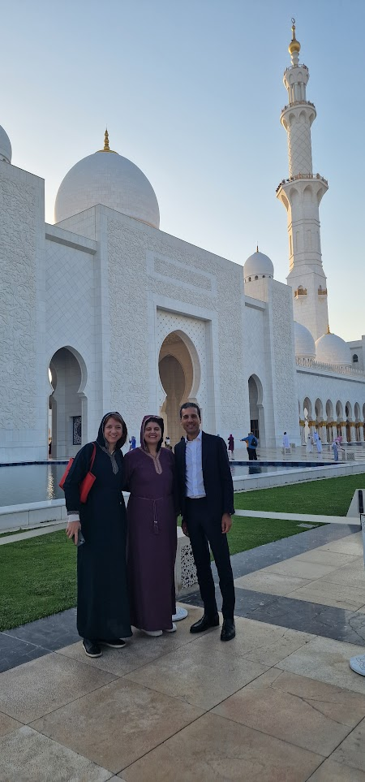
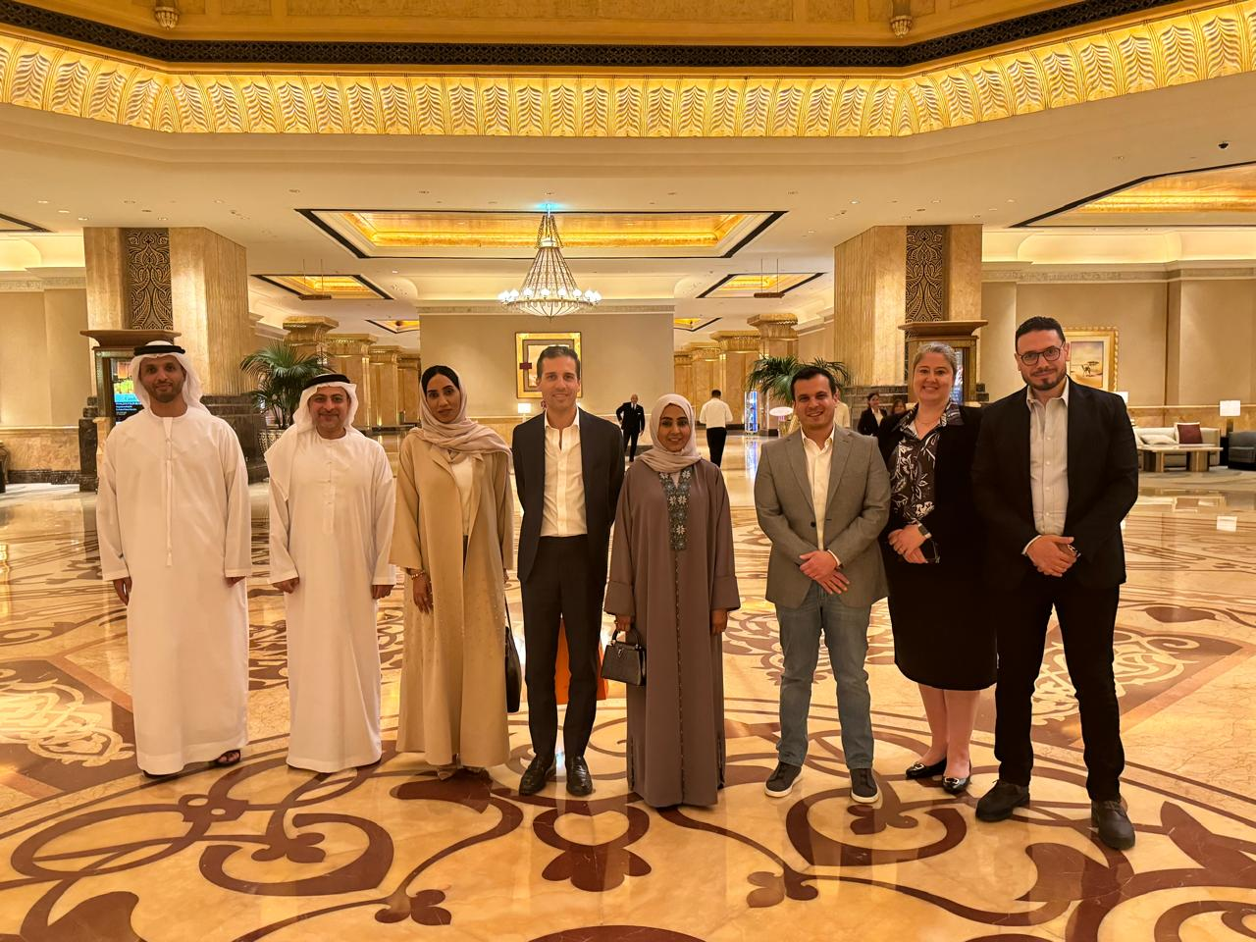
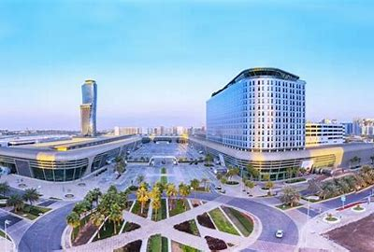
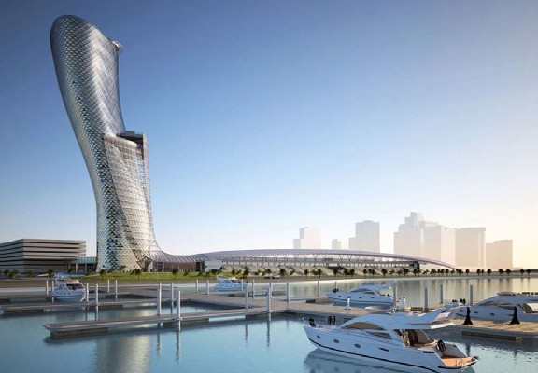
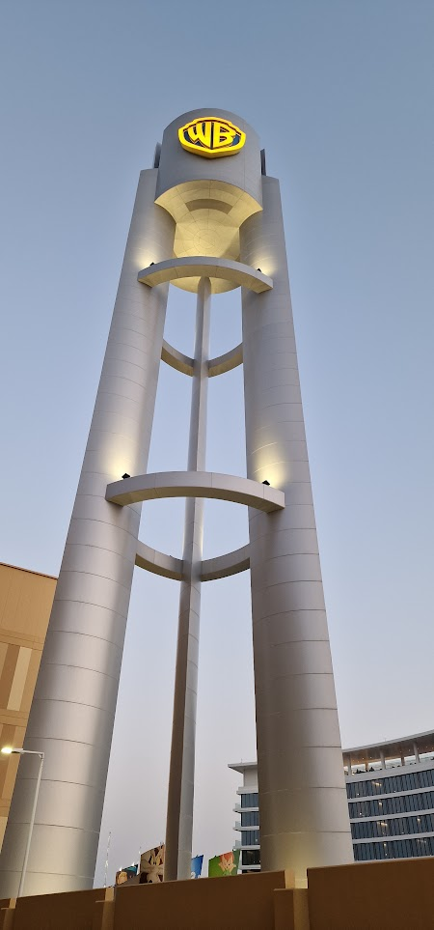
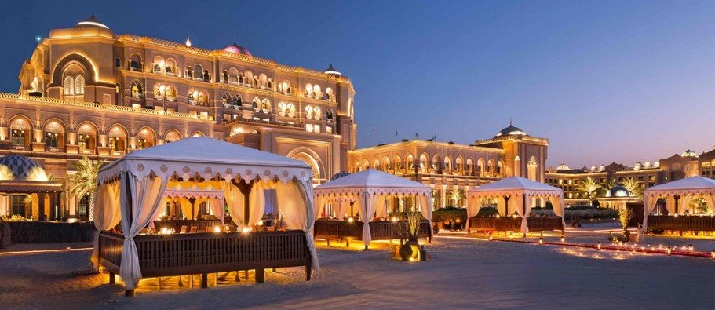
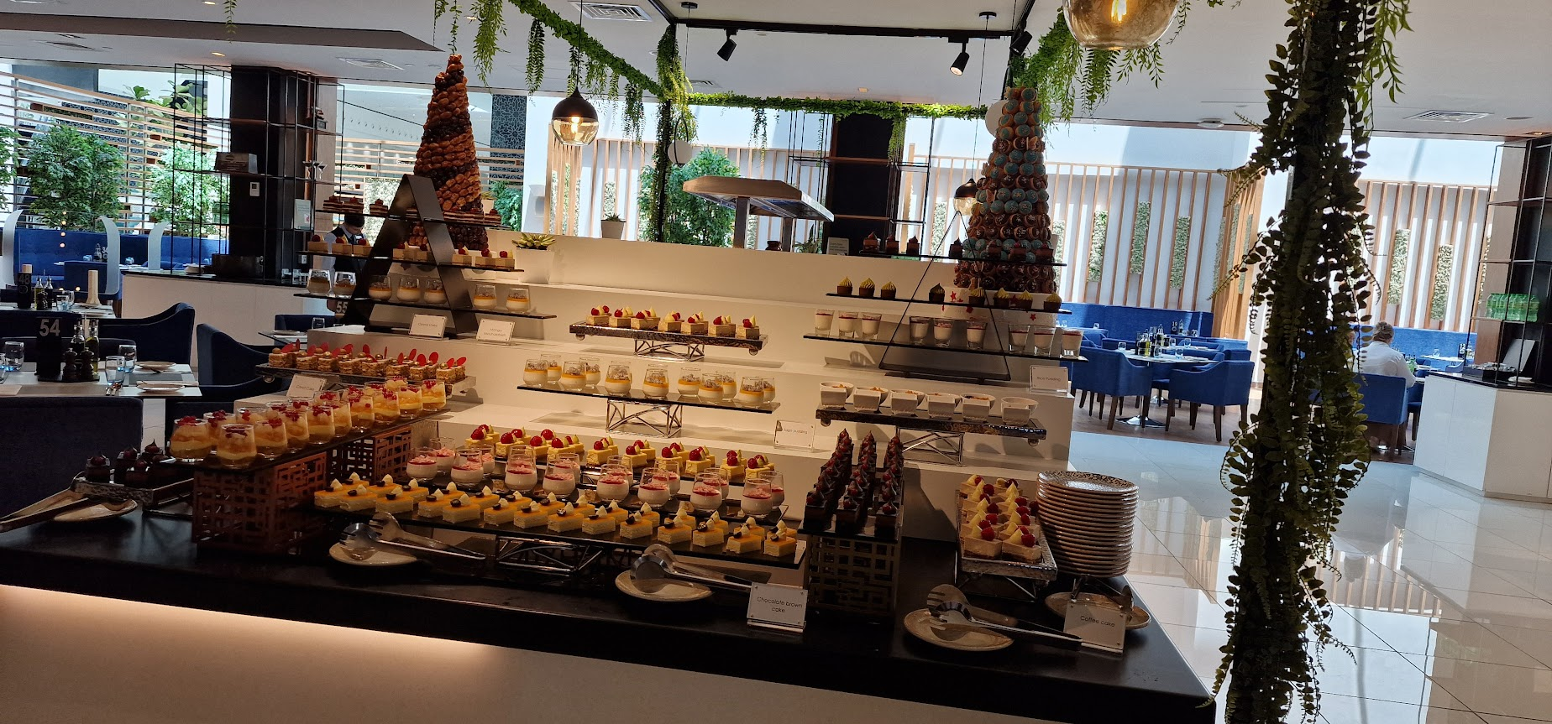
WGC-2027: Abu Dhabi (Site visit April 2024)

Slide 32
WGC-2027: Seoul
Suggested date: 7-10 July (rainy season)/ Alternative date suggested 20-25 September 2027 (conflict with ESCRS)
Venue: Coex Convention and Exhibition Center – 60 – 80 min from 2x international airports
Host: Korean Glaucoma Society
Hotels: many hotels within walking distance
Possible venues for President's dinner: TBA
Possible venues for Congress dinner: TBA

Slide 33
WGC-2027: Kyoto (Japan)
Japan- 2 bids Kyoto and Yokohama still requesting more information from them. The price difference very big between the two cities Yokohama is 270k more expensive
Suggested date: 7-10 April 2027 (when hosting in April no subsidies will be given) or 30 – 3 July
Venue: Kyoto International Conference Center – 75 minutes by train from the International airport
Host: Japanese Glaucoma Society
Hotels: The Prince Kyoto Takaragaike – within walking distance and 7 hotels within 20 min range from the venue
Possible venues for President's dinner: TBA
Possible venues for Congress dinner: Kyoto City Kyocera, Museum of Art or Daigoio Temple

Slide 34
WGC-2027: Yokohama (Japan)
Japan- 2 bids Kyoto and Yokohama still requesting more information from them. The price difference very big between the two cities Yokohama is 270k more expensive
Suggested date: 9 – 14 March 2027
Venue: Pacifico Yokohama – 30 min from Narita Airport
Host: Japanese Glaucoma Society
Hotels: Intercontinental Grand Yokohama is linked to the venue, many hotels within walking distance
Possible venues for President's dinner: TBA
Possible venues for Congress dinner: Osanbashi Hall, Marine Tower Yokohana and Sankeien Garden Kakushokaku

Slide 35
WGC-2027: Bahrain
Suggested date: March 2027 (no specific date) or September – February also option
Venue: Exibition World Bahrain– 30 min from Bahrain International Airport
Host: no local Society (supported by Local doctors)
Hotels: all hotels within 30 min driving. No hotels within walking distance
Possible venues for President's dinner: TBA
Possible venues for Congress dinner: TBA

Slide 36
WGC-2027
Any other suggestions?

Slide 37
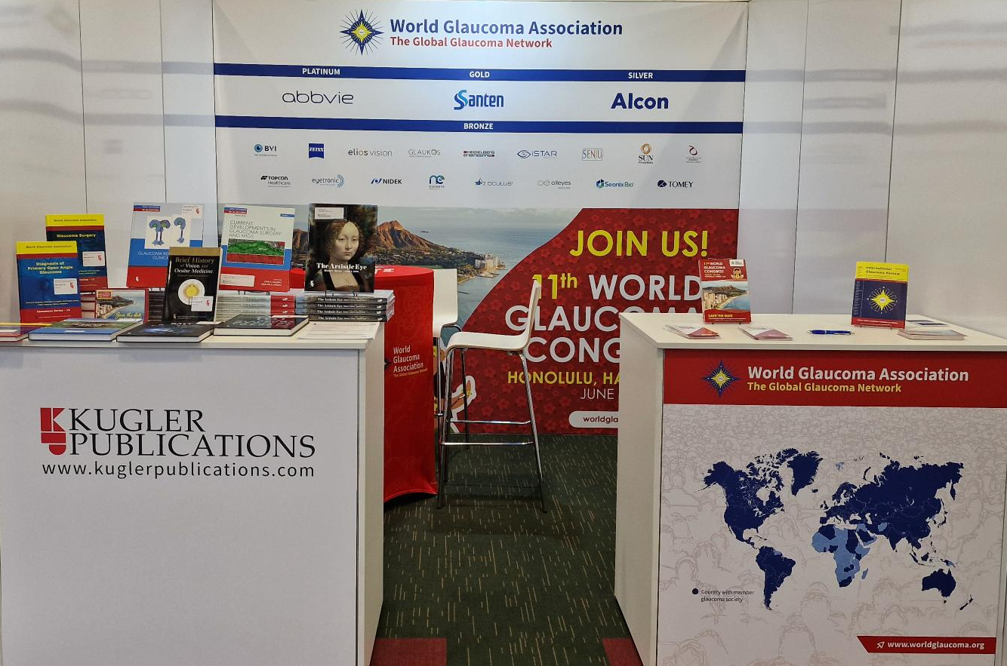

New Silver Industry Member
Bronze Member -> | Silver Member*
$ 8,500.00 | $ 35,000.00
*Confirmed, signed contract to be received.

Slide 38
Any other business

