Slide 1
What type of OCT findings are typical for glaucoma?
Kouros Nouri-Mahdavi, MD, MS
Professor in Residence
Kay K. Pick Chair of Ophthalmology
Director, Glaucoma Advanced Imaging and AI Laboratory

Slide 2
Conflict of Interest
 | No, nothing to disclose
X | Yes, specified below:
Receipt of grants / research supports: | Receipt of honoraria or consultation fees: | Participation in a company sponsored speaker’s bureau: | Stock shareholder: | Spouse / partner: | Other support:
Heidelberg Engineering | Topcon Healthcare | NA | NA | NA | NA

Slide 3
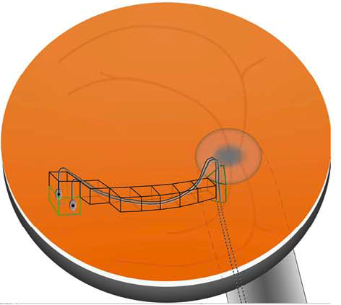
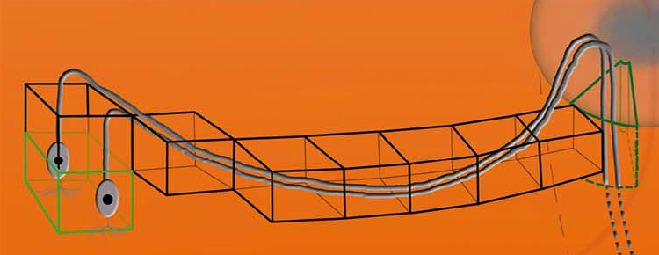
The RGC Axonal Complex
Bogunovic H, Young HK, Rashid A, et al. IOVS 2015

Slide 4
Use All Your Tools on The OCT Device
Retinal nerve fiber layer (RNFL): Most useful in early to moderate glaucoma
Neuroretinal rim (NRR) of the ONH:
  Influenced by the BMO area, complementary to RNFL
Macula: Potentially helpful imaging tool in moderate to advanced glaucoma

Slide 5
First Things First!
Make sure the OCT image is reliable:
Right patient, correct eye!
Adequate quality: Acceptable signal strength or quality factor
No artifacts: motion, blink, media opacity
Proper segmentation of RNFL, and neuroretinal rim

Slide 6
How glaucoma affects OCT findings?
Mostly RNFL or NRR thinning!
RNFL asymmetry between fellow eyes may be an early sign
Sometimes empty spaces (schisis cavities, occasional holes)
  Can lead to spurious thickening of the RNFL or NRR!

Slide 7
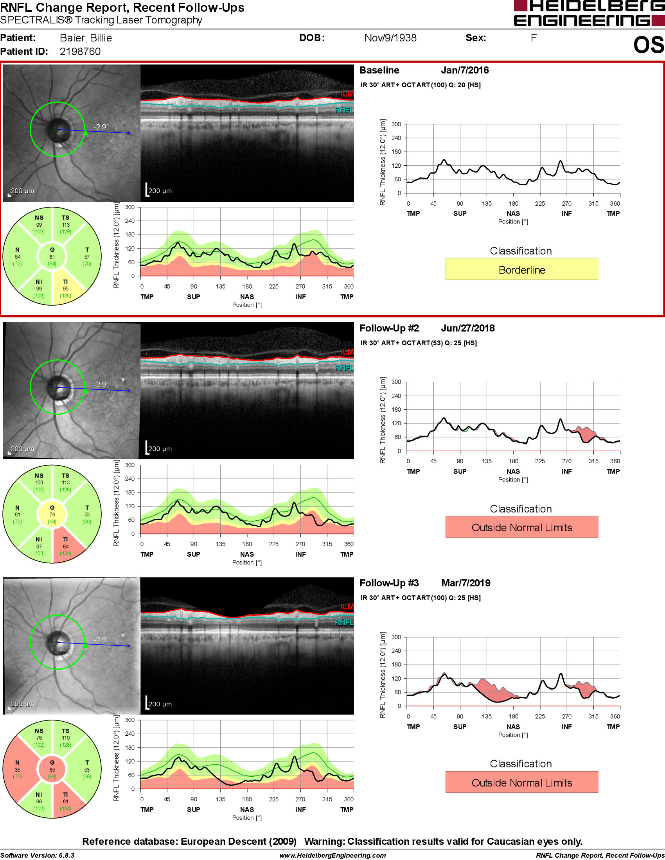
Real and Artifactitious findings can coexist!

Slide 8
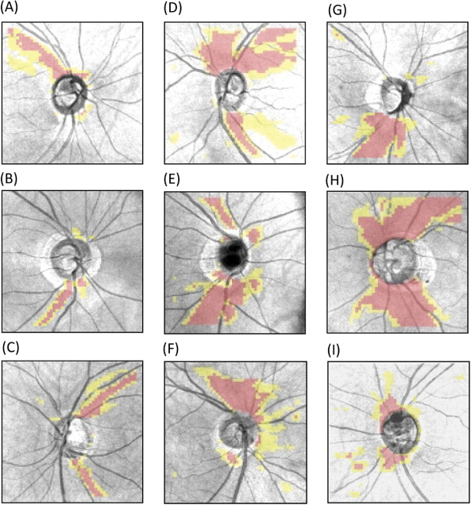
Patterns of RNFL Damage
Wedge defect with tip towards the ONH
Mostly at superior or inferior poles
Normally in defined peripapillary areas (Hood)
May be atypical in myopic eyes

Slide 9
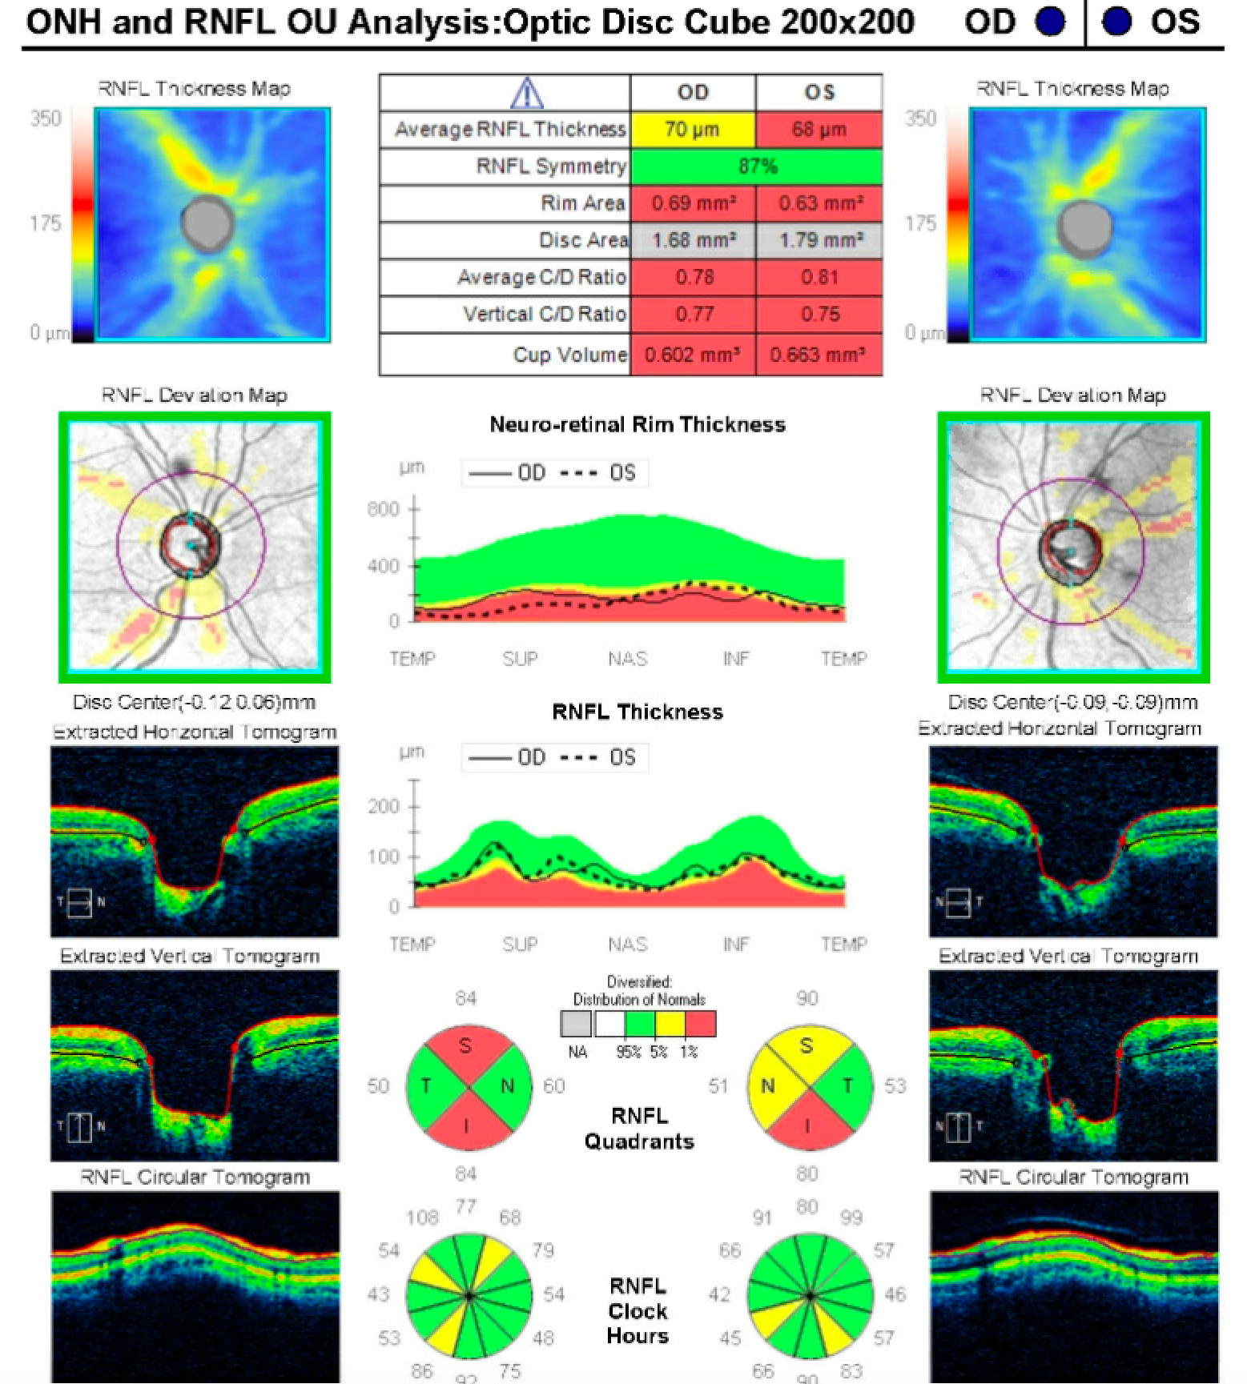
Patterns of RNFL Damage
Cirrus HD-OCT

Slide 10
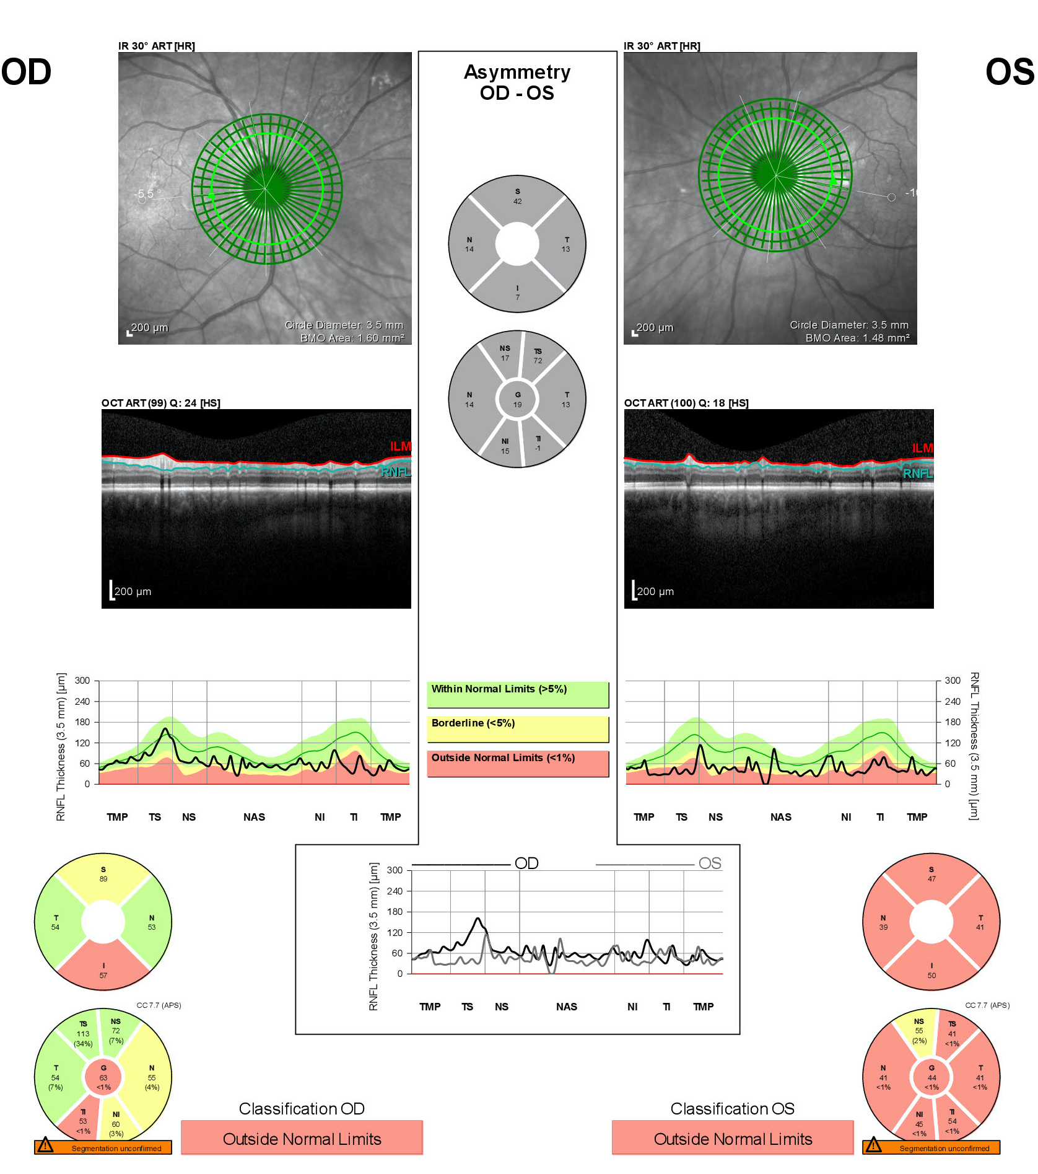
Patterns of RNFL Damage
Spectralis OCT
Glaucoma Module Premium Edition
Adjusted for Fovea-BMO Axis Angle

Slide 11
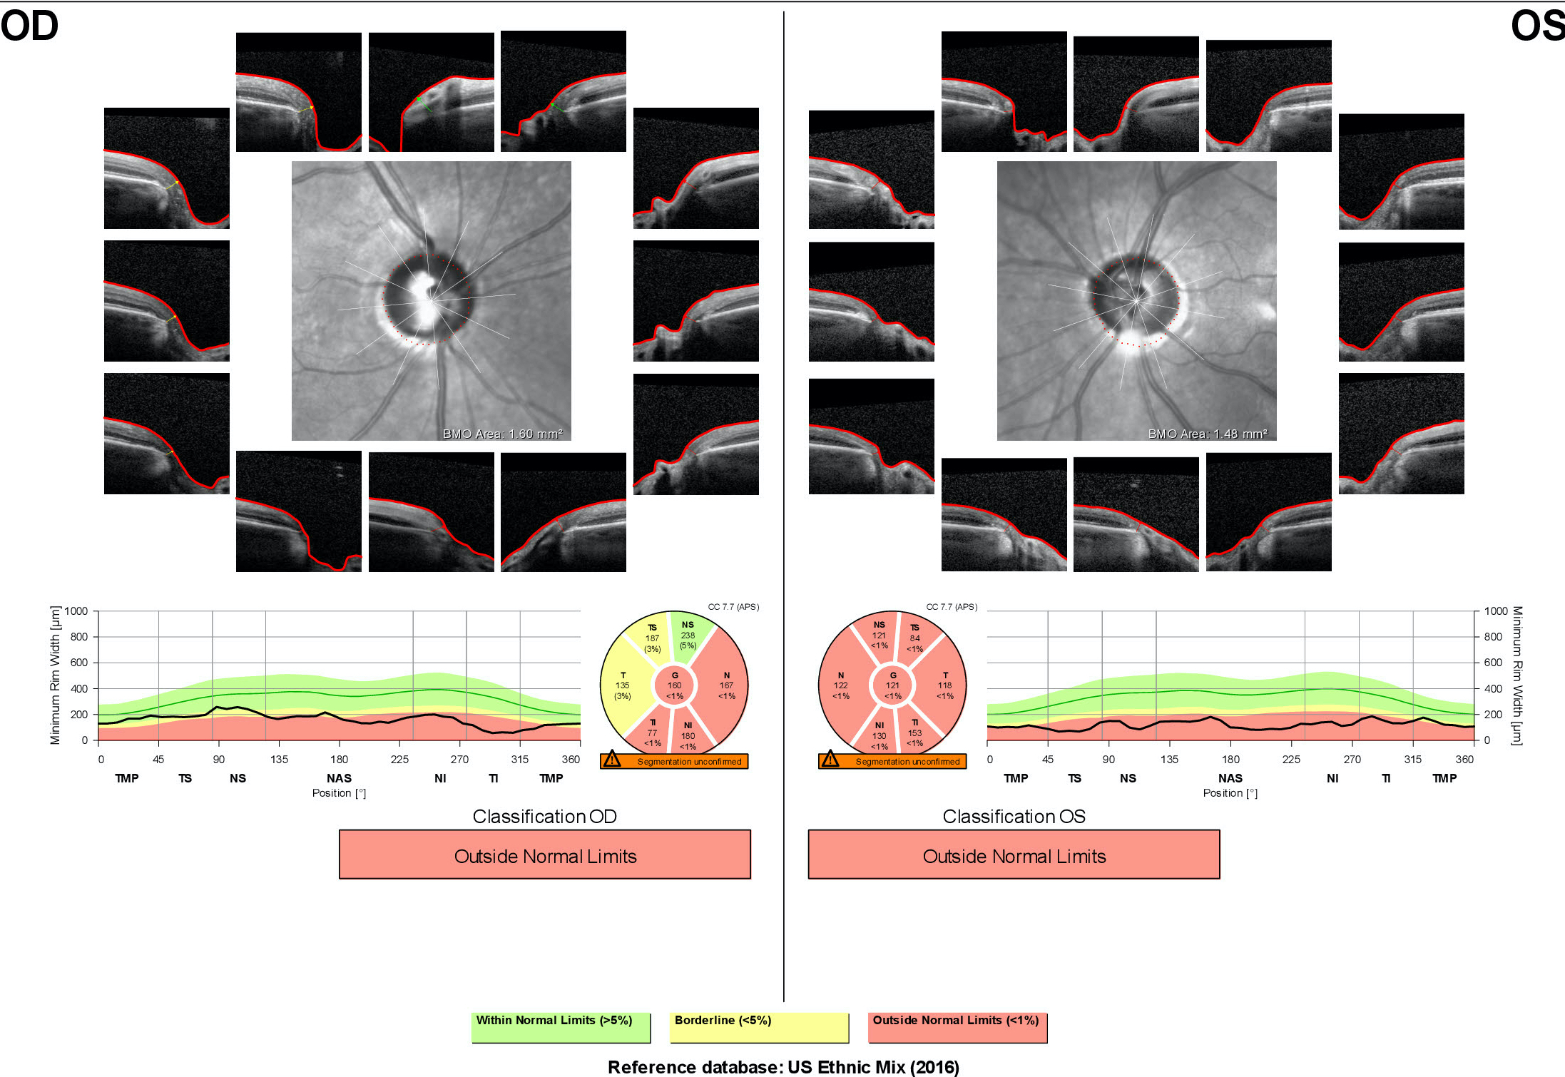

Slide 12
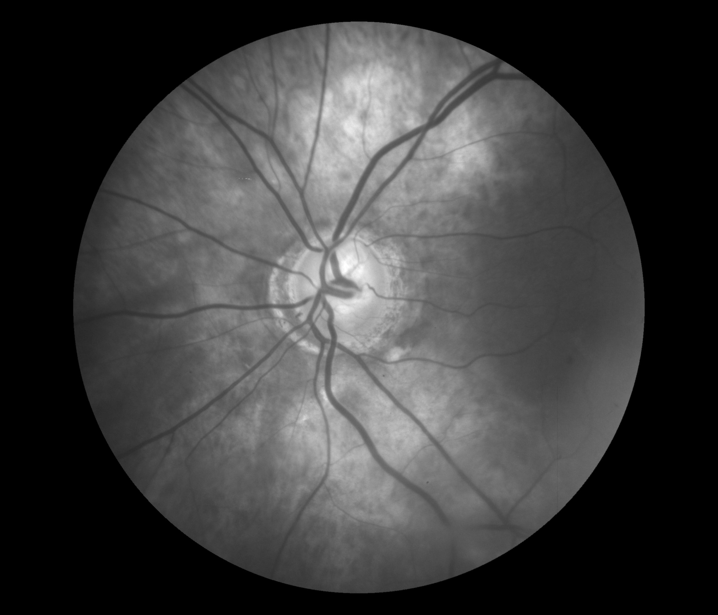
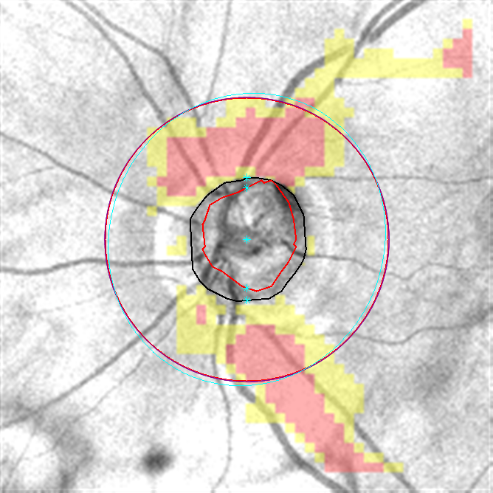
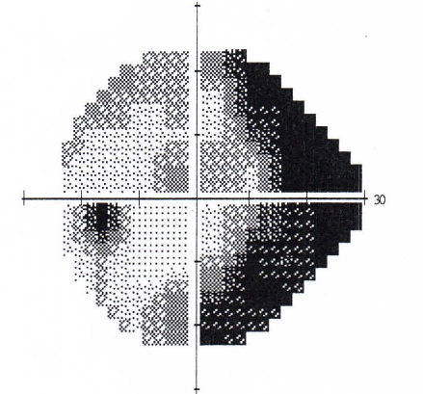
Myopic Eye

Slide 13
RNFL asymmetry can be subtle!

Slide 14
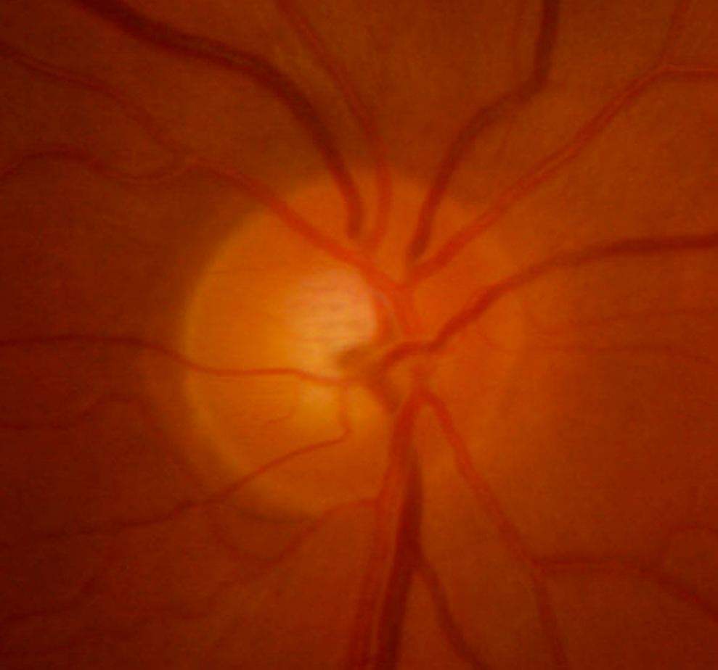
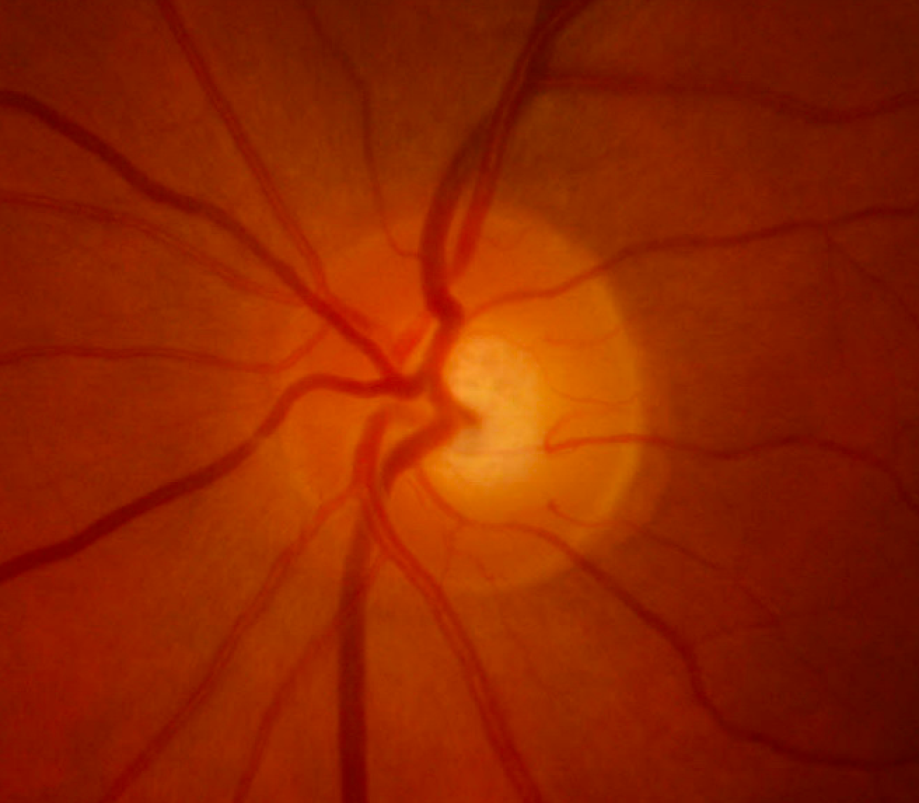
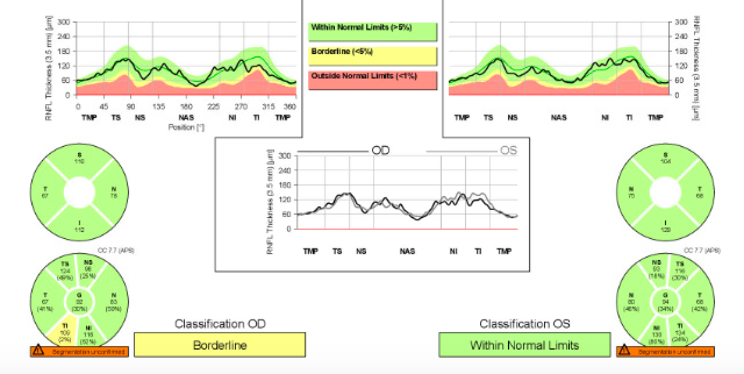
Early Glaucoma

Slide 15
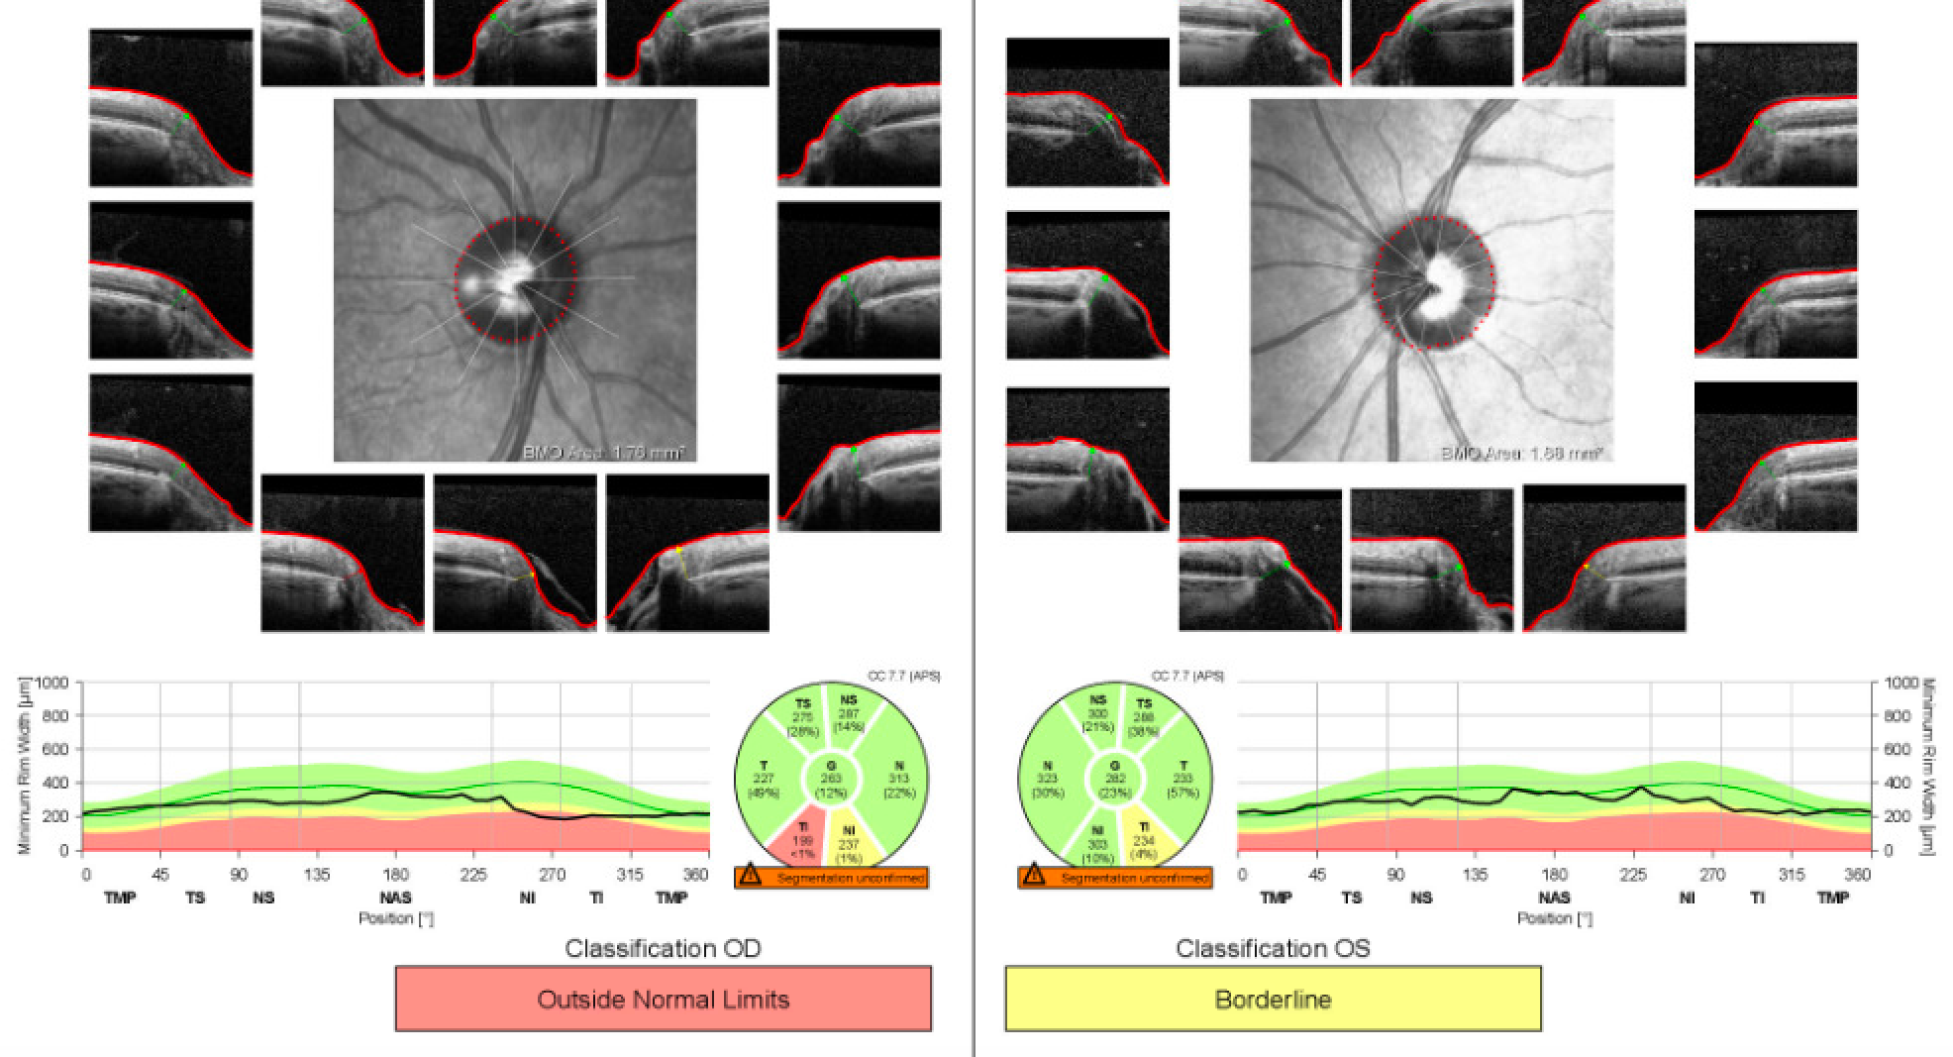

Slide 16
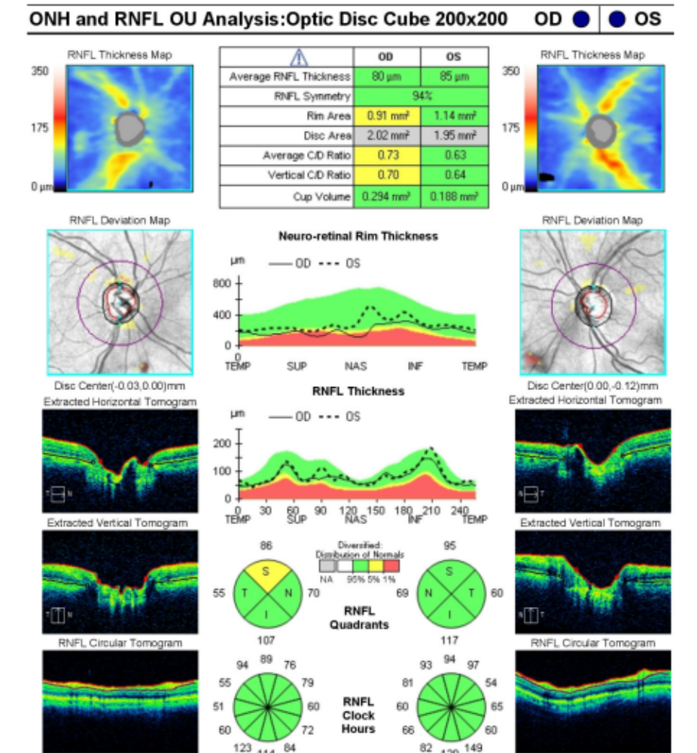

Slide 17
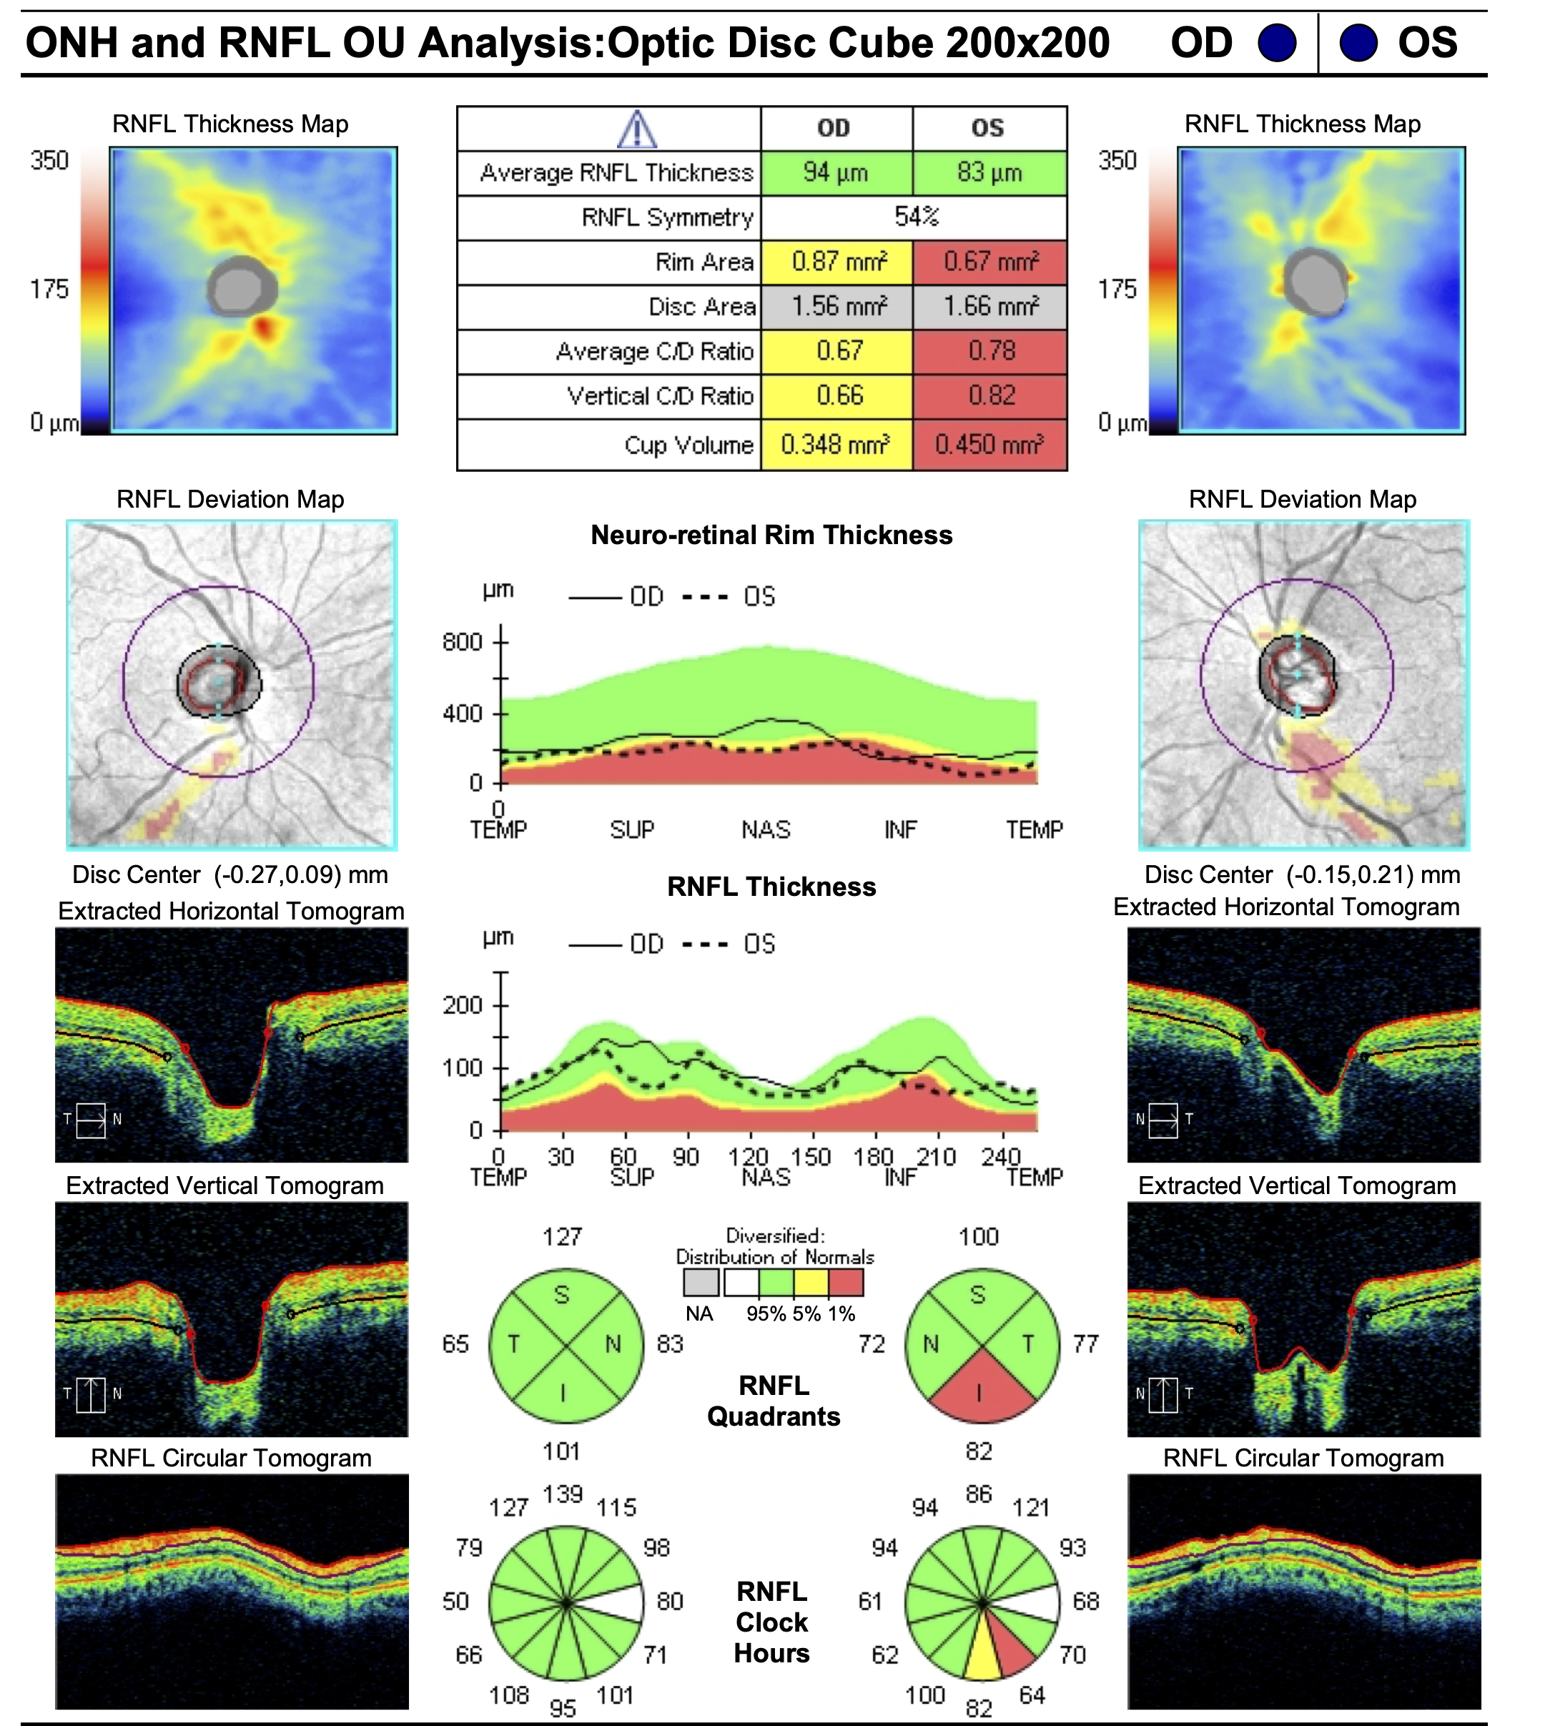
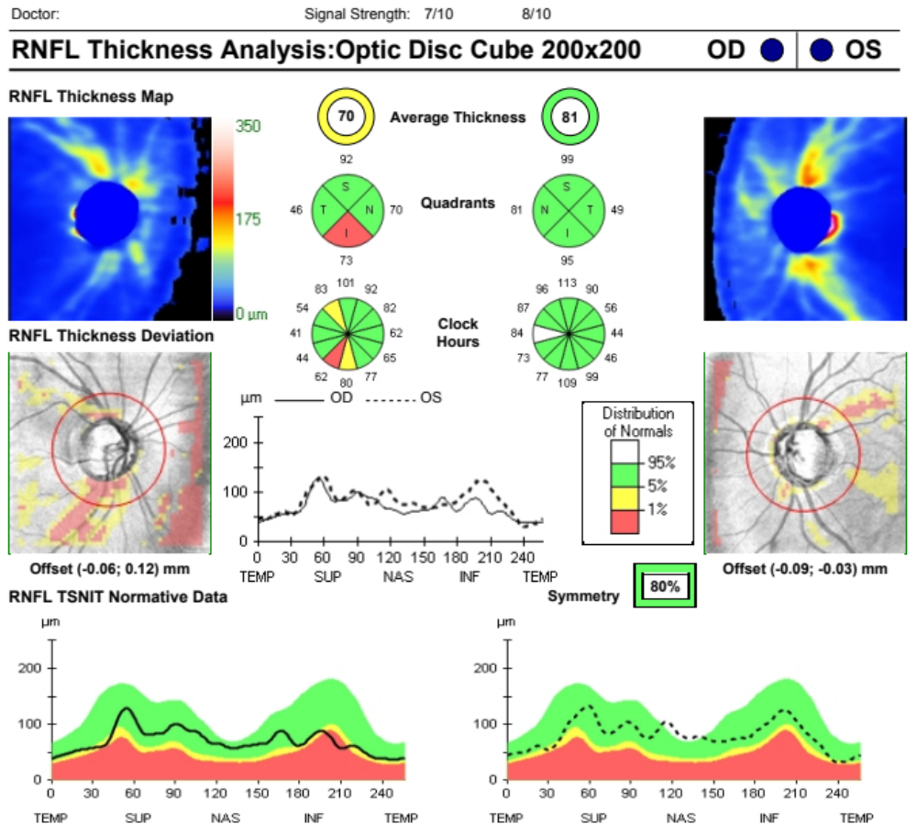

Slide 18
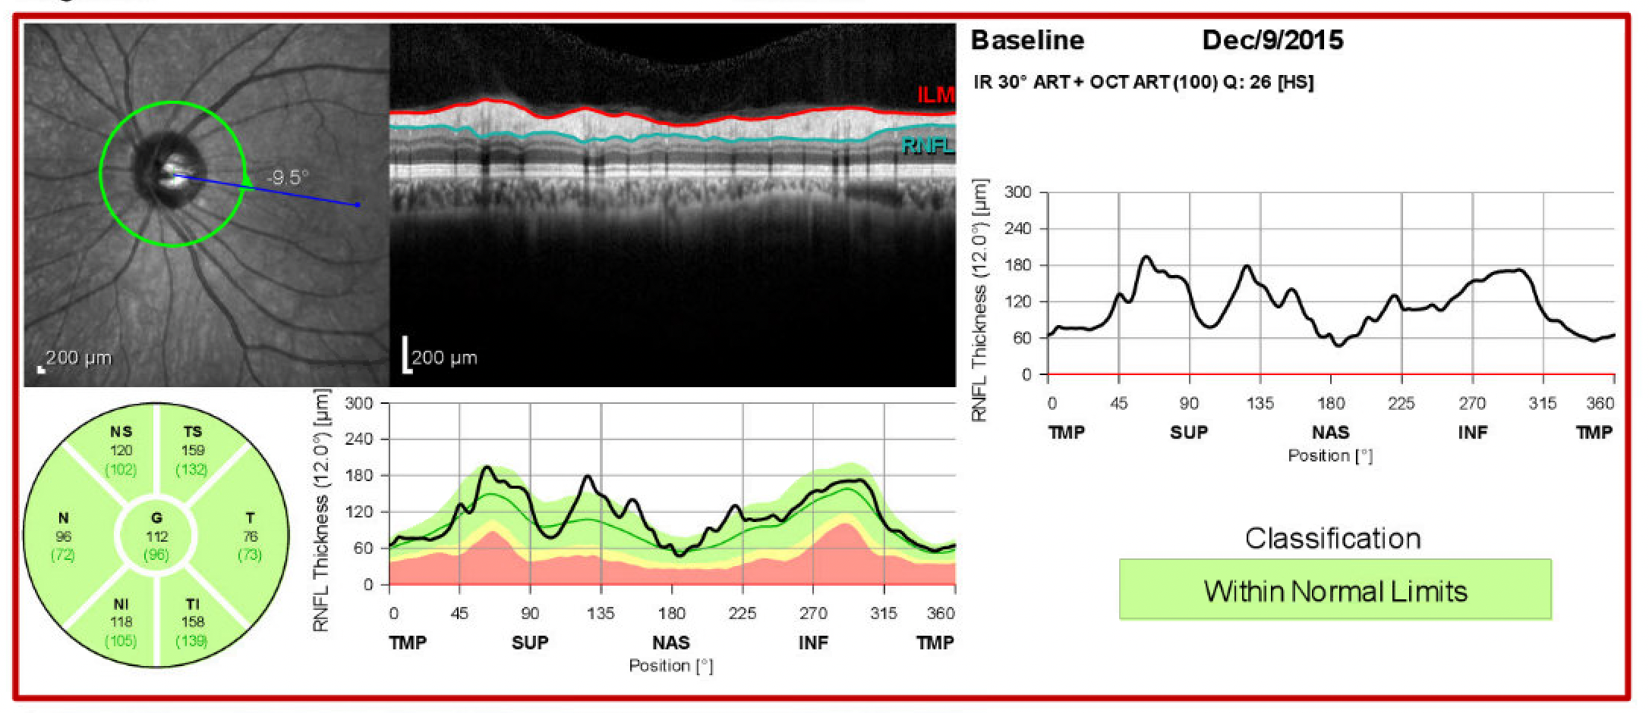
RNFL Split Bundle

Slide 19
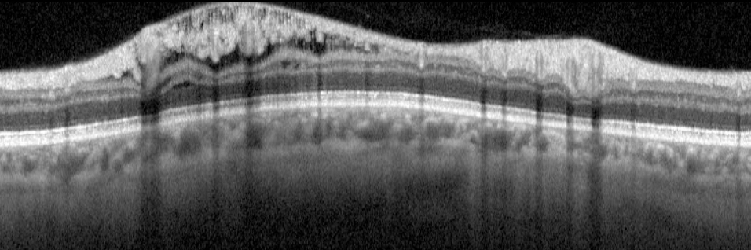
Schisis Cavity: RNFL
I
T
T
S
OS

Slide 20
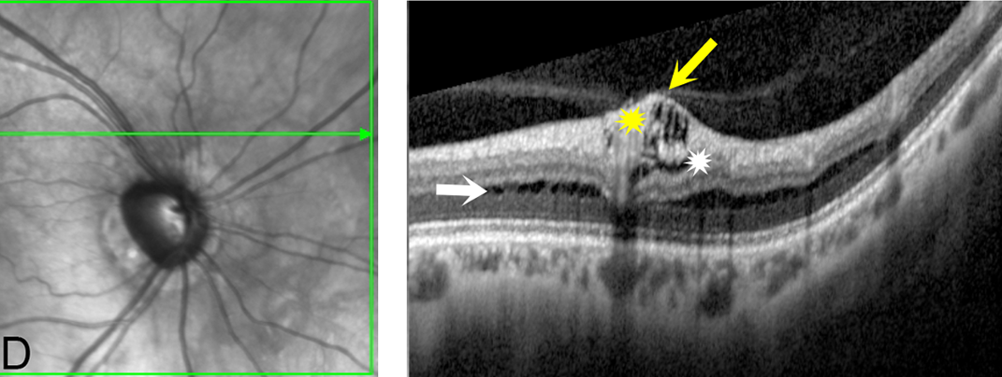
Schisis Cavities: Inner Retinal Layers and OPL/INL
1-6% prevalence

Slide 21
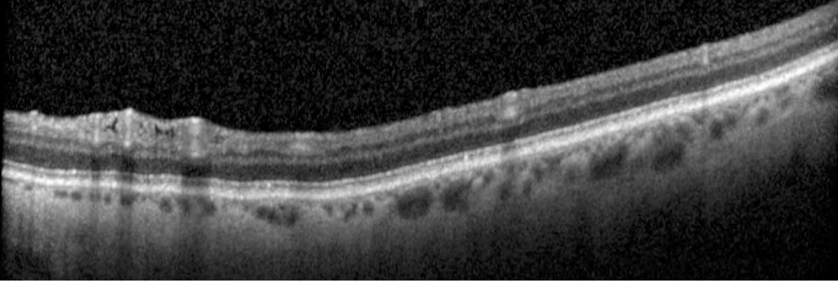
Inner Layer Holes

Slide 22

Thank You

