Slide 1


40th WGA Information and Planning Exchange
(IPE) meeting
Wednesday, June 28, 2023

Slide 2

Welcome
Neeru Gupta MD PhD MBA FRCSC DABO President

Slide 3

reaching over 25,000 individual and eye care professionals worldwide
91 glaucoma member societies

Slide 4

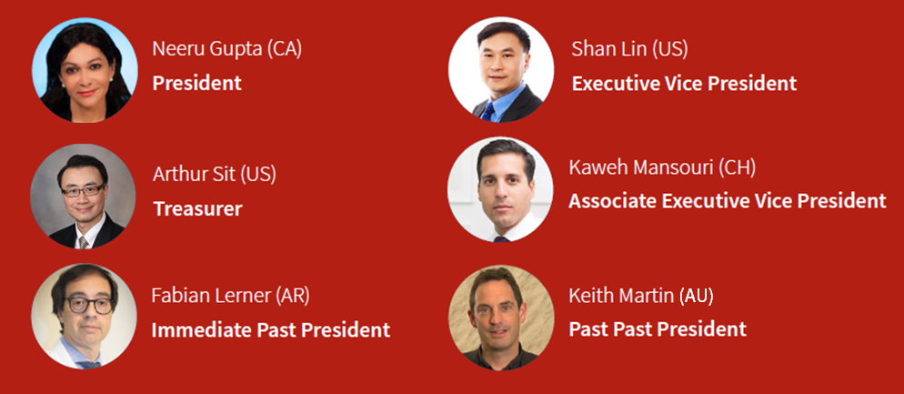
Executive Committee 2022-2023
The Executive Committee actively sets policy and ensures that the WGA has adequate resources to carry out its mission, and that its activities and expenses align with its mission focus.

Slide 5
Board of Governors
The Board of Governors is responsible for defining the WGA’s mission and values and for providing overall leadership and strategic direction.
Neeru Gupta, Canada
Arthur Sit, United States
Fabian Lerner, Argentina
Keith Martin, Australia
Makoto Aihara, Japan
Nkiru Kizor - Akaraiwe, Nigeria
Vijaya Lingam, India
Winifred Nolan, UK
Pradeep Ramulu, United States
Lisandro Sakata, Brazil
Ingeborg Stalmans, Belgium
Xinghuai Sun, China
Fotis Topouzis, Greece
Anja Tuulonen, Finland

Slide 6
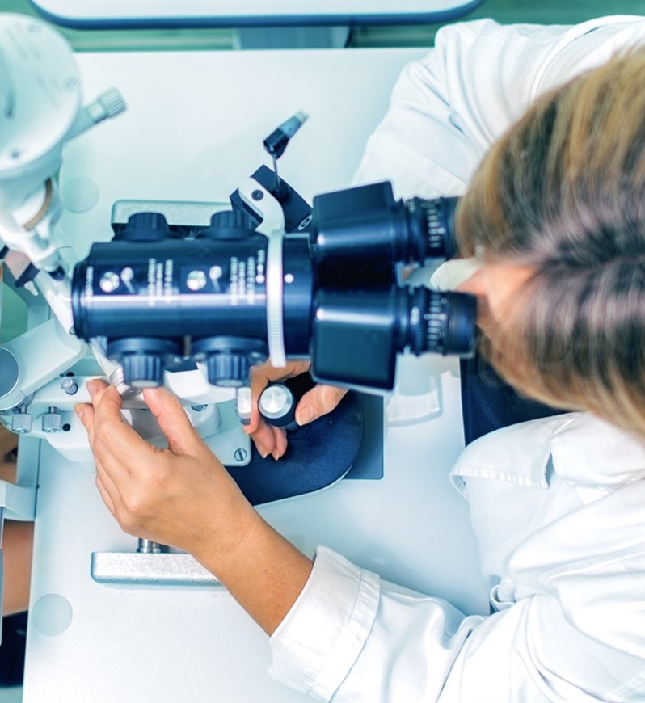
Council
The general task of the Council is to provide expertise and institutional memory from previous leadership.
Makoto Araie, Japan
Tin Aung, Singapore
Jonathan Crowston, Singapore
Robert Fechtner, US
David Friedman, US
Jian Ge, China
Ivan Goldberg, Australia
Franz Grehn, Germany
Daniel Grigera, Argentina
Paul Healey, Australia
Peng Khaw, UK
Yoshi Kitazawa, Japan
Dennis Lam, Hong Kong
Jeffrey Liebmann, US
Olusola Olawoye, Nigeria
Ki Ho Park, South Korea
Norbert Pfeiffer, Germany
GC Sekhar, India
Tarek Shaarawy, Switzerland
Kuldev Singh, US
Kazuhisa Sugiyama, Japan
Clement Tham, Hong Kong
Remo Susanna Jr, Brazil
Ravi Thomas, Australia
Carlo Traverso, Italy
Ningli Wang, China
Robert Weinreb, US

Slide 7























Our WGA industry members
PLATINUM
SILVER
BRONZE
GOLD

Slide 8

Shan Lin MD
Executive Vice President

Slide 9
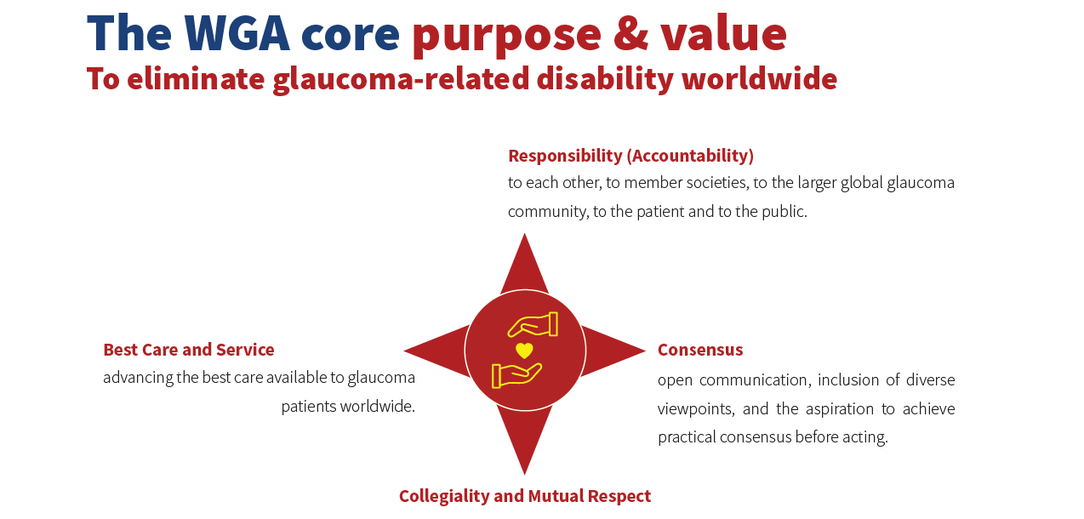

Slide 10
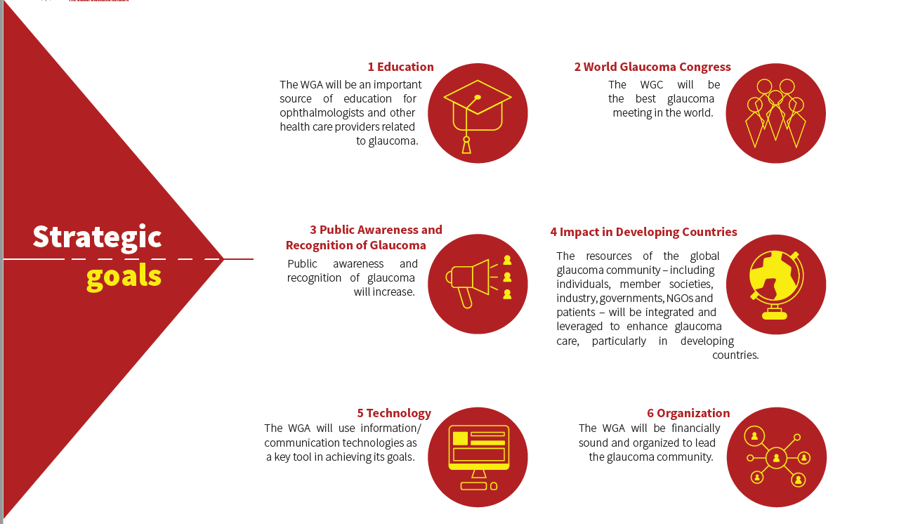

Slide 11
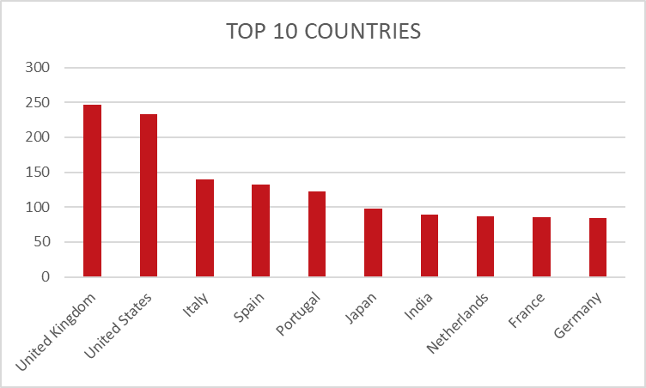
1. REGISTRATION
SOCIAL PROGRAMME
Welcome Reception (Wed): 1673 registrations
President’s Dinner (Thu): 228 persons accepted
Congress Dinner (Fri): 455 registrations
Farewell Reception (Sat): 1254 registrations
Currently, 3039 people registered for the congress.
WGC-2023 is in the top 2 most attended
WETLABS & WORKSHOPS
Wetlabs:
  8 wetlabs
  Many are fully booked
Workshops:
  4 workshops
  2 of them are fully booked
Society Symposia:
  40 society symposia

Slide 12

2. SPONSORSHIP & EXHIBITION
Current status
Confirmed/Signed: € 1.506.050 → € 50.700 EUR more since last month – HIGHEST INDUSTRY INCOME FOR A WGC!
Based on 1x Platinum, 1x Gold, 1x Silver, 13x Bronze, 19x Exhibitors, 6x Barter deals
Exhibition floor sold out!
Industry symposia: 16 industry slots → published on the congress website
Wetlabs: 5 industry programs → published on the congress website
Industry showcase: 2 sessions → published on the congress website

Slide 13
WGC Registration Comparison
WGC | Registration Numbers
2009 | 2666
2011 | 2982
2013 | 2047
2015 | 2149
2017 | 3053
2019 | 2183
2021 | 2913
2023 | 3117

Slide 14
WGC Abstract Comparison
WGC | Registration Numbers
2009 | 628
2011 | 762
2013 | 735
2015 | 402
2017 | 783
2019 | 569
2021 | 632
2023 | 988

Slide 15

World Glaucoma Week 2023
834 activities posted on the World Map
New video campaign with Korean celebrity Jung Ji-hoon (Rain)
KI HO PARK: success in engaging celebrities
Social media initiative sharing Myths of Facts in Glaucoma
Digital marketing campaign: social media and newsletters
  2,160,364 total reach social media
  58,913 WGW pageviews: 77% first-time website visitors

Slide 16
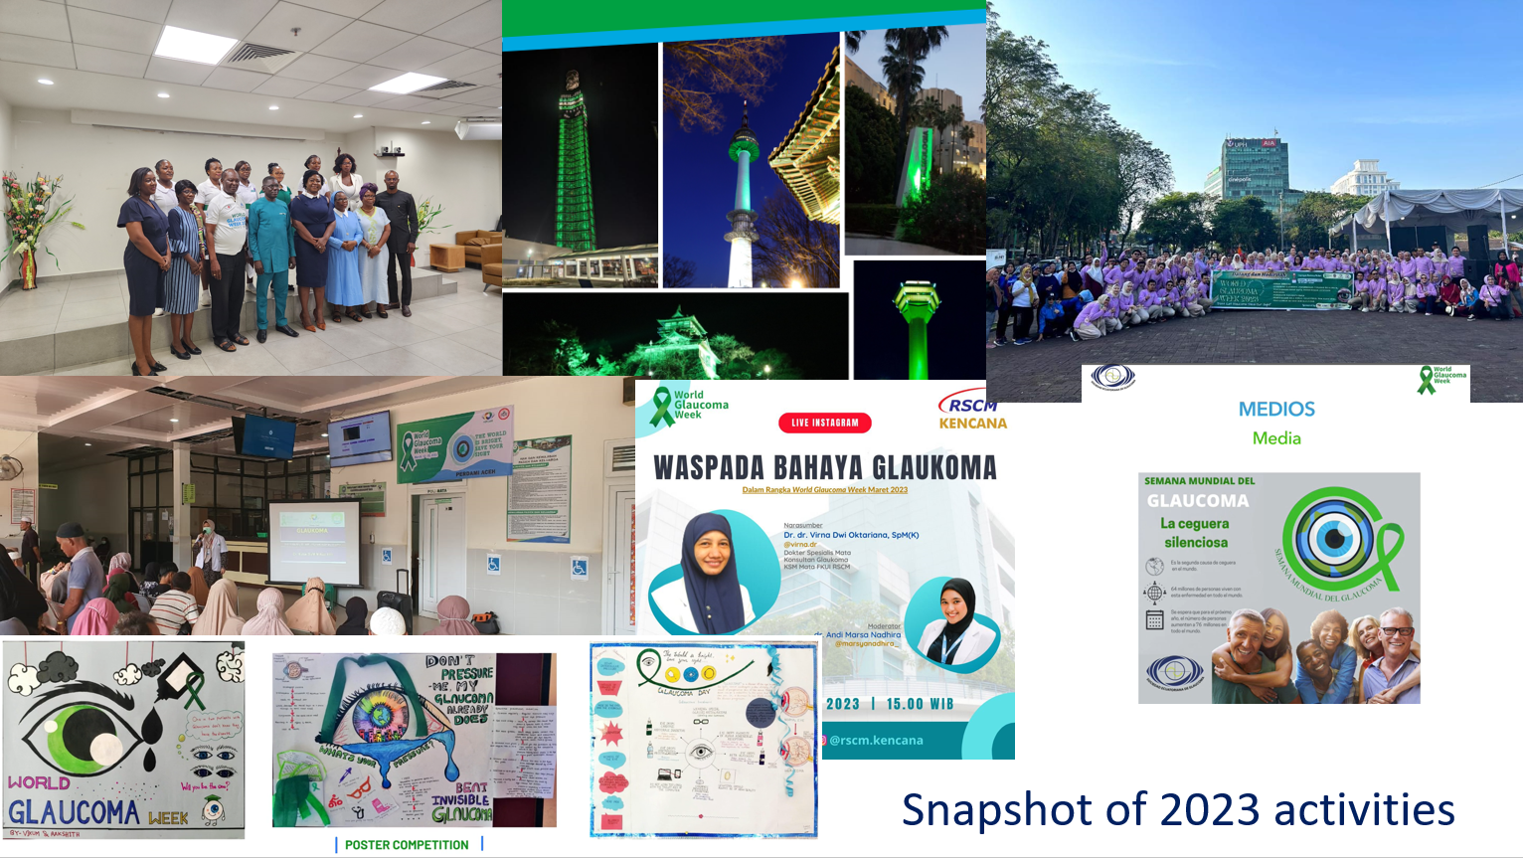

Slide 17
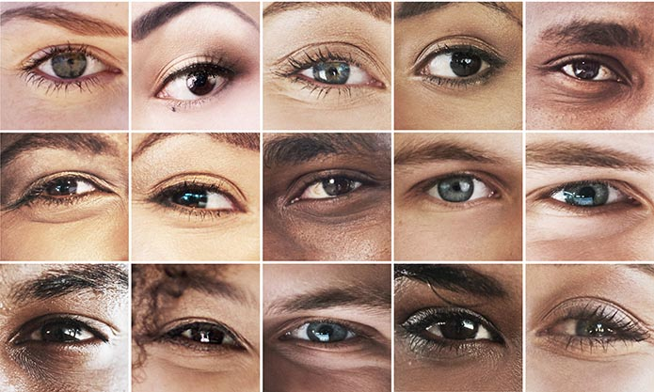


Next edition:
March 10-16, 2024

Slide 18
Website Visits and Database
In 2022 the WGA website had 188,226 visitors.
2023 on course to exceed 200,000

Slide 19



Connecting via social media
The social media campaign of the WGA continues to grow in reach, audience acquisition and engagement on our 4 channels.
The quarterly results show us that all WGA social media accounts have still room to grow but they keep bringing us steady results every quarter. All the accounts continue to have new followers and a steady engagement rate, this shows us that the audience enjoys our content and wants to come back for more.
There were 3 ad campaigns in Q1 of 2023:
Surgical Grand Rounds, Fundamental Questions in Glaucoma and World Glaucoma Week.
TOTAL REACH
1,387,887
2,241
1,919
7,871
1,022
IMPRESSIONS
REACH
REACH
REACH
13,700
5,986
950,020
418,181
TWITTER
LINKEDIN
FACEBOOK
INSTAGRAM
ENGAGEMENTS
CLICKS
ENGAGEMENTS
ENGAGEMENTS
4,658
2,152
5,249
9,550
NEW FOLLOWERS
NEW FOLLOWERS
NEW LIKES
NEW FOLLOWERS
81
370
165
274

Slide 20

ICO-World Glaucoma Association 3 Month Fellowship Program
Young ophthalmologists from developing countries learn practical skills and broaden their perspectives of ophthalmology and glaucoma.
In 2021, ten talented candidates from Africa received awards.
in collaboration with the

Slide 21
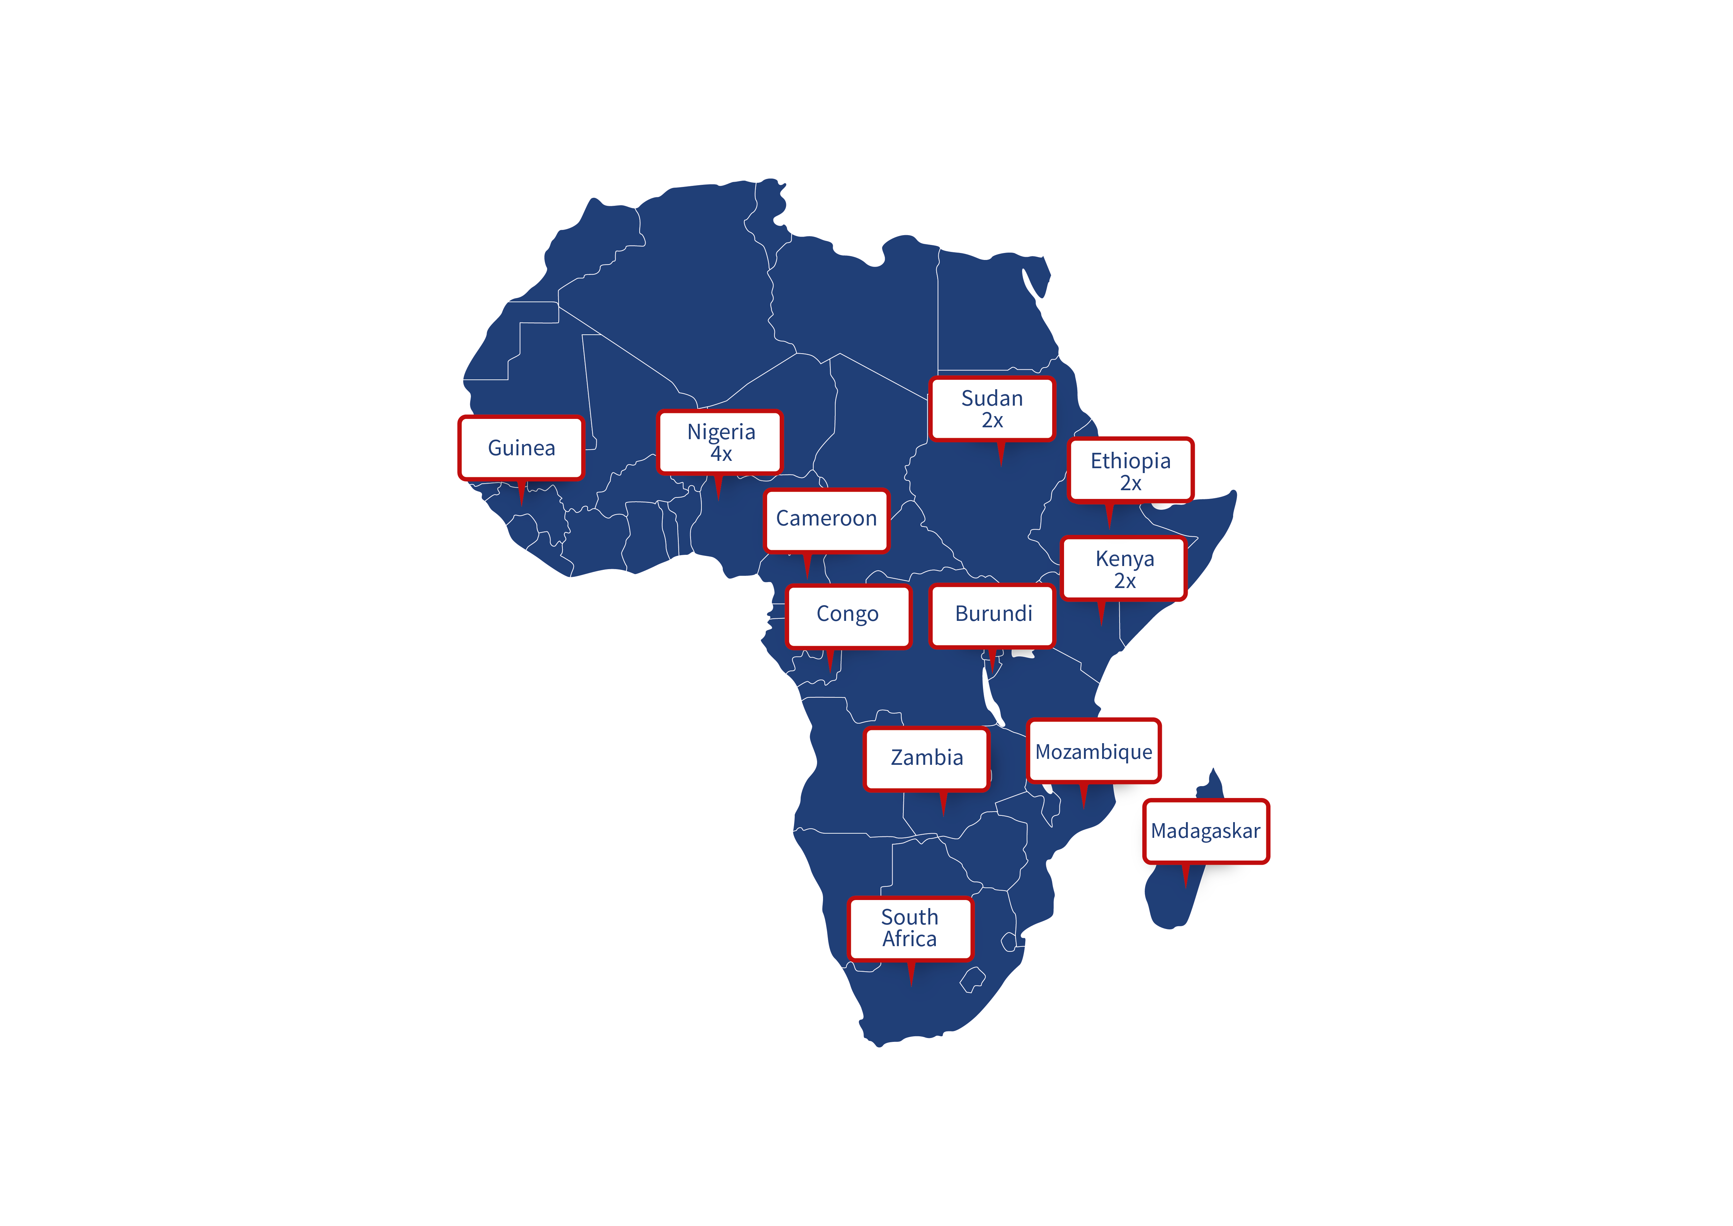
The WGA has supported
18 fellows from
12 countries in Africa
since 2017
20 more fellows promised in 2023 and 2024

Slide 22
Symposium at WGC-2023
Africa Symposium
Chairs: Neeru Gupta (Canada) and Olusola Olawoye (Nigeria)
New developments in the Genetics of OAG in SSA – Susan Williams (South Africa)
Surgery, not medicine, should be the standard firstline treatment for open-angle glaucoma in SSA – Naa Tagoe (Ghana) & Tesfaye Tadesse (Ethiopia)
Glaucoma drainage devices in the management of OAG Experience and outcomes in SSA – Sheila Marco (Kenya)
Major collaborative glaucoma studies in SSA  ongoing and completed: Findings so far? – Olusola Olawoye (Nigeria)
Is SLT relevant in the management of POAG in Africa? – Amel Ouertani (Tunisia)
Improving glaucoma management across SSAHow has training health workers, awareness, diagnosis and management improved over the past 10 years? – Nkiru Akaraiwe (Nigeria)

Slide 23
Education
Pradeep Ramulu MD PhD
Chair Education Committee

Slide 24
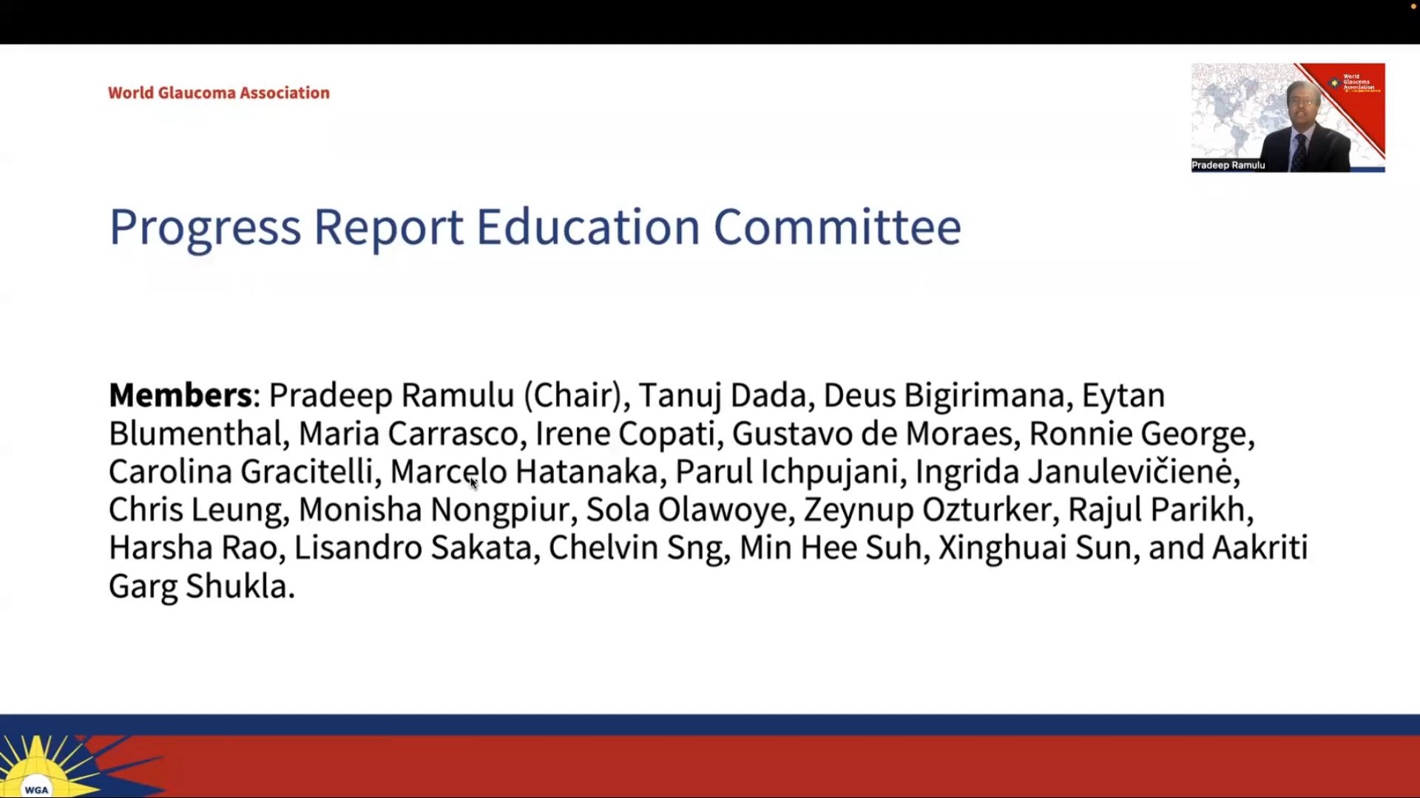

Slide 25
Shan Lin MD
Executive Vice President

Slide 26


WGA Global Webinars
Organizing Committee: Makoto Aihara, Tin Aung, Tanuj Dada, Neeru Gupta, Fabian Lerner, Shan Lin, Kaweh Mansouri, Olusola Olawoye, Ningli Wang, Robert N. Weinreb (Chair)
Free high-quality education for the entire glaucoma community.
The webinars to date have averaged thousands of viewers each with more than 180 countries represented.

Slide 27
Reaching all corners of the world
Top 20 countries
India
Nigeria
United States
United Kingdom
Argentina
China
Brazil
Malaysia
Peru
Philippines
Mexico
Australia
Japan
Indonesia
Romania
Myanmar
Colombia
Turkiye
Chile
Spain

Slide 28

Global Webinars
October 10, 2020 | Glaucoma Surgery
December 19, 2020 | Glaucoma Diagnosis, Monitoring and More
February 12, 2021 | Diagnosis and Management of Angle Closure
April 10, 2021 | Medical Treatment of Glaucoma: Now and Next
May 22, 2021 | Lifestyle and Glaucoma
October 9, 2021 | WGC-2021: Going Deeper
February 12, 2022 | Glaucoma and Myopia
May 21, 2022 | Childhood Glaucoma
November 5, 2022 | All About Minimally Invasive Glaucoma Surgery (MIGS)
Recordings available via WGA#One account

Slide 29



Celebrating 31 Years
Journal of Glaucoma
Editor in Chief
Neeru Gupta, MD, PhD, MBA, FRCSC, DABO
The Official Journal of the World Glaucoma Association

Slide 30

Thank You to our Editorial Board Members
Janey | Wiggs, MD, PhD | Balwantray | Chauhan, PhD | Donald | Hood, PhD | Norbert | Pfeiffer, MD, PhD
Tanuj | Dada, MD | Philip | Chen, MD | Alex | Huang, MD, PhD | Robert | Ritch, MD
Christopher A | Girkin, MD, MSPH | Jonathan | Crowston, MD, PhD | Chris | Johnson, PhD | Prin | Rojanapongpun, MD
Ki Ho | Park, MD, PhD | Robert | Fechtner, MD | Kenji | Kashiwagi, MD, PhD | Lisandro | Sakata, MD, PhD
Fotis | Topouzis, MD, PhD | Robert | Feldman, MD | Jay | Katz, MD | Joel S. | Schuman, MD
Pradeep | Ramulu, MD, PhD | Murray | Fingeret, OD | Tae Woo | Kim, MD, PhD | Janet | Serle, MD
Robert N. | Weinreb, MD | John | Fingert, MD, PhD | Fabian | Lerner, MD | Tarek | Shaarawy, MD
C. Michael | Van Buskirk, MD | Brad | Fortune, OD | Christopher | Leung, MD | Kuldev | Singh, MD, MPH
George A. | Cioffi, MD | Paul | Foster, MD, PhD | Richard | Lewis, MD | Arthur | Sit, MD, MS
Jeffrey M. | Liebmann, MD | Brian | Francis, MD | Shan | Lin, MD | Simon | Skalicky, Mphil, MBBS, PhD
Makoto | Aihara, MD, PhD | David | Friedman, MD, PhD | Elke | Lutjen-Drecoll, PhD | Greg | Skuta, MD
Alfonso | Anton, MD, PhD | Stefano | Gandolfo, MD | Steven | Mansberger, MD, MPH | George | Spaeth, MD
Florent | Aptel, MD, PhD | Chandrasekar | Garudadri, MD, FRCS | Kaweh | Mansouri, MD, MPH | Ingborg | Stalmans, MD, PhD
Makoto | Araie, MD, PhD | Ronnie | George, MD | Keith | Martin, MD | Kazuhisa | Sugiyama, MD. PhD
Sanjay | Asrani, MD | Ivan | Goldberg, MD | Felipe | Medeiros, MD, PhD | Xing-Huai | Sun, MD, PhD
Augusto | Azuara-Blanco, MD, PhD | Jeffery | Goldberg, MD | Frederick S. | Mikelberg, MD | Remo | Susanna, MD
Catherine | Birt, MA, MD, FRCSC | David | Greenfield, MD | Paul | Mitchell, MD, PhD | Ernst | Tamm, PhD
Eytan | Blumenthal, MD | Franz | Grehn, MD | James | Morgan, MD | Shandiz | Tehrani, MD, PhD,
James | Brandt, MD | Daniel | Grigera, MD | John C. | Morrison, MD | Clement | Tham, MD
Donald | Budenz, MD, MPH | Ronald | Gross, MD | Jonathan | Myers, MD | Carlo | Traverso, MD
Yvonne | Buys, MD | Alon | Harris, PhD | Kouros | Nouri-Mahdavi, MD | Anja | Tuulonen, MD
Joseph | Caprioli, MD | Anders | Heijl, MD, PhD | Sung Chul | Park, MD | Ningli | Wang, MD, PhD
Subhabrata | Chakrabarthi, MD | Gabor | Hollo, MD, PhD | Louis | Pasquale, MD | Yeni | Yucel, MD, PhD
 |  |  |  |  |  | Linda | Zangwill, PhD

Slide 31
Reader Interest
                2021
                13,566 average monthly visits
                104,205 unique visitors
                2022
                14,236 average monthly visits
                111,912 unique visitors

Slide 32
Number of Countries Reading the Journal

Slide 33

2022 JOG Twitter
@JOGJournal

Slide 34

Sign up for Online First Alerts on Homepage

Slide 35
Thank you
Committed and engaged international glaucoma expert reviewers
Editorial Board Members – 88 members from 21 countries
Jewel Johnson
Publisher
Wolters Kluwer
Managing Editor
Samantha Porter

Slide 36
International Glaucoma Review (IGR)
Kaweh Mansouri MD MPH
Associate EVP

Slide 37


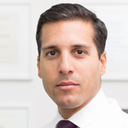
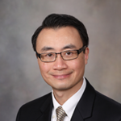
International Glaucoma Review
Official Journal of the World Glaucoma Association - Since 1999
Contributing Editors
Christopher Leung (HK)
Kaweh Mansouri (CH)
Arthur Sit (US)
Publisher: Kugler Publications, Simon Bakker (NL)

Slide 38
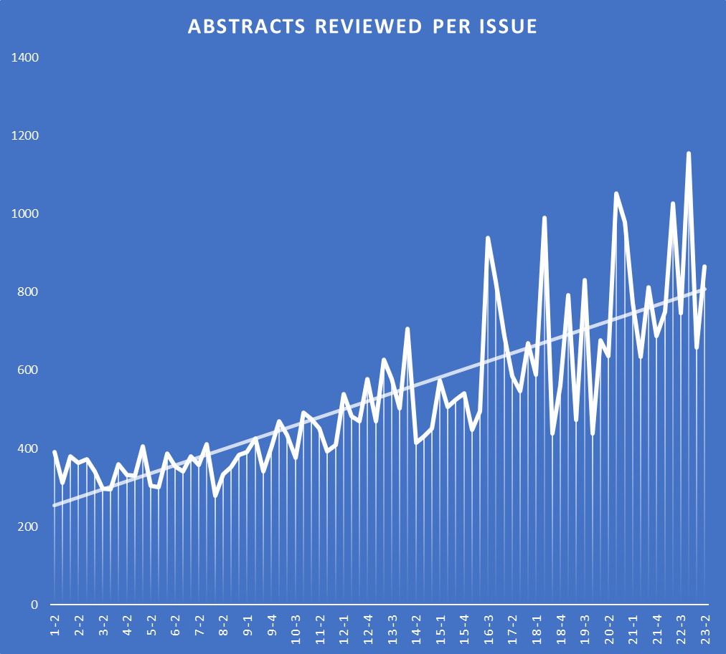
IGR production statistics
The average number of publications in Glaucoma is rapidly growing and so, too, are the number of abstracts to review prior to soliciting expert comments: ~3-fold increase since 1999
The database now holds over 45,000 searchable and categorized abstracts (by IGR’s unique classification system)
Of these abstracts, more than 2,100 are commented on by 650+ international experts
AVG abstracts reviewed per issue: 818. Measured over issues > vol. 20

Slide 39
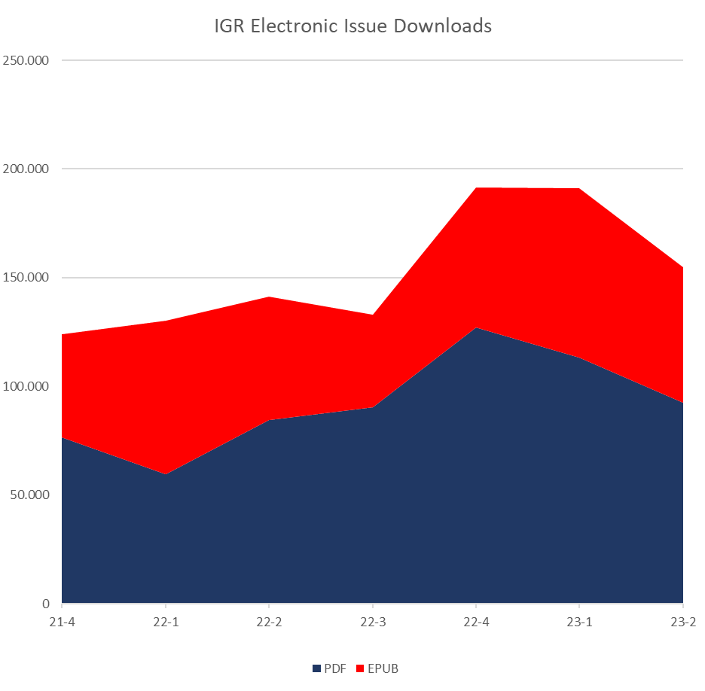
IGR issue downloads
AVG PDF download: ~ 120,00
(measured over issues > vol. 20)
23-1 broke all records with > 190,000 downloads!
The EPUB format is gaining in popularity
23-3 has just been published at the occasion of WGC-2023. Printed copies are available at the WGA booth.

Slide 40

IGR 2023
Editorial board update per January 1.
Welcome: Florent Aptel, Jiun Do, Anthony Khawaja, Miriam Kolko, Arsham Sheybani, Xiulan Zhang.
Thank you: Norbert Pfeiffer, Prin RojanaPongpun, Tarek Shaarawy
Introducing digital object identifiers (DOIs) for IGR comments to allow better linking and findability per August 1 (retroactively for all comments)
Publication schedule:
  23-3: June 2023 (WGC issue)
  23-4: September 2023
  24-1: December 2023
Connect with us for advertisement opportunity's

Slide 41
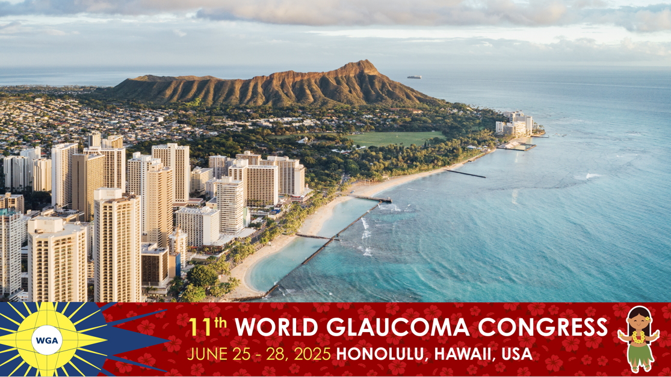

Slide 42

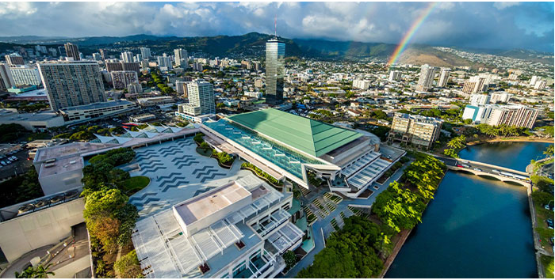
Hawaii Convention Center (HCC)
Designed by world-renowned architects Wimberly Allison Tong & Goo and LMN, this luminous structure shines like a gem tucked into its tropical setting, blending state-of-the-art technology with authentic island ambiance as a monument to the cultural diversity and legendary spirit of aloha that inspires attendees to see the world in a new light.
Distances
Daniel K. Inouye International Airport
Journey time: 14 minutes drive

Slide 43
Thank you

